Slide 1
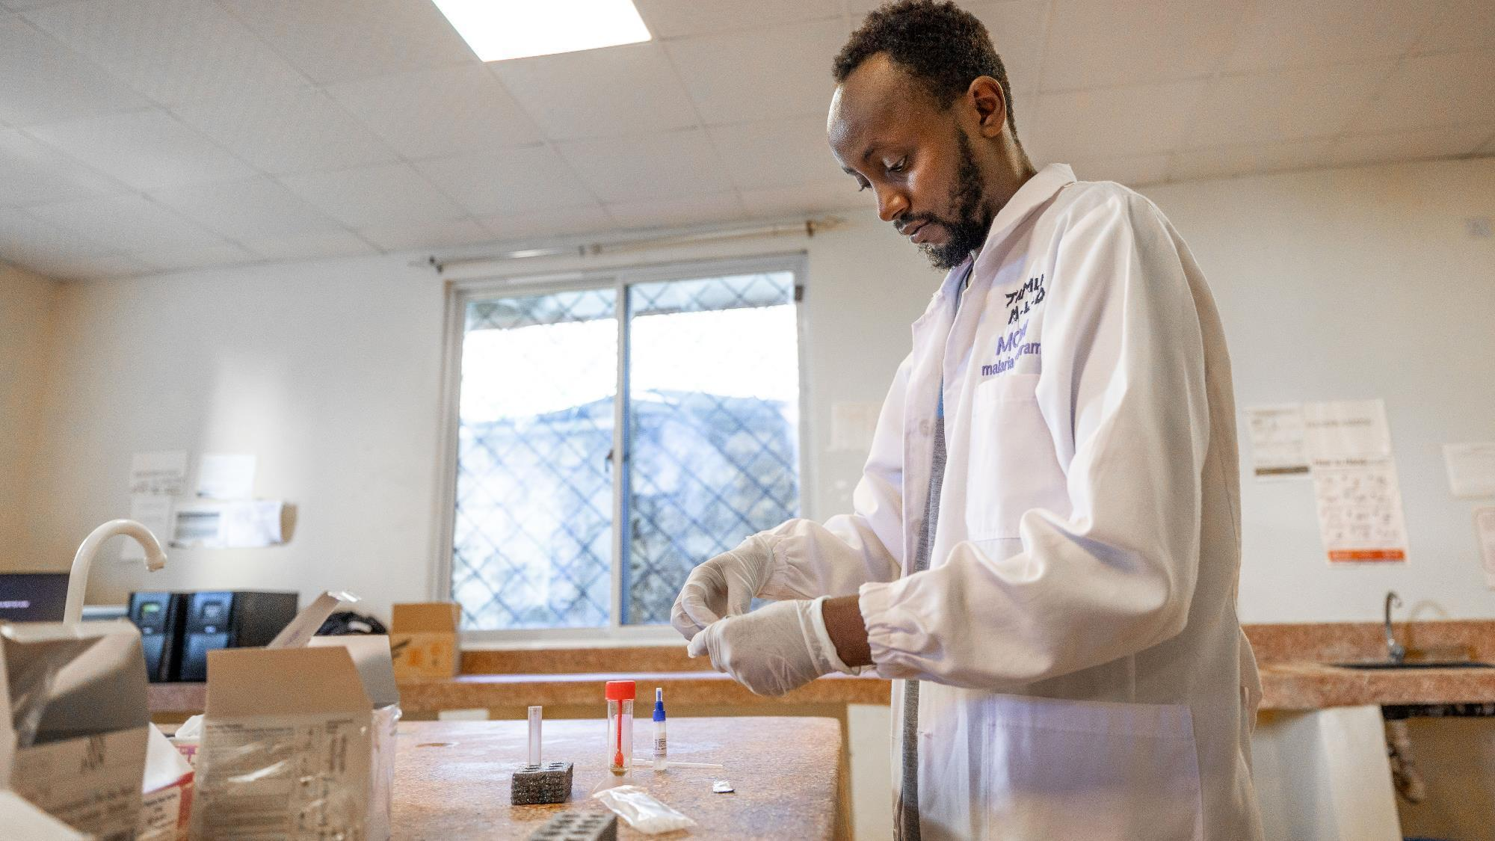

GTFCC recommendations
CHOLERA RAPID DIAGNOSTIC TESTS (RDTs)
V1.0 November 2024
© WHO / Genna Print
Notes:
Welcome to the third module of this course in which will discuss cholera Rapid Diagnostic Tests, or RDTs.

Slide 2
Learning objectives
Understand what RDTs are
Explain when and why to use RDTs for cholera
Understand the limitations of RDTs for cholera
Know the procedure to perform RDTs for cholera
Interpret RDT results
Troubleshoot RDTs (procedure and results)
Suggested previous modules: module 1 Introduction to Cholera and Cholera testing
3/2
Notes:
At the end of this module, you will be able to describe RDTs, explain when and why use RDTs. You will understand their limitations and know the procedure to perform RDTs for cholera. You will also be able to interpret RDT results and troubleshoot both the procedure and the results.

Slide 3
Outline
1
RDTs: what, why, when
2
Safety
3
Procedure
4
Reading the results
5
Reporting
6
End of module assessment
3/3
Notes:
This module is divided into the following 5 sections.

Slide 4
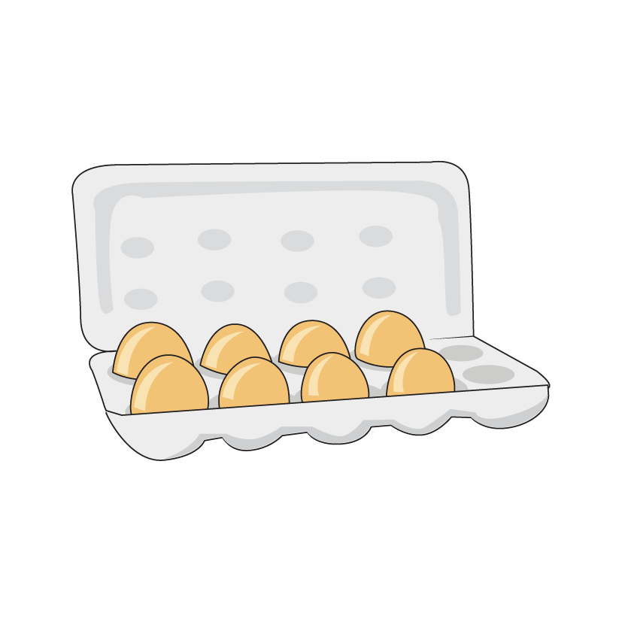

“
The result of any laboratory examination is only as good
as the sample received in the laboratory.
”
Good sample
Bad sample
Notes:
Before we begin, remember the result of any laboratory examination is only as good as the sample that was received by the laboratory. Refer back to the previous module to ensure the best quality samples to perform RDTs on.

Slide 5
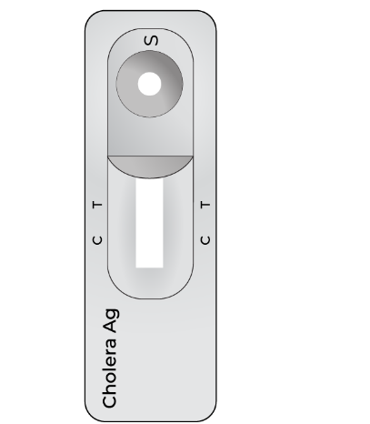
RDTS –
WHAT • WHY • WHEN
Notes:
Let's dive into our first section. Rapid diagnostic tests, what are they, why do we use them and when do we use them

Slide 6
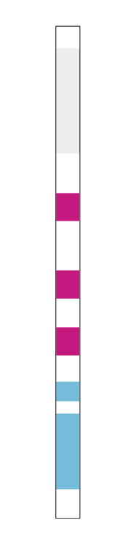
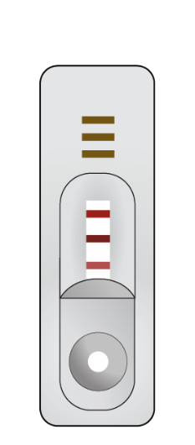
What are RDTs?
Concept:
Lateral flow immuno-chromatographic assays
  Rapid detection of O1 or O1 and O139 antigens (<30min)
Direct detection in stool samples
  Do not require complex laboratory set up
Packaging:
  Cassette
  Dipstick
    (just like home pregnancy tests or COVID tests)
  Packaged as kits including all reagents needed
Dipstick
Cassette
Control band
Control band
O139
O1
O1
O139
3/6
Notes:
Rapid diagnostic tests or RDTs are lateral flow immuno-chromatographic assays. The RDTs commonly used for cholera testing detect up to two “types” or serogroups of Vibrio cholerae through detection of the O1 antigen or both O1 and O139 antigens.
They work on stool samples and do not require any complex laboratory set up.
The tests present themselves in two formats represented on the images on the right. They can be in a dipstick format or a cassette format. Just like COVID tests or home pregnancy tests except that they are performed on stool.

Slide 7
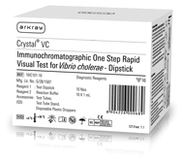
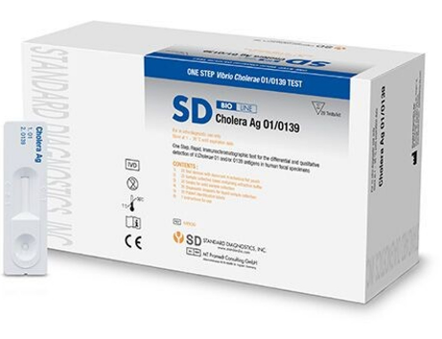
Products available
There are multiple commercially available RDTs with varying levels of accuracy making many of them less appropriate for use.
None of them are WHO pre-qualified as of yet.
WHO recommends and distributes:
Crystal VC Ag O1/O139
(Kit with 10 tests)
SD Bioline Cholera Ag O1/O139
(Kit with 20 tests)
3/7
Notes:
There are a variety of commercially available RDT. In fact there are at least 22 brands currently on the market. Each have different levels of accuracy or performance making many of them less appropriate for use and none of them are WHO pre-qualified as of yet. However, the WHO recommends and distributes two types: the Crystal VC O1/O139 and the SD Bioline O1/O139. The crystal VC is a dipstick while the SD Bioline is a cassette.

Slide 8
Why use RDTs?
Usable at the « bed-side » (need to collect stool sample)
Rapid: results in < 30 minutes
Inexpensive
Easy to use
No sample storage or transport
3/8

Slide 9
Why use RDTs?
RDTs are used :
  In the context of absence of a probable or confirmed outbreak, to speed up the detection of a suspected cholera outbreak or a probable cholera outbreak
  To monitor a probable or confirmed outbreak (community transmission)
The strategy to reach each of these objectives is described in the GTFCC recommendations for Public Health Surveillance for Cholera.
3/9

Slide 10
Summary
No outbreak
Outbreak
1
Treat the patient
Treat all, rehydration protocols (ATB)
≥ 2 yo, with AWD and severe dehydration,
or died from AWD
Any age, with AWD
or died from AWD
2
Identify a cholera suspect case
RDT on all suspect cases
Collect and send sample from all RDT+ to laboratory
RDT on first 3 suspected cases of the day
Collect and send 3 RDT+ samples per week from the area to laboratory
3
Test for cholera
Record immediately
Report daily on RDT+
Record immediately
Report weekly
4
Document and report
3/10
Notes:
To summarize,
Always treat the patient as soon as possible.
When there is no outbreak we aim to quickly detect the first case to quickly protect the community and alert other departments to contain the disease and prevent widespread outbreaks. To do this we identify suspect cases, this is anyone 2 years and above with AWD and SEVERE dehydration, or 2 and above who die with AWD. If RDTs are available, we test all suspected cases using the RDT’s. We also send the RDT reactive samples to the laboratory for confirmation by Culture or PCR. If RDTs are not available, we simply collect samples from all suspected cholera cases and send them to the laboratory for testing as soon as possible. We record all RDT results (reactive or non reactive) and report any reactive RDT result to the health authorities on the same day.
When there is an outbreak of cholera in the area or surveillance unit, we aim to monitor the outbreak. A suspected cholera case is now defined as any person of any age, with AWD or who has died from AWD. If RDTs are available, we test the first 3 suspected cases of the day in our health facility using RDTs. We also send the reactive RDT sample to the laboratory for confirmation by culture or PCR. If RDT are not available for any reason, we collect samples from the first 3 suspected cases of the week in the health facility and send them to a laboratory for testing. We keep record of all RDT results. Finally, we report all suspect cases and RDT results to health authorities on a weekly basis.

Slide 11
Samples for RDTs
RDTs should ideally be performed on fresh stool specimens within 2 hours of collection from a patient who has been ill for less than 4 days and who has not been given antibiotics.
Appropriate stool specimens for direct testing by RDTs:
  liquid stool
  viscous, mucoid, soft or semi-solid stool
Inappropriate stool specimens for direct testing by RDTs:
  stool preserved in Cary-Blair transport medium
  rectal swabs
Note: These specimens require additional steps (for example, enrichment) in a laboratory.
3/11

Slide 12
RDTs - Limitations
!
Cholera RDTs are not a replacement for stool culture or any molecular test to confirm cholera or to confirm a cholera outbreak.
Cholera RDTs cannot be used for diagnosis of individual cholera cases.
The result of cholera RDTs should not influence case management.
Cholera RDTs do not detect the cholera toxin.
Cholera RDTs do not provide antimicrobial susceptibility data.
3/12
Notes:
RDT also have limitations. They cannot be used to confirm Vibrio cholerae O1 or O139 and therefor never replace culture or molecular confirmation. They cannot confirm the diagnosis of a case of cholera.
Patient treatment should never depend on the RDT result. Treatment must be based on the level of dehydration of the patient.
The RDTs that are available today do not detect the cholera toxin.
And finally, RDTs do not provide us with any antimicrobial susceptibility data.

Slide 13
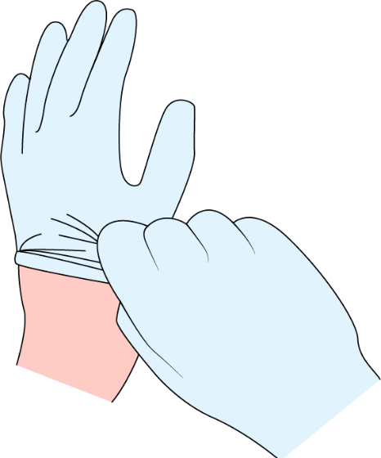
SAFETY
Notes:
A few safety notes before we discuss the procedure

Slide 14
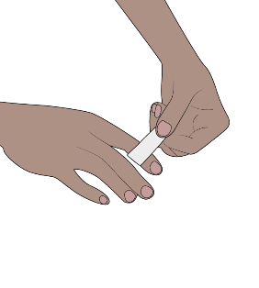
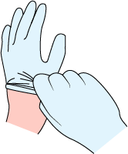


Safety first
Basic hygiene practices
Protect yourself, your patients and your community.
If you have cuts or abrasions on the skin of your hands, cover them with adhesive dressing.
Wear gloves when collecting and handling stool specimens.
Remove gloves and wash your hands after completing any task involving the handling of stool specimens.
    Adhere to proper waste disposal procedures
You can also protect your clothes by wearing scrubs or a lab coat.
3/14

Slide 15

PROCEDURE
Notes:
Let’s look at the procedure for a Rapid Diagnostic Test

Slide 16
Considerations prior to testing
Consider the testing strategy applied currently in your area (suspect case definition, strategy, who and when to test).
Verify expiry dates of RDTs on hand.
Verify adequate storage conditions of RDTs as per manufacturer’s instructions.
Read the manufacturer’s instructions for use.
Allow all kit components and specimens to reach a temperature of 15°C-30°C before testing.
Procedure may vary and include a sample enrichment step in Alkaline Peptone Water (APW).
3/16
Notes:
Before you start, always return to the manufacturer’s specifications. Look at the procedure that is provided with the kit that you are using.

Slide 17
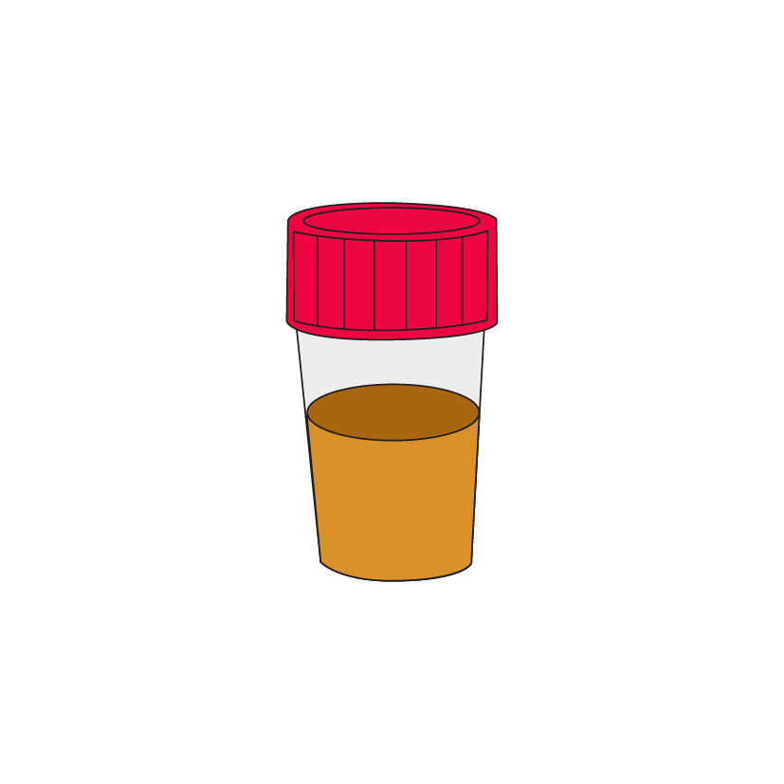
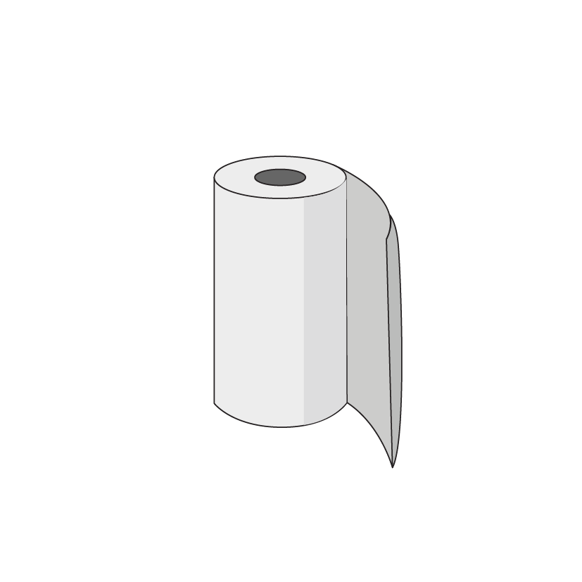
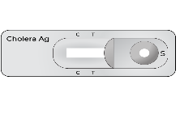




Supplies and material
RDTs should be performed on a stable surface that can easily be cleaned.
Gloves and scrubs/labcoat
Hazardous waste bin or bag
Tissue paper
Test kit
Timer
Register/forms
Marker/pen
3/17
Notes:
Here is the minimum list of supplies and materials you will need to perform RDT tests.
Gloves and scrubs/labcoat – to protect yourself and avoid contamination
Hazardous waste bin or bag to dispose of materials after use
Tissue paper – for cleaning surfaces and materials and incase of any spills which might occur
Test kit – this contains materials needed for testing, like droppers or tubes as well as the actual test.
Timer – to ensure the correct time for reading the test is followed, you can also use the timer on your phone if necessary. Be careful to avoid contaminating it!
Register/forms – The correct paperwork to document the test was performed and the results. All tests should be documented even if invalid or negative
Marker/pen – To write on the test and to fill in the paperwork

Slide 18
Crystal® VC O1/O139, Arkray
Dipstick method
3/18
Notes:
Note to presenter - Only review this section is country orders and uses Arkray tests to avoid confusion.
Crystal® VC O1/O139, Arkray, the Arkray RDT test is a strip with test reagents on it we call this a dipstick test. It is one of the 2 GTFCC recommended test kits available to test for Vibrio Cholerae. Here we will look at the standard operating procedurers or SOP needed to perform the test correctly to ensure accurate reliable results.

Slide 19
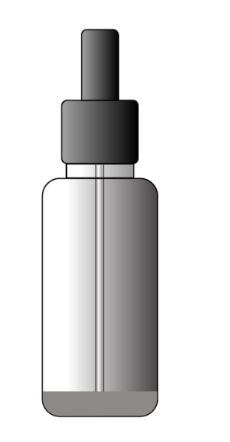
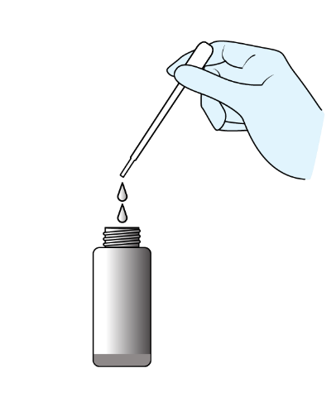
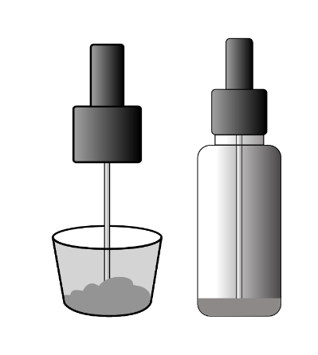

1
2
Semi-solid faecal specimens: Collect a small quantity of stool using the collection stick and transfer to the tube containing reaction buffer.
Liquid faecal specimens: Draw liquid specimen using the dropper and transfer 2 drops to the tube containing reaction buffer.
Label tube with patient identifier. Open the cap of the sample processing vial.
or
Sample processing vial
Discard the dropper in the sharps container or double-lined
plastic bag labelled “biohazard” after adding specimen.
3/19
Notes:
After putting on your gloves and preparing all the material required, start by labeling the vial and test tubes with the correct patient ID as it is written on the sample collection container.
Open the cap of the sample processing vial provided in the kit and the sample container. Depending on the condition of the stool – semi-solid or liquid select the best sample collection method. You don’t need a lot of stool in the processing vial for the test.
If sample is semi solid, use the collection stick attached to the vial container to transfer a small amount of stool into the bottle and close the lids of the vial and the stool cup.
If the sample is liquid, use a plastic pipette to transfer 2 drops of the liquid into the vial. Close the lids of the vial and the stool cup and discard the dropper into the waste container.

Slide 20
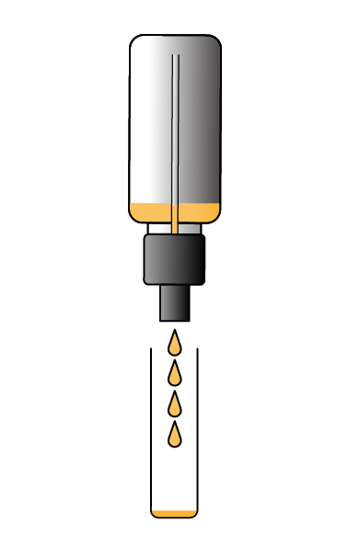
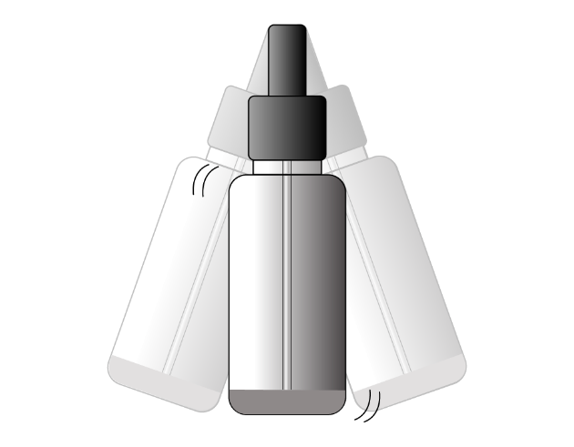
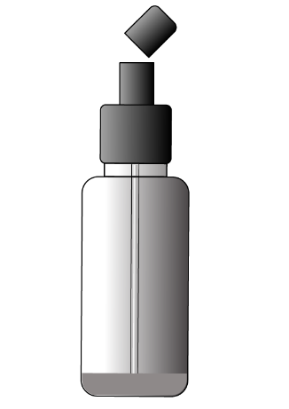
3
4
5
Tightly recap sample processing vial and shake to mix contents.
Break open the outer end of the cap (point away and cover with tissue to avoid splash).
Dispense 4 drops of processed sample into labelled 5ml test tube.
3/20
Notes:
Check the lid is tightly fastened before shaking the contents to mix. You can use a tissue to cover the lid as an extra precaution to avoid leaks and spills while shaking.
The tip of the vial lid can be snapped off. Always make sure to point the lid away from you and use the tissue to catch any splashes
Dispense 4 drops of the stool/buffer mixture into the labeled tube
Discard the used sample vials in the biowaste container

Slide 21
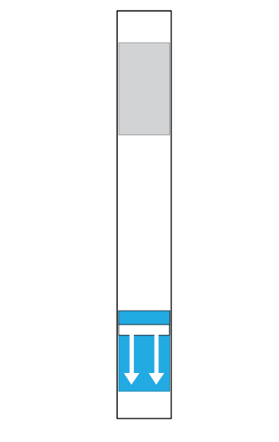
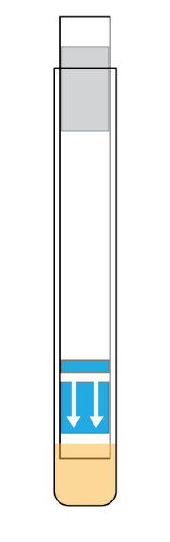
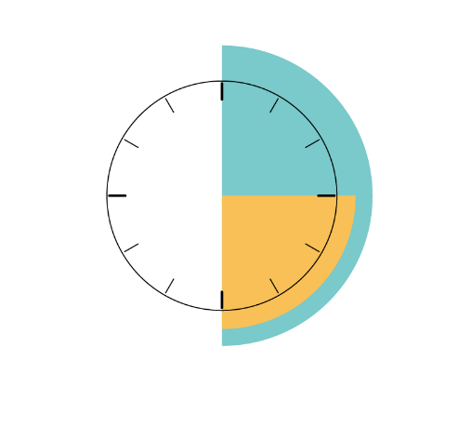
6
Carefully open test pouch. Discard if damaged, or if desiccant is missing or changed in colour. Write patient ID on the dipstick.
Place the dipstick in the test tube with the arrows facing down. Confirm the end of the dipstick is submerged in the processed sample.
Only touch here
ID here
Bands will appear here
No Control band = invalid result
Wait
Read
Insert dipstick with arrows
pointed down
“dipping area”
3/21
Notes:
Carefully open the test kit. If it is damaged, or the desiccant is missing or has changed color, throw it away and use another test.
Only touch and hold the dipstick from the top end.
Write the patient’s name or ID on the dipstick as indicated on these pictures and set the timer to 15 mins
Place the labelled dipstick arrow end down into the sample mix and start the timer
Set up any other tests and wait the 15 mins.
Dispose of the test dipstick after reading in the biowaste container

Slide 22
Bioline™ Cholera Ag O1/O139, Abbott
Cassette method
3/22
Notes:
Note to presenter - Only review this section is country orders and uses Bioline tests to avoid confusion.
Bioline™ Cholera Ag O1/O139, Abbott RDT test is contained in a plastic case known as a cassette, It is one of the 2 GTFCC recommended test kits available to test for Vibrio Cholerae. Here we will look at the standard operating procedurers or SOP needed to perform the test correctly to ensure accurate reliable results.

Slide 23
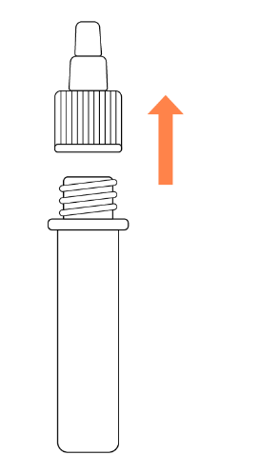
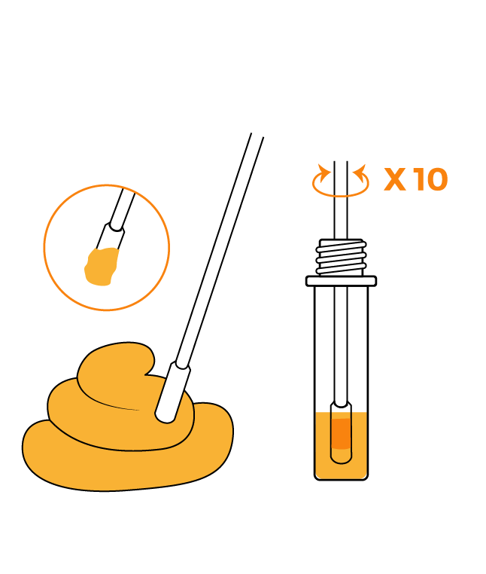
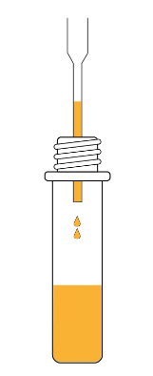
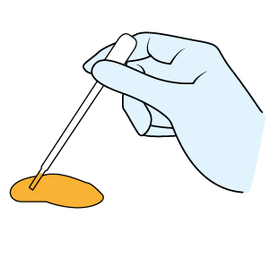
1
2
Label tube with patient identifier. Open the cap of the specimen collection tube.
Semi-solid faecal specimens: Collect sufficient specimen using the collection swab and insert the swab into collection tube and swirl the swab at least 10 times.
Liquid faecal specimens: Draw liquid specimen up to the fill line using the dropper and transfer to the tube containing reaction buffer
Specimen collection tube
3/23
Notes:
After putting on your gloves and preparing all the material required, start by labeling the vial and test tubes with the correct patient ID as it is written on the Specimen collection tube
Open the cap of the sample processing vial provided in the kit. Take care to unscrew the entire lid and not the small cap!
Depending on the condition of the stool – semi-solid or liquid select the best sample collection method. You don’t need a lot of stool in the Specimen collection tube for the test.
If sample is semi solid, use a swab to transfer a small amount of stool into the bottle, swirl the swab at least 10 times to transfer the sample into the liquid.
If the sample is liquid, use the provided plastic pipette. The pipette has a line which shows you how much sample to collect. Transfer the liquid in the pipette into the vial. Note – do not use other pipettes as the fill line may not be the correct volume for this test.

Slide 24
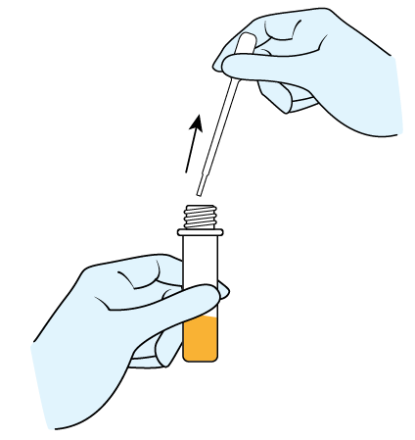
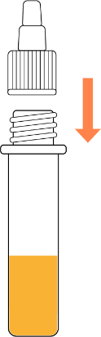
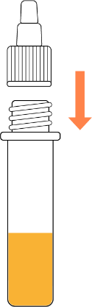
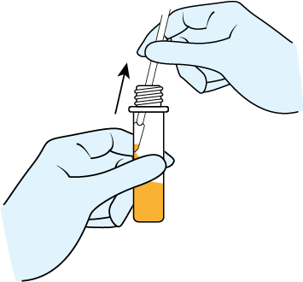
3
Semi-solid faecal specimens: Remove the swab while squeezing the swab against the wall of tube. Assemble the filter cap on the specimen collection tube.
Liquid faecal specimens: Discard the dropper. Assemble the filter cap on the specimen collection tube.
or
Discard the swab or dropper in the sharps container or double-lined plastic
bag labelled “biohazard” after adding specimen.
3/24
Notes:
Take care when removing the swab, gently squeeze the swab against the side of the container so the liquid remains in the container.
Close the lids of the vial and any sample containers used. Discard the swab or dropper into the waste container.

Slide 25
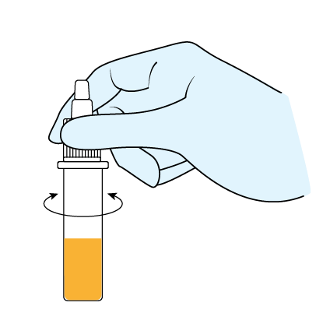
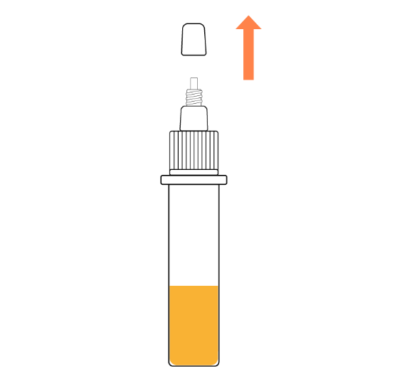
4
5
Shake tube thoroughly to ensure proper mixing of the fecal specimen with extraction buffer.
Unscrew the nozzle cap of the specimen collection tube.
3/25
Notes:
Check the lid is tightly fastened before shaking the contents to mix. You can use a tissue to cover the lid as an extra precaution to avoid leaks and spills while shaking.
Twist open the small cap of the specimen collection lid.

Slide 26
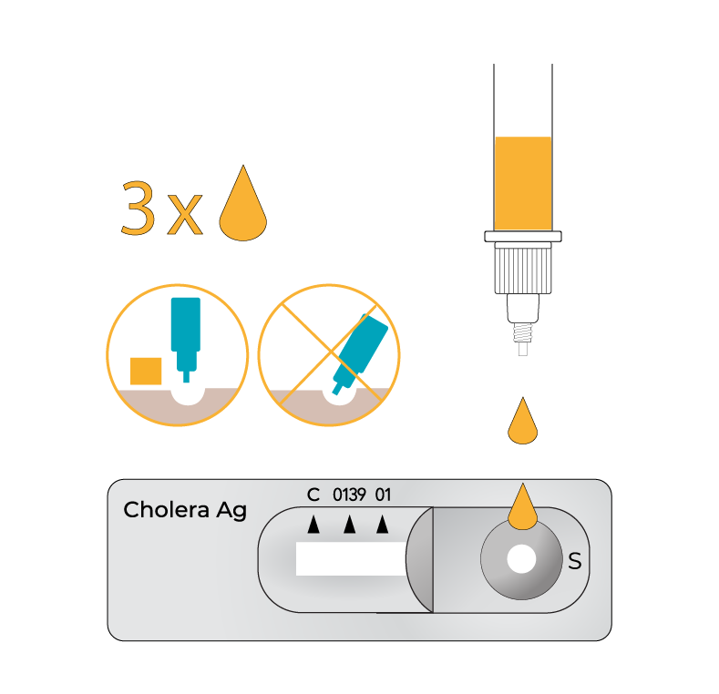
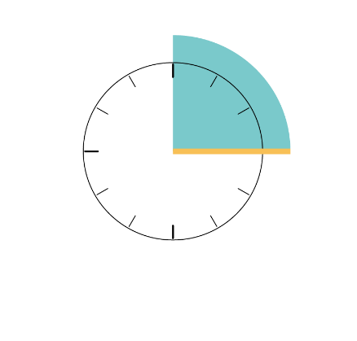

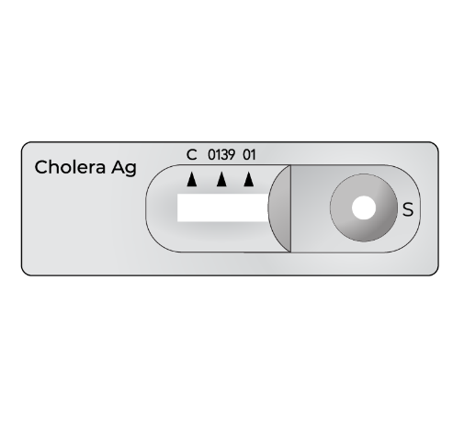
6
Carefully open test pouch. Discard if damaged, or if desiccant is missing or changed in colour. Write patient ID on the cassette.
Hold the collection tube vertically and dispense 3 drops into the specimen well “S”.
Bands will appear here
No Control Band = invalid results
Wait
Read
Add specimen here
ID here
3/26
Notes:
Carefully open the test kit. If it is damaged, or the desiccant is missing or has changed color, throw it away and use another test.
Only touch and hold the dipstick from the top end.
Write the patient’s name or ID on the cassette as indicated on these pictures and set the timer to 15 mins
Holding the sample tube straight, gently dispense 3 drops into the specimen well – marked with an S. Be careful to add 3 drops, adding too much or too few drops can change the test results.
Start the timer and discard the specimen collection tube.
Set up any other tests and wait the 15 mins.
The result must be read after 15 mins, longer than this can lead to false results being reported.
Dispose of the test cassette after reading in the biowaste.

Slide 27
Troubleshooting the procedure
RDTs not stored according to manufacturer’s recommendations or out of date.
Manufacturers may have changed the procedure.
Too much or too little sample used.
Failure to check kit contents prior to performing the test.
3/27
Notes:
Pay attention to these common causes of error during the procedure that can cause issues with the results.
The RDT may not be stored as the manufacturers recommend or they may be expired
Manufacturers may have changed the procedure and the user hasn’t checked the new instructions
You may have added too much or too little sample to the specimen buffer or to the test cassette
An item in the kit may be damaged

Slide 28

READING THE RESULTS
Notes:
Let’s look at the results and the interpretation of the results.

Slide 29
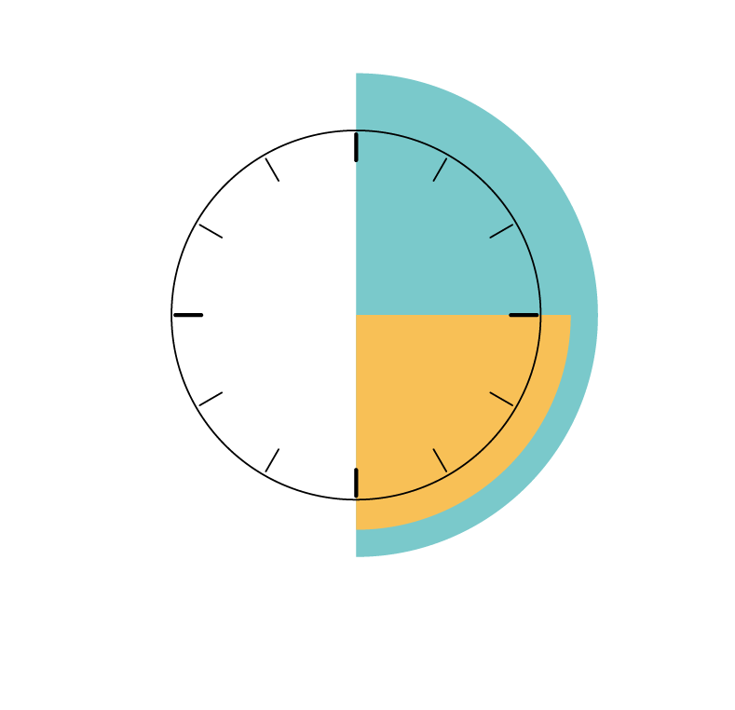
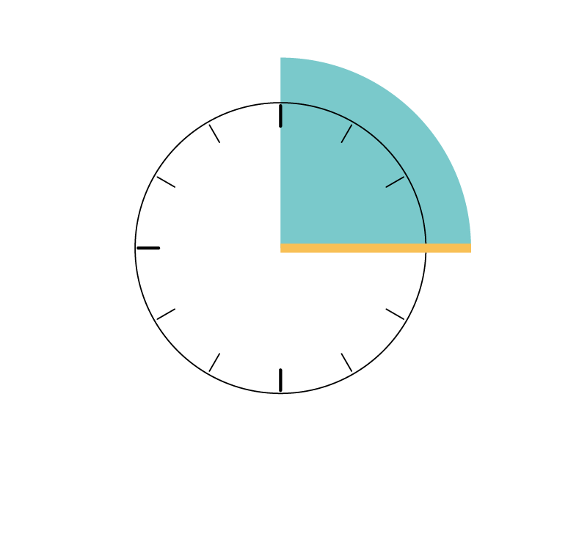
Waiting to read the results
Dipstick: Wait 15-30 minutes then hold the test-tube and raise the strip up so you can read the bands but do not remove the bottom of the strip from the tube to avoid making a mess.
Cassette: Wait 15 minutes and read results immediately. Do not read after 15 minutes.
Wait
Wait
Read
Read
Use a laboratory timer or the timer on your phone for correct reading time.
3/29
Notes:
After adding the sample to the test, you must wait to read the results. The amount of time you wait depends on the test kit so please refer to the kit instructions for specifics.
For Arkray dipstick, it is recommended to wait 15 to 30 minutes then to remove the dipstick from the test tube and read the results.
For Bioline cassettes, it is recommended to wait 15 minutes exactly and read the results.
It is important to stick to the recommended time. Waiting too little may lead to false non-reactive (negative) readings while waiting too long could lead to false reactive (positive) readings or false negatives as bands can change over time.

Slide 30
Results: Reactive / non-reactive
Reactive
Non-reactive
The sample reacted with the test lines
A line is seen in the testing area for VC O1 or VC O139
Indicates a strong probability of cholera infection but is not confirmatory
"Positive" is reserved for confirmed cases after laboratory testing.
The sample does not react with the test lines
No lines are seen in the testing area
Does not rule out cholera completely
"Negative" can imply certainty, which the RDT cannot provide.
Clear terminology ensures proper case management and public health action.
3/30
Notes:
When reporting RDT results we use the term – Reactive or Non-reactive instead of Positive or Negative this is to communicate the results in a more accurate way. RDT’s do not confirm Cholera, so we avoid saying positive as it can give the impression that a case has been confirmed. We use reactive to indicate that a test line has had a reaction with the tested sample.
We report reactive for each test line which is seen on the test rather than just saying “cholera positive” which doesn’t tell us much information. In this this way we accurately communicate the added information of which serogroup reacted.
On the other hand, since RDT’s have limitations, we report Non-reactive instead of negative as negative implies a certainty which the test doesn’t provide.

Slide 31
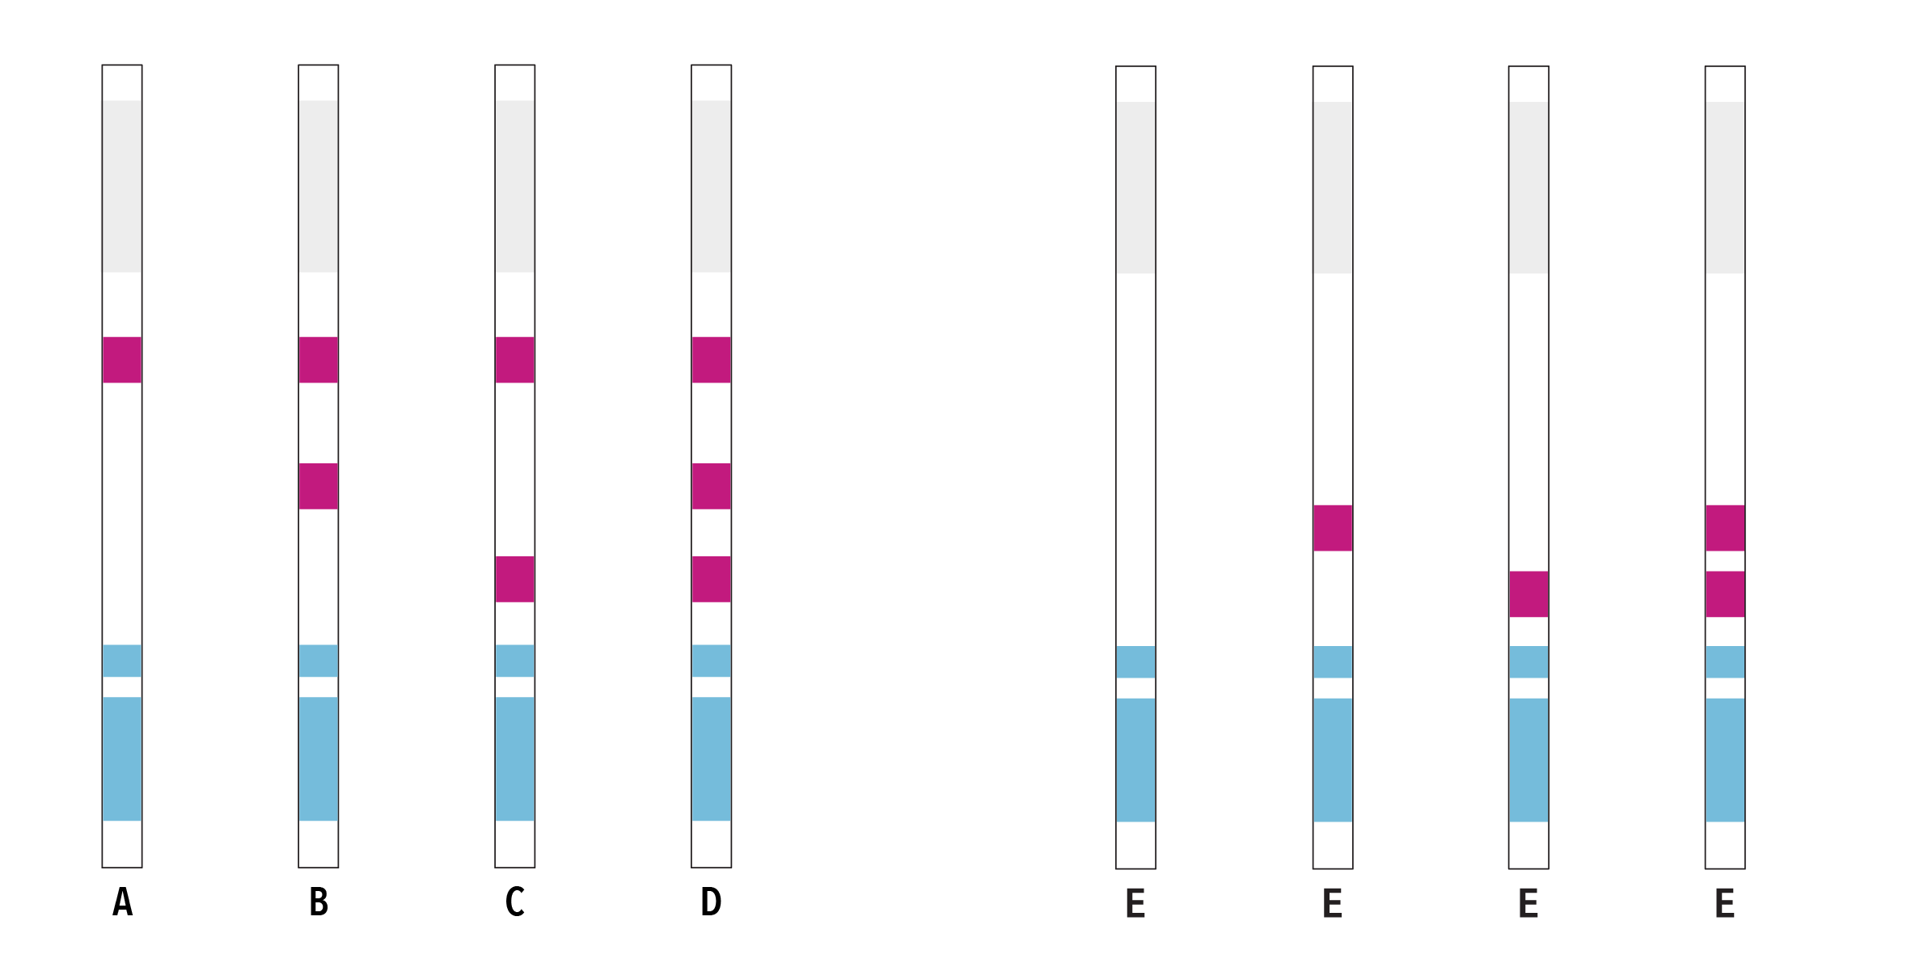
Results: Dipstick
Control band
No control band
O1
O139
valid results
invalid results
3/31
Notes:
Note to presenter – You can review test results for tests in use to avoid confusion.
For Akray dipsticks, the results could look like this with presence or absence of control bands, or bands for VC O1 or VC O139.

Slide 32
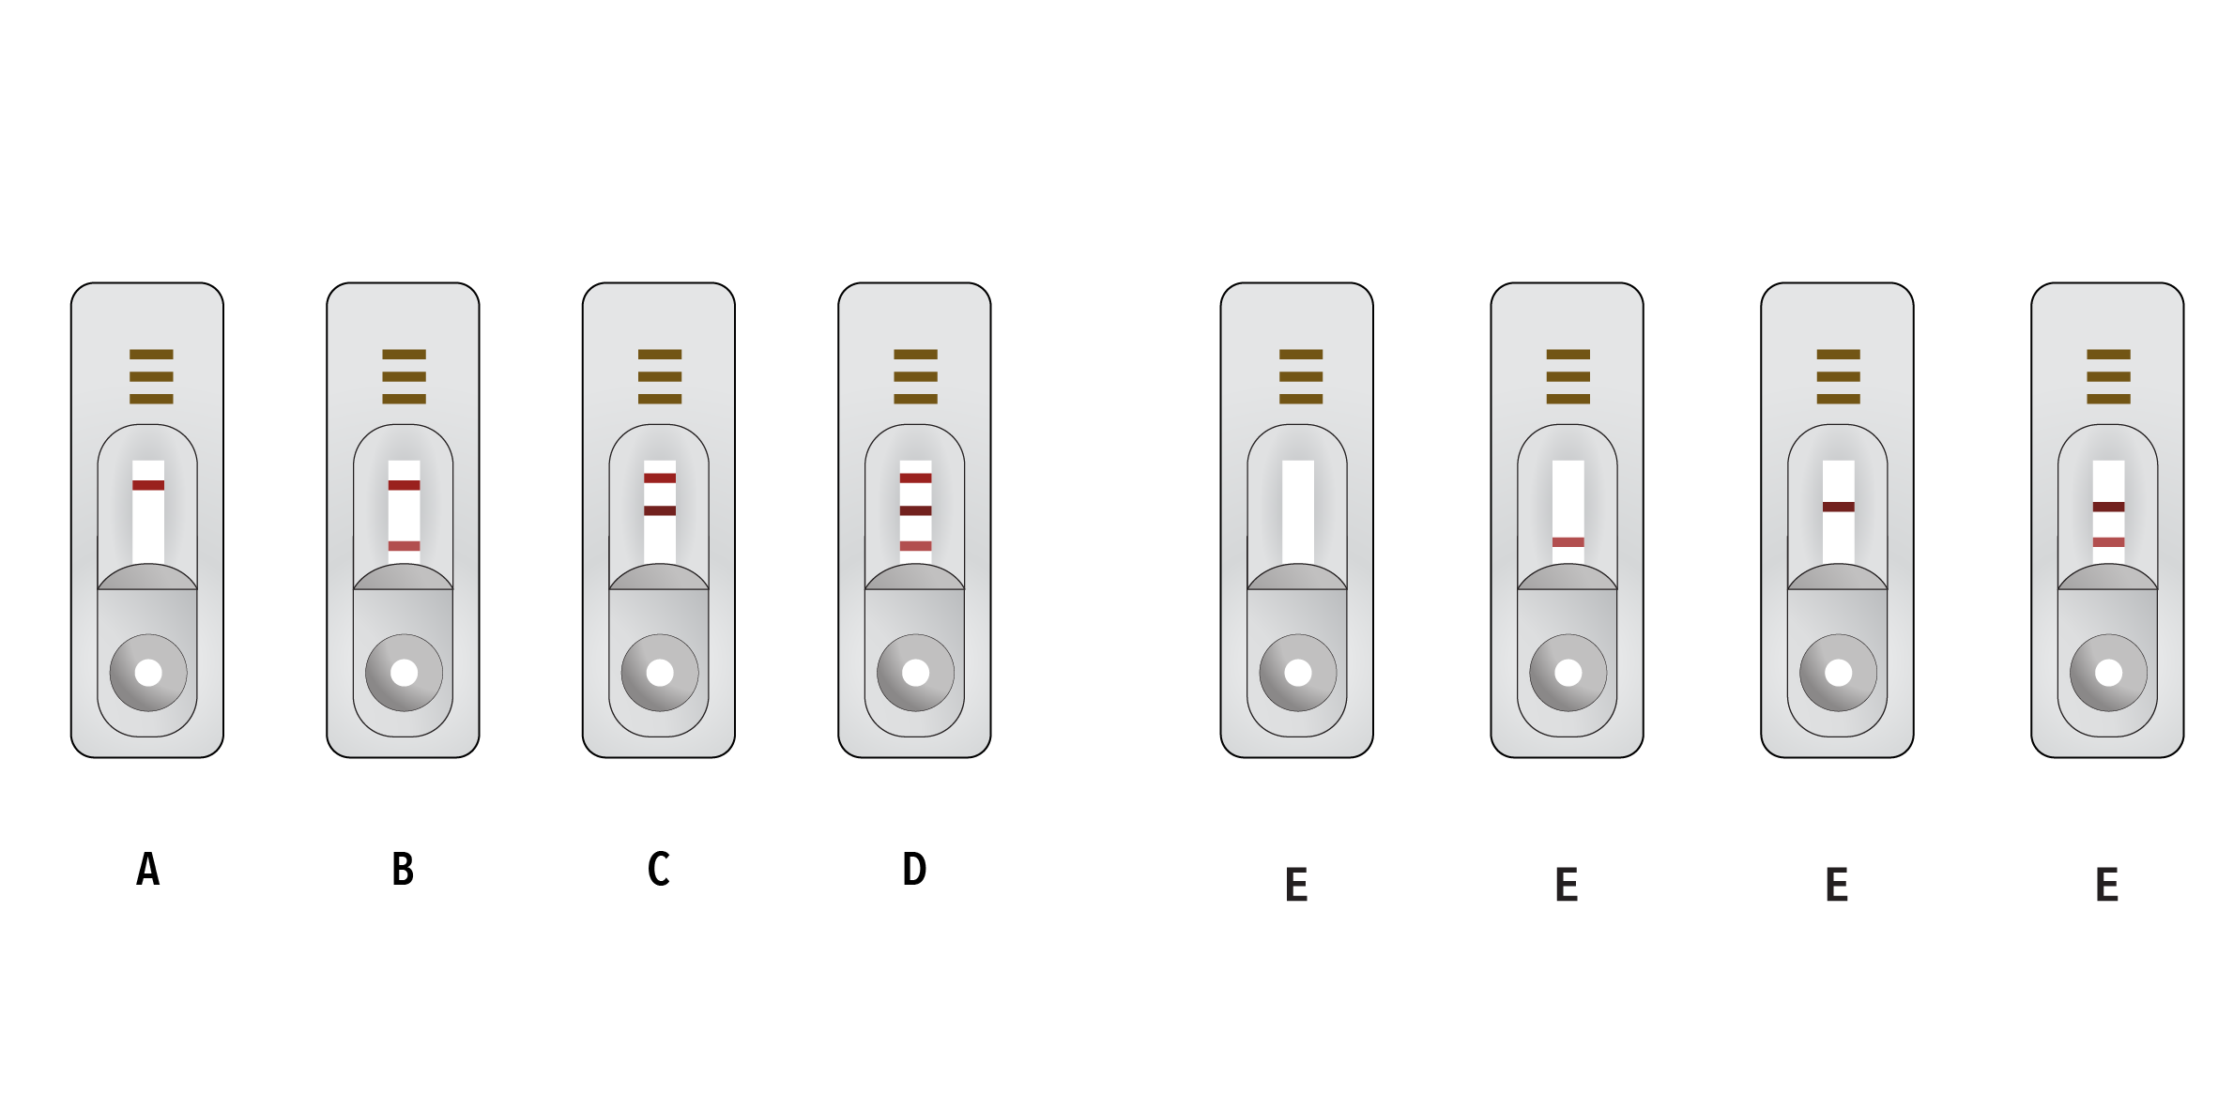
Results: Cassette
No control band
Control band
O139
O1
valid results
invalid results
3/32
Notes:
Note to presenter – You can review test results for tests in use to avoid confusion.
For Bioline cassettes, these are the different possible results with the presence or absence of control lines, or lines for VC O1 or VC O139.

Slide 33
Key recommendations for reading of results
Each RDT test kit, even from the same manufacturer, may have different positions for test and control bands/lines on the test. Read the instructions provided with the specific RDT in use for correct reporting.
If the control line does not appear, the test is invalid and the test should be repeated.
Even a faint / weak test band is considered to be reactive.
3/33
Notes:
RDT test kits, even coming from the same manufacturer, may have different positions for test and control bands/lines on the test. Please refer to the instructions provided with the specific RDT in use for correct reading instructions.

Slide 34
Control band
The control line MUST appear for a test to be valid. If it does not appear, the result is considered invalid, and the specimen should be retested using a new test kit.
Control band
No control band
O1
O139
valid results
invalid results
3/34
Notes:
The first thing to do when reading the results, is to check to see if there is a control band. If this band or line does not appear, the test is invalid and you must not report results.
All 4 Arkray dipsticks on the right of this image, are invalid because of the absence of a control band.

Slide 35
Control band
The control line MUST appear for a test to be valid. If it does not appear, the result is considered invalid, and the specimen should be retested using a new test kit.
Control band
No control band
O139
O1
valid results
invalid results
3/35
Notes:
For Bioline cassettes, these are the different possible results, the first thing to look for is the presence or absence of control lines, then lines for VC O1 or VC O139.
All 4 dipsticks on the right of this image, are invalid because of the absence of a control band.

Slide 36

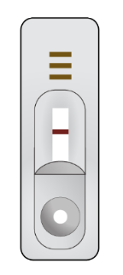
Invalid: reading
No visible control band
!
Control band
ACTIONS
1.Record RDT invalid
2.Redo the test
3.Report final result
O1
Control band
O139
O139
O1
3/36
Notes:
When no control band is seen, regardless of any other lines, you must record the initial invalid result. Repeat the test using a new test device. Report the final result. If the result remains invalid it may be appropriate to send the sample for further testing at the laboratory.
If results from many samples are invalid refer to troubleshooting methods. A high number of invalids can indicate a problem with testing methods or the kits.

Slide 37
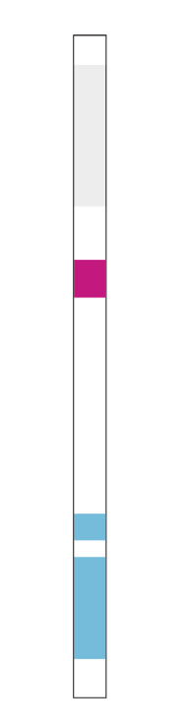
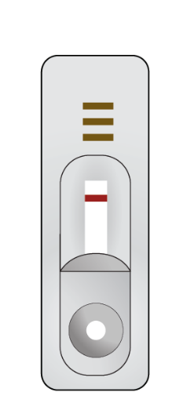
O1 and O139 non-reactive: reading
Visible control band
No band for O1
No band for O139
Control band
!
O1
O139
Control band
ACTION
Report RDT non-reactive result
O139
O1
3/37
Notes:
When the control band is apparent, but there are no bands for O1 or O139 the result can be interpreted as non-reactive (negative). You can then report the RDT as a Non-reactive result.

Slide 38
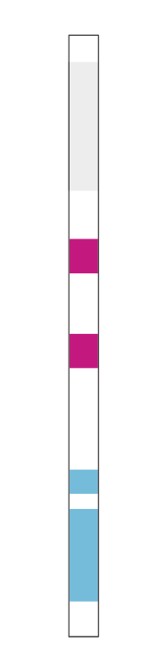
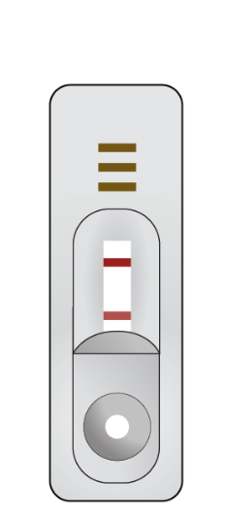
O1 reactive: reading
Visible control band
Visible O1 band
No O139 band
Control band
!
O1
Control band
O139
O139
ACTION
Report RDT reactive for O1
O1
3/38
Notes:
When the control and O1 bands are observed, and the O139 band is not observed, this is a reactive RDT result for O1. You must report this as RDT reactive for O1.

Slide 39
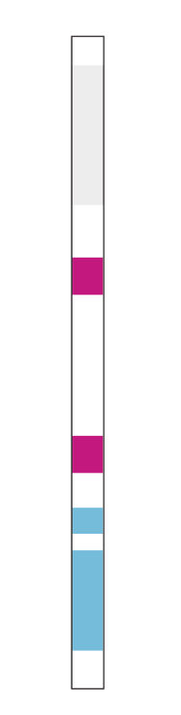
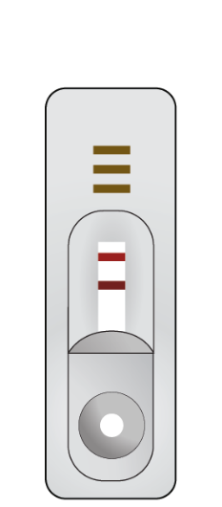
O139 reactive: reading
VC O139 does not currently circulate outside of South East Asia.
Current tests do not always perform well for O139, sometimes the O139 band might falsely appear.
Visible control band
Visible O139 band
No O1 band
!
ACTIONS
1.Redo the test
2.If same results, report reactive O139
3.Send the sample to a laboratory for further confirmation
Control band
O1
Control band
O139
O139
O1
3/39
Notes:
Now, if both control and O139 bands are observed but not the O1 band, let us pause a little. The test is valid because there is a control band and it appears to be O139 reactive.
However it is good to know that Vibrio cholerae O139 are not yet found outside of certain regions of South Asia. So the result should be considered in your country context.
The O139 test lines do not always perform well and sometimes we have false results, where a band is seen for O139. If this is an unexpected result in your context we recommend to redo the test, and report that result.
If you obtain the same result, O139 reactive, send the initial sample to a laboratory for further confirmation.

Slide 40
O1 and O139 reactive: reading
O139 does not currently circulate outside of South Asia.
Current tests do not always perform well for O139 and sometimes the O139 band might falsely appear.
Visible control band
Visible O1 band
Visible O139 band
!
ACTIONS
1.Redo the test
2.If same result, report O1 and O139 reactive
3.Send the sample to a laboratory for further confirmation
Control band
O1
Control band
O139
O1
O139
3/40
Notes:
This is a similar situation where all control, O1 and O139 bands are observed. Let us pause again. The test is valid because there is a control band and it appears to be both O1 and O139 reactive.
This is however an unusual result. Keeping in mind what we said about O139 being rare and mostly found in South Asia, it is even more rare to find a patient that has been infected with both VC O1 and O139. In fact this has never been documented.
So this may be false or incorrect line, for O139 while still being a correct reaction, Reactive, for O1. Again we recommend redoing the test, and reporting that second result. If you obtain the same result, report and send the initial sample to a laboratory for further confirmation.
When you report on these types of results, a comment can be added to the report.

Slide 41
Troubleshooting the results
Results not read in the recommended timeframe (waited too long or too little).
Misinterpretation of results. Misreading of weak bands.
The absence of a control band invalidates the test, which should therefore be repeated.
False negatives/
false positives can occur.
RDT reactive = strong probability that a suspected case is infected with VC but not 100% certainty
RDT non-reactive = strong probability that a suspected case is not infected with VC but not 100% certainty
3/41
Notes:
Difficulties with the reading test results may arise in certain situations. These could be linked to
not waiting the appropriate amount of time before reading the results (waiting too long or too little)
The Misreading of results (for example when we fail to check which band corresponds to which result)
The absence of a control band which directly invalidates the test
And finally, incorrect results can rarely occur either showing a band where there shouldn't be a band, or not showing a band where there should be a band.
Think if it this way, when you have a reactive RDT for cholera VC O1, there is a strong probability that the patient has cholera but you do not have 100% certainty.
When you have a non-reactive RDT, there is even a stronger probability that the patient does not have cholera but you are not 100% certain.
Always treat a suspected case on the basis of their symptoms and level of dehydration, and not only on the basis of an RDT result.

Slide 42

REPORTING
Notes:
Reporting

Slide 43
Any and all RDT results should be immediately recorded in a electronic or paper-based register.
Any and all RDT results should be reported, even if the RDT is non-reactive or invalid.
3/43
Notes:
In your local RDT register you should record the results of all tests performed, even if the test is invalid or needs to be repeated. All results should be recorded immediately they are read in a local log or register and the appropriate form – surveillance and laboratory referral forms.
This is important to account for all tests used, so 20 tests in a kit have 20 results in the logbook for accurate stock forecasting, but also critical to identify potential challenges with the test.
To many invalids or false results may indicate that staff need a refresher training, or that the kit is not working as expected. This can be communicated up the chain of command to resolve the issue and avoid wasting time, effort and resources.

Slide 44
Reporting RDT results
Who to report to: local health authorities and the laboratory if the sample is being sent there.
Why: health authorities need the RDT results to take action and adapt the response to an outbreak ; the laboratory takes into consideration the RDT results during their own testing.
What to report: patient and sample information and RDT result.
How: RDT results must be reported in the case report form and if a sample is sent to a laboratory, the RDT results must also be reported on the sample referral form.
3/44
Notes:
RDT results should be reported in to the national cholera surveillance database through the surveillance teams so that an outbreak can be appropriately responded to or to adapt a response to an outbreak. In this case there is generally a reporting mechanism in place that can involve reporting the RDT results in the case investigation forms.
If a sample is being sent to the laboratory and an RDT was performed in the field, then it is good practice to share the RDT result with the laboratory too. They will take into account these results when they further analyze the sample. In this situation, patient and sample information together with the RDT result are shared through the sample referral form.

Slide 45
Key recommendations for reporting
Write and check the patient ID/sample ID so results can be matched to a person
Saying you have no information is also information
?
Did you redo the test?
  Reporting O139? Pause and reflect on the situation
3/45
Notes:
When reporting the RDT result, pay particular attention to using the correct patient or sample ID.
As always, saying when you have no information is information by itself. For example if an RDT was not performed it is best to report “RDT not done” than to leave a space empty.
And finally, before reporting an O139 reactive result, “pause and reflect”. Did you redo the test first? Does this result make sense?

Slide 46
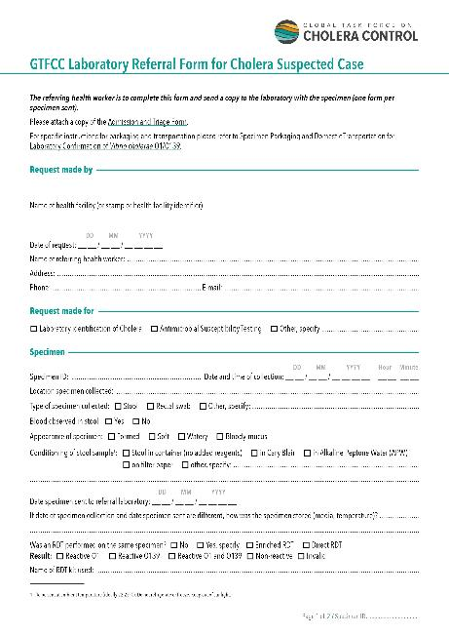
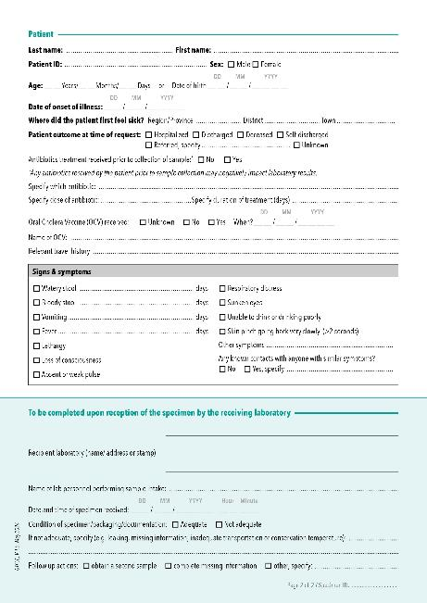
GTFCC Laboratory referral form for cholera suspected case
https://www.gtfcc.org/resources/gtfcc-laboratory-referral-and-results-reporting-forms/
3/46

Slide 47
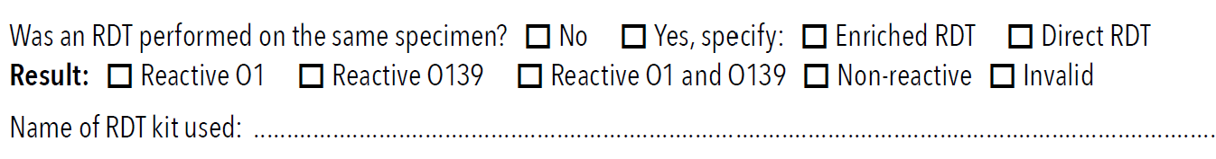
Completing the RDT results for samples referred to the laboratory
2
1
3
4
1
2
3
Yes = RDT performed on same sample as sent to the laboratory
No = RDT not performed
Direct = RDT done using fresh stool
Enriched = RDT done using stool incubated in APW for 6 - 8 hours
Report the RDT result, which lines were reactive
4
RDT manufacturer and kit name
3/47
Notes:
Note for script: they will have to do this on the case report form as well
Lets look at how to correctly complete the example GTFCC laboratory reffaral form for clear communication. This is the level of information which is recommended for completion. There are only 4 things to fill in but this small amount of information can tell the laboratory and Epi teams a lot and is important to ensure the laboratory can follow the testing strategy and provide the best quality information to inform the response.
1. Was the RDT performed on the same specimen as is sent to the laboratory, this can be used by the laboratory to compare the laboratory results to the RDT, if the samples were not the same it may explain why the results on the sent sample are different from the ones in the laboratory.
Same sample means the patient sample was collected into the appropriate containers, and either the sample was tested by RDT and then processed for transport, or one pot was collected to be tested by RDT and a second portion of sample was processed for transport. In both cases the sample was from the same patient from the same collection time.
A sample from the same patient collected at a different time is not the same sample.
2. It is rare for the healthcare facility t perform RDT’s on “enriched” samples. To do this requires additional reagents and equipment as well as an 8 hour incubation time. It is most common and encouraged to perform the RDT directly from the stool sample. Tick the method your facility used.
3. There are 4 options for results – the control and VC O1 line reacted, – the control and VC O139 line reacted, –the control and VC O1 and O139 line reacted or the control line was absent. Always remember to check the control line is visible before reading the results
4. Write in the name and manufacturer of the test, this tells the laboratory if a recommended test kit is used, which results to expect, for example a facility using a test which only looks for VC O1 should never report reactive 0139. The lab and surviellence can also gather information on the test performance to ensure the test is working as expected.

Slide 48
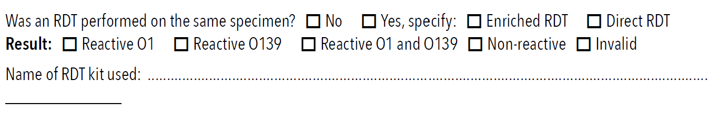

Examples
1
No RDT performed
2
No information, lab is confused – was test not performed or not reported?
3
Yes RDT performed on fresh stool, reactive O1 result using Bioline VC O1/O139 test
Bioline VC 01 /0139
3/48
Notes:
Lets look at some examples when completing the form:
1 – No RDT was performed, if this is a facility which should have RDT’s then the laboratory might be alerted to a stock out and that this facility requires more tests, or this may tell the Epi team this suspect case is from an area outside of the expected cholera risk area so a positive could modify the local response. Or this could be from a laboratory which doesn’t have RDT’s, depending on the epidemiological situation, the lab can determine if they should process this sample – if the site is in an outbreak and are sending 50 samples per week, this is outside the testing strategy, to save resources the laboratory would not test and may retrain the site on the correct testing strategy. You can see already how just this small piece of information can be used for action.
2 – This is the worst case scenario for the laboratory and epi teams. There is no information, none of the above decisions can be made. This can lead to tests being performed unnecessarily, waste or resources and time. If a test was performed and not recorded that test was essentially wasted, the results do not inform the response which can delay action.
3 – This is good information, The lab now knows that the RDT test was performed on a sample collected at a different time point than the one sent to the laboratory, this could be due to the transport schedule or other logistic reasons. The HCW did the test directly on the stool sample and the result was reactive for VC O1 using one of the 2 GTFCC recommended kits. Now when the laboratory finished testing they can compare their results to the RDT results and understand if there is a difference. Depending on the Epidemiological situation this clear information may alert the response teams to take action.
Clear data communication can mean the difference between a timely response and an outbreak.

Slide 49
What to do now
If there is no currently known outbreak or the outbreak has not been confirmed yet, send any RDT+ sample immediately to a laboratory for further confirmation.
If an outbreak has been confirmed, send at least 3 RDT+ samples per week per surveillance unit for further lab confirmation.
For more information Public Health Surveillance for Cholera.
3/49
Notes:
You have performed a rapid diagnostic test and you have a RDT reactive result. You have reported that result. What should be done now?
We refer you back to the testing strategy in place in your country.
Ideally, if there is no confirmed cholera outbreak in your area the sample that is RDT reactive should be sent to the laboratory of reference for them to confirm cholera.
If there is an ongoing confirmed outbreak, there is no longer a need to laboratory-confirm all RDT reactive results. The GTFCC recommends in that case, only 3 RDT reactive samples per week per surveillance unit be sent to a laboratory for confirmation and further characterization.

Slide 50

Links to GTFCC support material
Recommendations for public health surveillance for cholera : https://www.gtfcc.org/resources/public-health-surveillance-for-cholera/
Rapid Diagnostic Test (RDT) for cholera detection : https://www.gtfcc.org/resources/rapid-diagnostic-test-rdt-for-cholera-detection/
Quick reference guide for reading of cholera Rapid Diagnostic Tests (RDT) : https://www.gtfcc.org/resources/rapid-diagnostic-test-rdt-for-cholera-detection/
Laboratory referral form for cholera suspected case : https://www.gtfcc.org/resources/gtfcc-laboratory-referral-and-results-reporting-forms/
Template cholera case report form : https://view.officeapps.live.com/op/view.aspx?src=https%3A%2F%2Fwww.gtfcc.org%2Fwp-content%2Fuploads%2F2024%2F03%2Fgtfcc-template-cholera-case-report-form.docx&wdOrigin=BROWSELINK
3/50
Notes:
Further information you can access to support your learning.

Slide 51

END OF MODULE
ASSESSMENT

Slide 52
Assessment
RDTs should ideally be performed on fresh stool specimens within 4 hours of collection from a patient who has been ill for less than 2 days and who has not been given antibiotics.
  True or False
If the RDT indicates the presence of O1, and the control line is not visible, then the result is considered to be reactive.
  True or False
It is important to report non-reactive test results and whether or not an RDT has been performed.
  True or False
Cholera RDTs cannot be used for confirmation of a case of cholera.
  True or False
3/52

Slide 53
Assessment
5. A rectal swab can be used for an RDT.
  True or False
6. If the RDT shows bands for O1 and O139, and the control band is
visible, what would you do? (select all appropriate answers)
  Redo test
  Report as O1 and O139 reactive
  Report as invalid
  Send a sample
How would you report a RDT test where no lines are seen?
Bioline VC 01 /0139
3/53

Slide 54
Assessment Answers
RDTs should ideally be performed on fresh stool specimens within 4 hours of collection from a patient who has been ill for less than 2 days and who has not been given antibiotics.
  False to refresh your memory go to slide 11
If the RDT indicates the presence of O1, and the control line is not visible, then the result is considered to be reactive.
  False the result would be invalid without the control line to refresh your memory go to slide 33 and 36
It is important to report negative test results and whether or not an RDT has been performed.
  True, this avoids unnecessary repeat testing and provides vital epi information to refresh your memory go to slide 43
Cholera RDTs cannot be used for confirmation of a case of cholera.
  True go to refresh your memory go to slide 12
3/54

Slide 55

Assessment Answers
A rectal swab can be used for an RDT.
  False or only with additional step go to slide 11 to refresh your memory
If the RDT shows bands for O1 and O139, and the control band is visible, what would you do? (select all appropriate answers)
  Redo test and report the second results, if RDT results remains O1 and O139 send sample for lab testing go to slide 40 to refresh your memory
How would you report an RDT test where no lines are seen?
  Go to slide 47/48 to refresh your memory
Bioline VC 01 /0139
3/55

