Slide 1
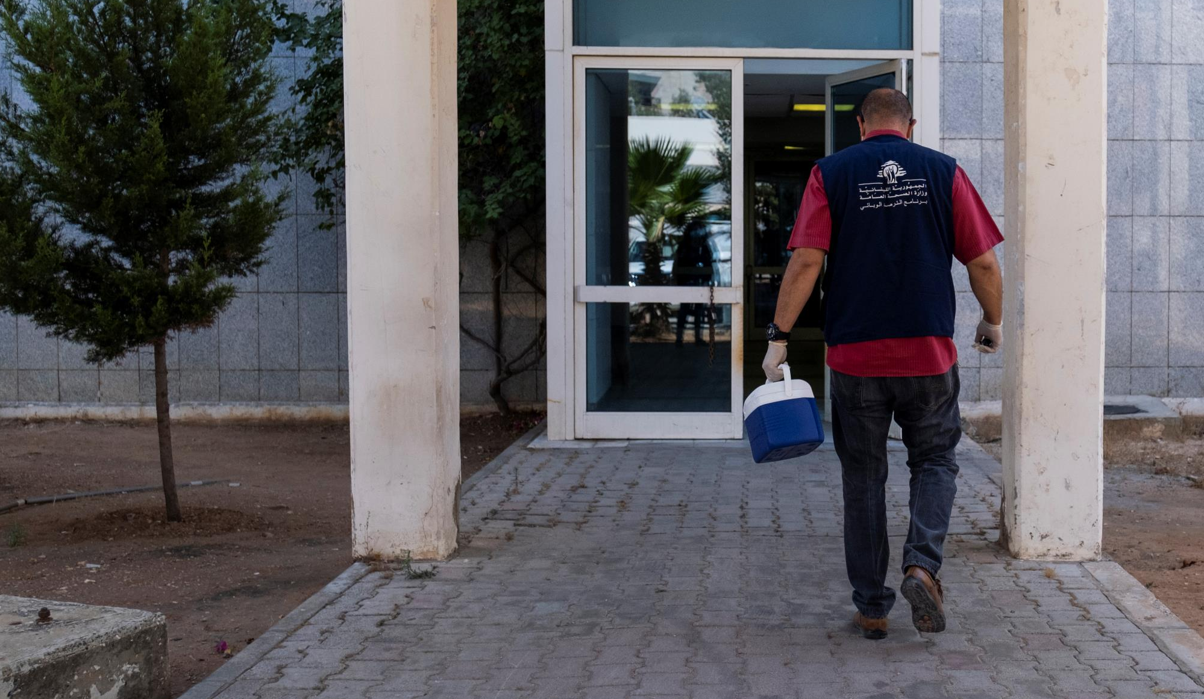

GTFCC recommendations
SAMPLE COLLECTION, PREPARATION AND TRANSPORT FOR CHOLERA
V1.0 November 2024
© WHO / Natalie Naccache
Notes:
Welcome to the second module of this course entitled “Sample collection, Preparation and Transport for Cholera”.

Slide 2
Learning objectives
Describe what is a good specimen for cholera testing
Safely collect and prepare good quality samples for cholera testing
Define the key factors affecting storage and transport of samples
Identify what is needed for adequate transport of samples
Apply best practices in reporting
Suggested previous modules: module 1 Introduction to Cholera and Cholera testing
2 /2
Notes:
At the end of this module, you will be able to:
Describe what makes for an appropriate specimen for cholera testing
Safely collect and prepare high quality samples for cholera testing
Define the key factors affecting storage and transport of these samples
Identify what is needed for adequate sample transport
And apply best practices for reporting with the samples

Slide 3
Outline
1
Sample collection
2
Sample storage and preparation for transport
3
Sample transport
Referral forms
4
5
End of module assessment
2 /3
Notes:
This module is divided into the five following sections.

Slide 4
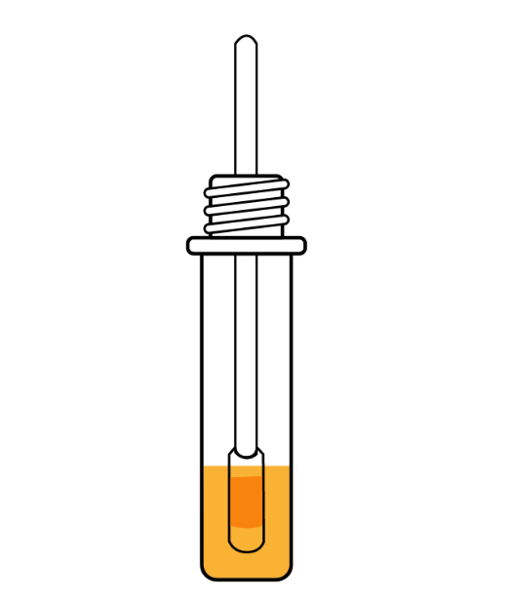
Sample collection
Notes:
Let us dive into our first section: Sample collection for cholera testing

Slide 5
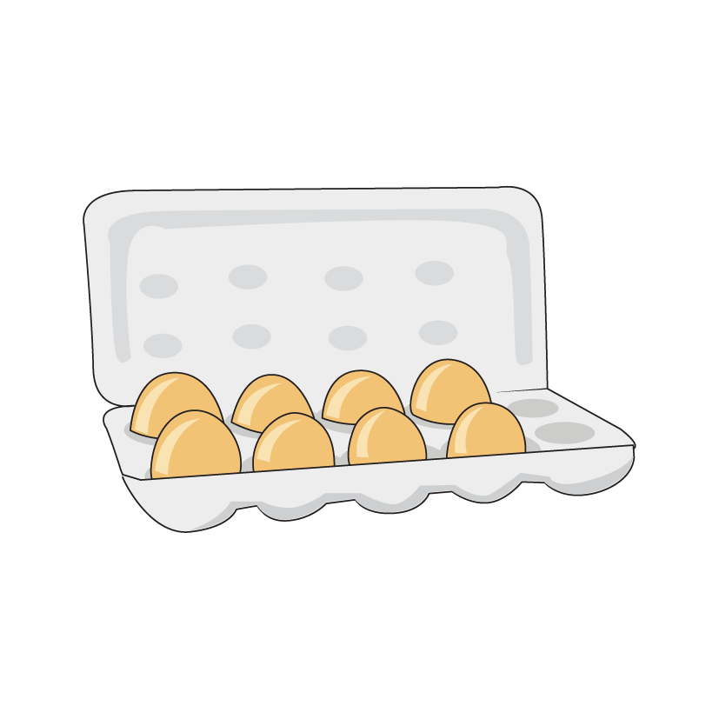

“
The result of any laboratory examination is only as good
as the sample received in the laboratory.
”
Good sample
Bad sample
Notes:
One key message to remember is that the result of any laboratory examination is only as good as the sample that was received by the laboratory. Think of it like this: can we cook a good meal if we only receive damaged eggs?

Slide 6
Outcomes of sample collection
The first step to perform any type of testing for cholera is adequate sample collection
Outcomes of adequate specimen collection and transport :
  Accurate, reliable test results
  Correct diagnosis and effective treatment
  On-time reporting of test results
  High customer satisfaction
  Reduced costs
Outcomes of inadequate specimen collection and transport :
  Questionable test results
  Incorrect diagnosis and ineffective treatment in case of antibiotic need
  Delays in reporting of test results
  Unnecessary re-testing
  Decreased customer satisfaction
  Increased costs
  Injury
  Death
2 /6
Notes:
Before any type of testing can be done, a good quality sample must be collected and sent to the laboratory.
In fact, if the sample collection and transport is done correctly, the outcomes will be:
- Accurate and reliable test results
- Test results can be reported in a timely way
- There may be high customer/patient satisfaction
- Costs are reduced
- And very importantly we can obtain the correct diagnosis and decide on effective treatment
Now if a sample is incorrectly collected and transported, there may be negative outcomes such as:
- We may not trust the lab results
- There may be delays in getting lab results
- There may be a need to re-test or even to take another sample from the unfortunate patient
- There may be decreased satisfaction on the side of the patient or the doctor
- It may cost more to re-test
- And very importantly, poor lab results can lead to incorrect diagnosis and ineffective choice of treatment for the patient or in worst case event, lead to injury or death

Slide 7
Specimen criteria for cholera testing
Stool or rectal swabs are the recommended specimen types for cholera testing
Specimens should be collected from patients who:
  Fit the definition for a suspected case of cholera within the testing strategy
  Preferably, are within 4 days of onset of symptoms (when the bacteria are found in greater numbers in the stool)
  Preferably, have not taken antibiotics
Refer to module 1: Introduction to Cholera
and Cholera testing
2 /7
Notes:
To test a patient for cholera, we need to test the stool.
We can collect fresh, loose stool or perform a rectal swab.
The specimen (or sample) should be collected from patients who show symptoms for cholera, who are suspected cases of cholera and selected according to the testing strategy that is applied in your area. Refer module 1 introduction to cholera and cholera testing for more information on this.
It is preferable to collect a sample from the patient when the patient has been sick for less than 4 days. During the first four days of illness, there are usually more bacteria in the stool which helps the tests work better.
It is also preferable that the patient has not been given any antibiotics before the sample has been taken. Antibiotics may kill the bacteria in the stool and this may lead to increased difficulty in confirming the diagnosis of cholera.

Slide 8
Antibiotics
Patient care should always be prioritized. Specimens from patient who have not taken antibiotics are preferred as antibiotics may reduce the number of bacteria in the sample hence impacting test accuracy.
If the patient has taken antibiotics, report this
information in the sample collection forms:
!
  Which antibiotic was taken?
  Saying you have no information is information
  How much / dosage?
  When / for how long?
2 /8
Notes:
Patient care should always be prioritized. Specimens from patients who have not taken antibiotics are preferred.
Again, antibiotics may kill the bacteria that is in the stool and any tests performed afterwards could then come out falsely negative.
It may happen that despite your efforts the patient has been given antibiotics. In this case it is very important to report this information to the laboratory in the sample collection form. It is important to note which antibiotics were taken, how much antibiotics were taken i.e the dosage and when was the antibiotic taken or for how long.
Saying that you have no information on the reporting form is also information by itself!

Slide 9
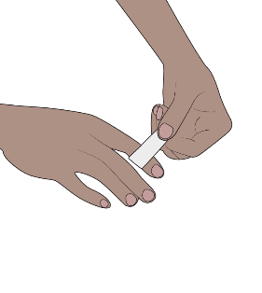
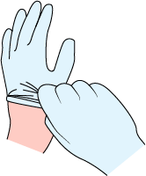
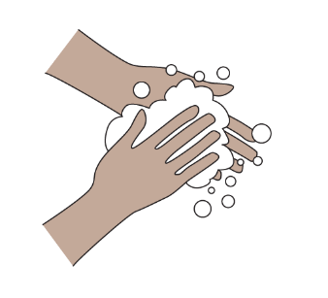

Safely collect samples
Basic hygiene practices
Protect yourself, your patients and your community.
If you have cuts or abrasions on the skin of your hands, cover them with adhesive dressing.
Wear gloves when collecting and handling stool specimens.
Remove gloves and wash your hands after completing any task involving the handling of stool specimens.
    Adhere to proper waste disposal procedures
You can also protect your clothes by wearing scrubs or a lab coat.
2 /9
Notes:
Before starting the procedure, it is always important to remember the basic safety measures. These are key to keeping you and your community safe.
First, wear gloves every time you collect or handle a stool sample.
If you have any cuts or abrasions on your skin, if possible cover them with adhesive dressing or skin tape first.
When you are done collecting and handling the sample, remove the gloves and wash your hands with soap.
Use a new pair of gloves and wash your hands in between each patient.
You may also protect your clothes by wearing scrubs or a lab coat.
Be sure to adhere to proper procedures for the disposal of any waste.

Slide 10
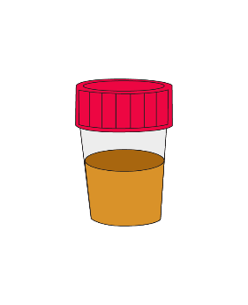
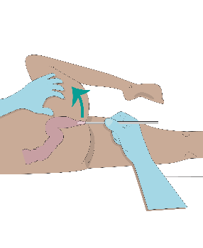
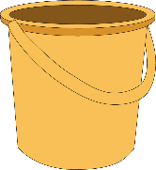

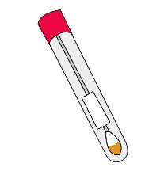
How to collect specimens for cholera testing
Able and bed-ridden patients
who produce loose stool
Patients who
do not produce loose stool
Primary container
Fecal swab
Stool cup
Rectal swab
After further sample preparation, you may have other types of samples such as a sample on filter paper or in Alkaline Peptone Water as presented in the next section.
https://www.gtfcc.org/resources/specimen-collection-preparation-and-packaging-for-transport/
2 /10
Notes:
To test for cholera we first need to collect a sample of stool from the patient.
If the patient can produce loose stool by themselves, we will collect the loose stool in a primary container before transferring some of it into a stool cup or onto a fecal swab.
In rare cases the patient may not be able to produce loose stool and collecting a rectal swab may be required. Rectal swabs are in fact rarely needed with cholera patients as these patients often have profuse diarrhea.
After further sample preparation, you may have other types of samples such as a sample on filter paper or in Alkaline Peptone water. This will be presented in the next section of this module.

Slide 11

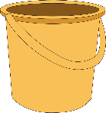
All about bleach
Bleach and other disinfectants can kill the bacterium and lead to incorrect test results
!
Always collect stool samples from patients using clean containers – without disinfectant or detergent residue or other contaminants (urine etc.)
  Pay attention
Before use, bedpans and buckets should be washed, disinfected, rinsed thoroughly with clean water and dried.
2 /11
Notes:
Before we look further into the steps to collect a sample, a word of caution. Bleach or other disinfectants can kill bacteria responsible for cholera in a sample. This may lead to the tests not working or not detecting cholera correctly. We would call that a false negative.
It is important to be careful to collect the stool from patients using only clean containers without any traces of disinfectant or detergent residue or other contaminants such as urine. Before use, bedpans and buckets should be washed, disinfected, rinsed thoroughly with clean water and dried.

Slide 12
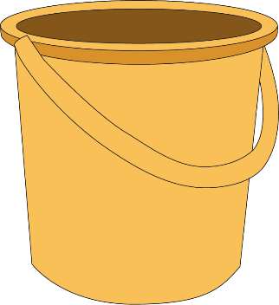

Able patients
PROCEDURE FOR LOOSE STOOL
    Provide the patient with a container such as a bucket/bedpan without traces of detergent or disinfectant or a new plastic bag (like a zip-lock bag) or ideally a wide biodegradable paper cup with a wide enough opening.
    Instruct the patient to:
      urinate before using the container
      pass stool in the container
2 /12
Notes:
How to collect loose stool.
Ideally, the patient is able to provide you a sample themself. In that case, provide the patient with a container such as a bucket or a bedpan without traces of detergent or disinfectant, or a new plastic bag (like a zip-lock bag) or ideally a wide biodegradable paper cup with a wide enough opening for them to use to collect loose stool.
Explain to the patient that they should urinate before using the container or the bag. They can then pass stool in the container or bag.

Slide 13

Bed-ridden patients
PROCEDURE FOR LOOSE STOOL
    Use a clean, unused bedpan or bucket. A bedpan or bucket must be washed, bleached, thoroughly rinsed and well dried before being reused.
    The bedpan or bucket must not have any residue of chlorine or any other disinfectant.
    Place it under the hole of a cholera bed or under the patient.
    Collect freshly passed stool.
2 /13
Notes:
If the patient is bed-ridden, use a clean, unused bedpan or bucket placed under the bed or under the patient. Again, make sure the bedpan does not have any traces of bleach or other disinfectant.

Slide 14
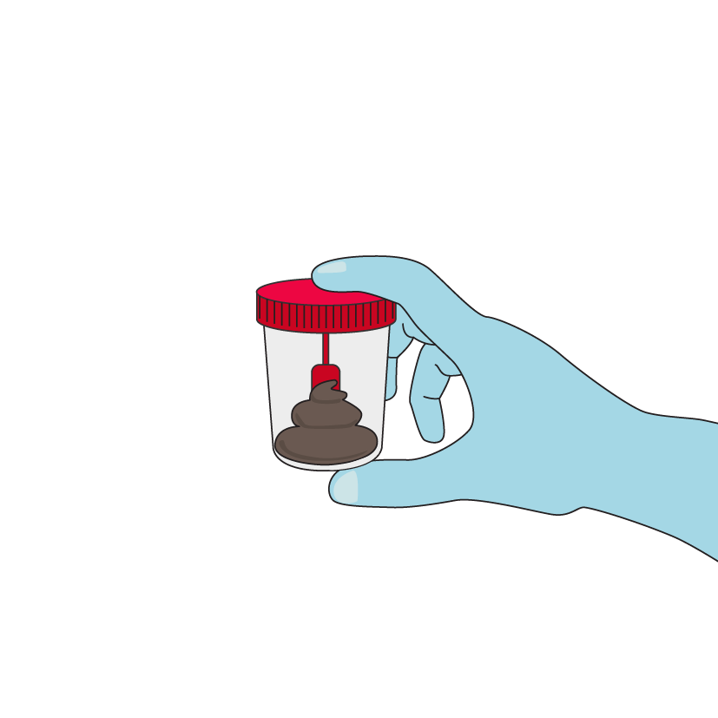
To transfer stool to a stool cup
PROCEDURE FOR STOOL CUP
This part of the procedure may be performed by the staff or patient if adequately instructed:
Transfer stool from the initial container into a stool cup using the provided spoon, a sterile spatula, or a swab. Fill the stool cup no more than halfway.
Empty the leftover stool from the bucket/plastic bag into the toilet, latrine or sewage pit.
Leave the dirty bucket/plastic bag in a designated location or discard the plastic bag in the appropriate biohazard bin.
Remove gloves and wash hands.
Return the filled stool cup to health worker in charge.
Make sure the lid of the stool cup is tightly closed and that it is correctly labelled!
Notes:
You may then need to transfer some stool into a stool cup. This part of the procedure can also be performed by the patient if they are able. In this case you need to provide the patient with detailed step by step instructions.
Use the stool cup spoon or a sterile wooden spatula, and scoop some of the stool into the smaller collection cup. Several big scoopfuls are needed, but no more than half a cup.
Throw away the stool leftover in the container or bag into the toilet
Leave the container in a designated location or throw away the bag in a designated biohazard bin
Ask the patient to hand over the filled collection cup. Make sure it is tightly sealed and correctly labelled at least with the patient's ID number.

Slide 15
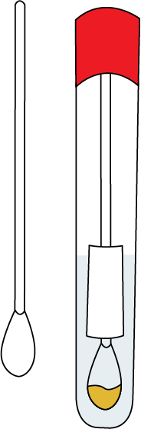
To transfer stool onto a faecal swab
PROCEDURE FOR FAECAL SWAB
      Use a sterile cotton or polyester-tipped swab.
      Dip swab and swirl it in the stool.
      Use the swab to sample any mucus or tissue shreds, if present.
      For RDT: do not place swab in transport medium and continue immediately with the RDT.
      For transport: place the swab tip first all the way in the tube of transport medium (most often Cary Blair medium).
Make sure the tube is tightly closed and correctly labelled!
2 /15
Notes:
Instead of stool in a stool cup, the laboratory may need a sample in the form of a swab in a tube of transport medium such as Cary Blair.
In this case, when you have the loose stool in a container, use a sterile cotton or polyester-tipped swab and dip it in the stool. Swirl or rotate it around for a few seconds. Be sure to pick up some mucus and shreds of tissue if any are present in the stool. Then transfer the swab tip first into the tube of transport medium, all the way to the bottom of the tube. Leave the swab in the tube, for this you may need to break off the tip. Close the tube and label it correctly.

Slide 16

To collect a rectal swab
PROCEDURE FOR RECTAL SWAB
Ensure patient privacy and explain the procedure.
If two rectal swabs are needed, collect at the same time.
1
Ask the patient to lie on their side and to bend and lift their knee that is most on top.
2
Moisten the swab with the sterile transport medium or with saline provided.
3
Insert the swab through the rectal sphincter 3–4 cm.
4
Rotate for 5 to 10 seconds, and withdraw with care.
5
Examine to ensure there is faecal material visible on the swab.
2 /16
Notes:
In rare cases, you will need to perform a rectal swab. This is indeed rare with cholera patients as they tend to have profuse watery diarrhea.
Always ensure patient privacy and explain the procedure.
If two rectal swabs are required, collect them at the same time.
So to perform a rectal swab:
- Have the patient place themselves comfortably lying on their side with their top leg folded
- Open the wrapper of the swab by the handle end, and never touch the sterile tip of the swab
- Moisten the swab in sterile transport medium
- Insert the swab in the rectal sphincter about 3–4 cm
- Rotate the swab for 5 to 10 seconds, and withdraw gently
- Examine the swab and make sure there is visible fecal material. If not, repeat the procedure with a new swab.

Slide 17
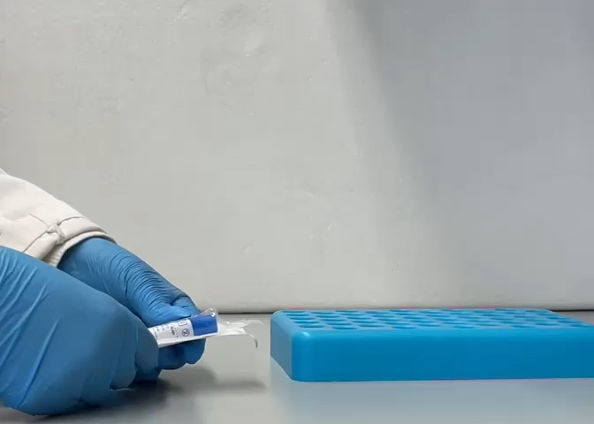
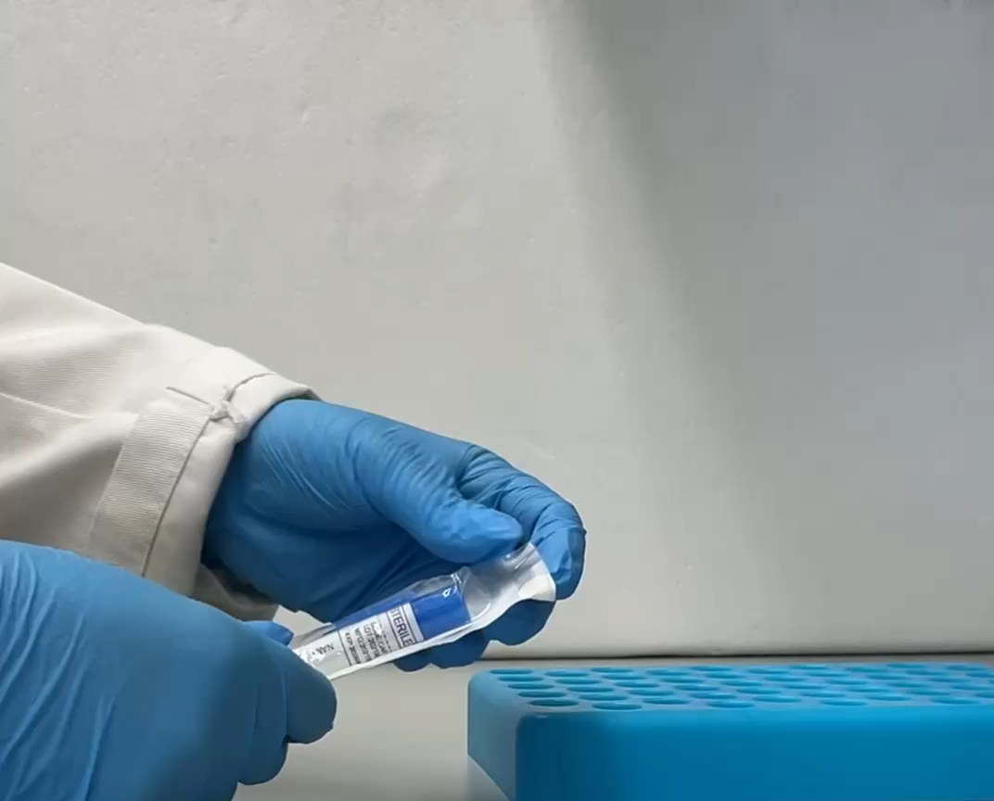
How to handle a swab
Always unwrap a sterile swab without touching the tip and without letting the tip touch anything else to avoid contamination.
For some types of swabs, you may need
to snap the swab so that it fits into
the tube of Cary Blair.
Notes:
When you are working with sterile swabs, it is crucial to never touch the tip of the swab otherwise it is no longer sterile and you may contaminate the sample that you aim to collect.
Only open the new swab with clean gloves, and open it by the base of the swab and not the tip. When it is removed from its package, do not let the sterile tip touch anything else but the patient or the sample.
For some types of swabs. You may need to snap the swab handle so that it fits into the tube of Cary Blair.

Slide 18
Waste management
Any biological waste needs to be disposed of appropriately, this applies to any materials that have been in contact with faecal matter
If you are providing patients with reusable buckets or containers to collect stool, you will need to have a system in place to safely store, wash and sterilize these items before they can be used again.
If you are providing patients with disposable bags, there needs to be a biohazard bin available for the patient to throw the bag away and mechanisms in place to incinerate the biological waste and not let contaminated plastic disperse in the environment.
2 /18
Notes:
As a general rule, any biological waste needs to be disposed of appropriately. This applies to any material that have been in contact with faecal matter.
If you are providing reusable buckets or containers, you will need to have a system in place to safely store, wash and sterilize these items before they can be used again. If you are providing disposable bags, there needs to be a biohazard bin available for the patient to throw it away and mechanisms in place to incinerate the biological waste and not let contaminated plastic disperse in the environment.

Slide 19
What next?
You now have a stool sample in a collection cup or have a swab
(faecal swab or a rectal swab)
Directly test using a Rapid Diagnostic Test (RDT)*
Prepare the sample for transport to a laboratory
Go to module 3:
Cholera Rapid Diagnostic tests
*Not all types of samples can be used for a direct RDT
Notes:
Now that you have either a stool sample in a collection cup or have a swab (a feacal swab or a rectal swab), what will you be doing next?
You may want to prepare the sample for transport to a laboratory. We will be discussing the procedures for this in the next part of this course.
You may also be required to directly test your sample using a rapid diagnostic test. We will discuss the procedures for testing with RDT in the next module.

Slide 20
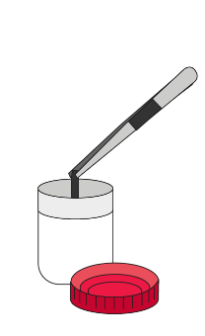
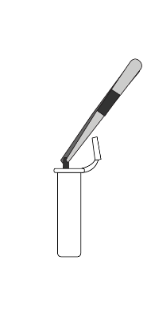
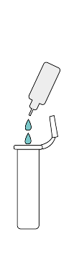
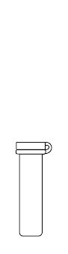
Sample STORAGE AND Preparation FOR TRANSPORT
Notes:
Sample storage and preparation for transport.

Slide 21
Preparing samples for transport
There are different methods of preparing cholera samples for transport
The method used will depend on:
1
2
3
What resources are available (stool cups,
Cary Blair swabs, etc.)
When the sample is expected to be tested (within 2 hours, >2 hours…)
What type of tests are to be performed (RDT, culture, PCR etc..)
These decisions are to be made in advance by the cholera laboratory
in coordination with the surveillance team!
2 /21
Notes:
There are different methods for preparing cholera samples for transport.
The choice of the transport method will depend on:
What resources are available. Do you have stool cups, Cary Blair swabs, etc
How long will the sample take to get to the laboratory and when it is expected to be tested. Will it get to be tested in less than 2 hours or more than 2 hours.
And what type of tests are to be performed at the laboratory. Will the lab be culturing the sample, or doing PCR for example.
These decisions are usually made by the laboratory in coordination with the surveillance team. Make sure you are always aware of the procedures required.

Slide 22

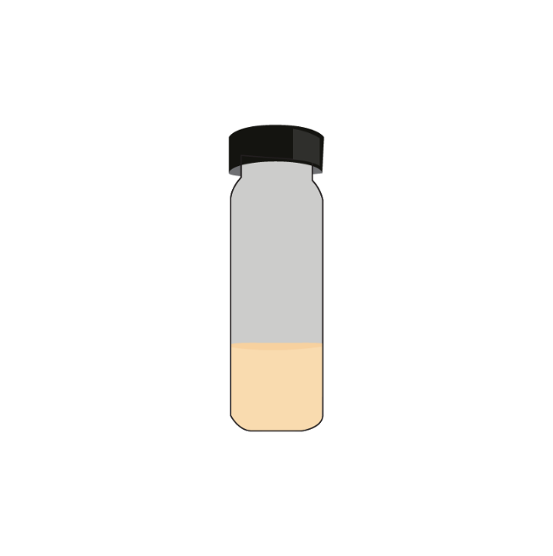
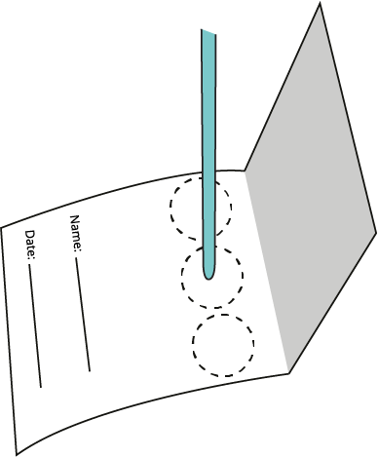
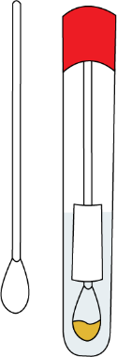
Preparing samples for transport
5 most commonly recommended ways to prepare samples
2 /22
Notes:
There are 5 most common ways to prepare samples for shipping to the laboratory:
A sample can be sent directly in the stool cup
A sample can be sent in as a swab in Cary Blair transport media
A sample can be sent in a tube of Alkaline Peptone Water
A sample can be sent on wet filter paper
A sample can be sent on dry filter paper
We will go through the procedures and characteristics of all these methods.

Slide 23
Safely collect samples
Basic hygiene practices
Protect yourself, your patients and your community.
If you have cuts or abrasions on the skin of your hands, cover them with adhesive dressing.
Wear gloves when collecting and handling stool specimens.
Remove gloves and wash your hands after completing any task involving the handling of stool specimens.
    Adhere to proper waste disposal procedures
You can also protect your clothes by wearing scrubs or a lab coat.
Notes:
Before starting the procedure, the basic safety and hygiene practices. These are key to keeping you and your community safe.
Wear gloves every time you collect or handle a stool sample.
If you have any cuts or abrasions on your skin, if possible cover them with adhesive dressing or skin tape first.
When you are done collecting and handling the sample, remove the gloves and wash your hands with soap.
Use a new pair of gloves and wash your hands in between each patient.
You may also protect your clothes by wearing scrubs or a lab coat.
Be sure to adhere to proper procedures for the disposal of any waste.

Slide 24
SAMPLE In a Cary Blair Swab
The most favored transport medium for suspected V. cholerae specimens
Material Required
Conservation
Cary Blair
semi-solid, bottle/tube
Swab
sterile, cotton/polyester
For testing within an average of 7 days from collection.
Should be transported at ambient temperatures (22 ºC – 25 ºC).
Keep container out of direct sunlight.
Procedure
Compatibility with testing methods*
For faecal samples: dip swab in stool and transfer into Cary Blair tube.
Rectal swab: place swab directly into Cary Blair tube.
No further manipulation is needed.
Culture
2 /24
*Used for culture mainly • Molecular testing and RDT are possible but require culture and enrichment step in APW
Notes:
The most favored transport medium for specimens with suspected Vibrio cholerae is a medium called Cary Blair.
You will need tubes with sterile Cary Blair medium in them. In general these tubes come with sterile swabs.
If your initial sample is loose stool in a container, use a sterile swab to dip in the stool, swirl it about and transfer the swab all the way down into the tube of Cary Blair and leave it in the tube.
If you had to perform a rectal swab, you can place the rectal swab directly into the tube of Cary Blair.
On average, these samples can be stored and transported for 7 days at ambient temperature. Be careful to keep any samples out of direct sunlight.
The laboratory will be able to perform culture directly from these samples, or even RDT and molecular testing but only after further processing.

Slide 25
Sample in a Stool cup
Material Required
Conservation
For testing within 2 hours from collection only.
Should be transported at ambient temperatures (22 ºC – 25 ºC).
Keep container out of direct sunlight.
Stool container
plastic, screw on cap, 30ml, without disinfectant
Compatibility with testing methods
Procedure
RDT
Culture
PCR...
Keep in initial stool cup.
Parafilm or sealing tape can be used to seal container and prevent leakage when possible!
2 /25
Notes:
Stool samples can be sent to the laboratory in the initial simple stool cup but they would need to be tested rapidly within 2 hours of collection.
These samples must be sent at ambient temperature, ideally between 22 and 25 degrees centigrade. There is generally no need to add icepacks unless the temperature is expected to go above 35 degrees.
From these types of samples, if the tests are done rapidly, the laboratory can perform a RDT, culture or even molecular analysis.

Slide 26
Sample in Alkaline Peptone Water (APW)
Conservation
Material Required
For testing within 24 hours from collection only.
Should be transported at ambient temperatures (22 ºC – 25 ºC).
Keep container out of direct sunlight.
APW
tubes with screw cap, transfer pipettes or swabs
Procedure
Transfer faecal matter from initial container
into APW tube.
Parafilm or sealing tape to seal container and
prevent leakage when possible!
NOTE: the faecal matter should not exceed 10%
of the volume of the APW enrichment.
Compatibility with testing methods
RDT
Culture
PCR...
2 /26
Notes:
A sample can be suspended in Alkaline Peptone Water to favor the growth of Vibrio cholerae. This is generally not the preferred method as it requires more preparation and must be received quickly at the laboratory.
You will need prepared tubes of sterile APW and transfer pipettes or swabs.
Using a transfer pipette or swab, transfer some stool from the initial container into a tube of APW in a way that the stool should not take up more than 10% of the total volume of APW.
These samples must be tested within less than 24 hours.
They should be transported at ambient temperature
And finally, this preparation in APW can be used in the laboratory for RDT, culture and molecular testing.

Slide 27
SAMPLE ON Wet Filter paper
Material Required
Conservation
WFP
Filter paper discs
(6mm Ø, non-sterile),
sterile saline solution, forceps
or needle,
2ml tube (screw cap)
For testing within 15 days from collection.
Should be transported at ambient temperatures (22 ºC – 25 ºC).
Keep container out of direct sunlight.
Procedure
Compatibility with testing methods
Dip filter paper disk into watery faecal material with
single-use device (forceps, needle), transfer into tube,
add 2 to 3 drops of sterile saline, close tube.
RDT*
Culture
PCR...
*RDT requires an enrichment step in APW
Notes:
A sample can be sent on wet filter paper.
You will require filter paper disks, some saline solution, a small tube with a screw cap and a single-use needle or forceps.
Use the single-use needle or forceps to dip the disk in the stool, then place that disk in the small tube, add 2 or 3 drops of saline solution and close the tube.
This way, the sample can be stored or transported for a maximum of 10 days at ambient temperature.
From these samples, the laboratory can perform culture or molecular tests but they will need extra processing before an RDT can be performed.

Slide 28
SAMPLE ON DRY FILTER PAPER
Material Required
Conservation
DFP
Whatman cards
(903 protein saver,
FTA Elute Micro Cards), disposable transfer pipettes, individual pouches, desiccant
No limitation to duration of conservation.
Should be transported at ambient temperatures (22 ºC – 25 ºC).
Keep container out of direct sunlight.
Procedure
Compatibility with testing methods*
Deposit one drop of watery stool filling the circle on filter paper.
Air dry paper in a clean, dust free area, before placing into individual pouch with desiccant.
PCR...
*Used for molecular testing only • Cannot be used for culture or RDT
2 /28
Notes:
Samples can also be sent on dry filter paper.
For this method you will need whatman cards, disposable transfer pipettes, individual plastic pouches and a desiccant.
Use the transfer pipette to deposit one drop of watery stool onto the filter paper. Let the paper air dry before placing it into an individual pouch with desiccant.
Using this method, a sample can theoretically be kept indefinitely in ambient temperature however the laboratory will only be able to perform molecular analysis such as PCR and not culture or RDT.

Slide 29
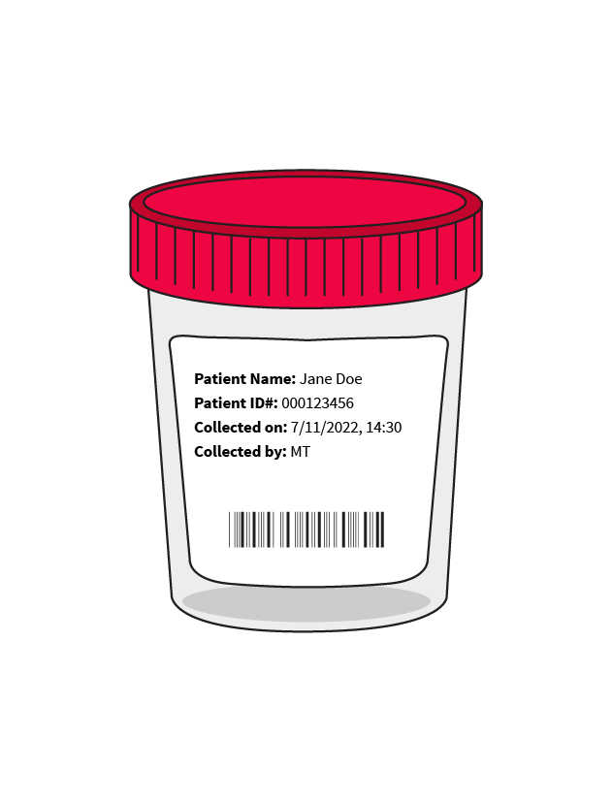
Labelling specimens for transport
As a minimum, each specimen should be labelled with:
  Patient name
  Unique identification number
  Time and date of collection
  Collector’s initials
Use computer-generated barcodes if possible.
Be sure to adhere to the national procedures in place.
2 /29
Notes:
Accurately labeling samples is critical.
At a minimum, each specimen should be identified by:
patient’s name and/or unique identification number
The time and date of collection of the sample
The initials or name of the person having collected the sample
Other information can be important such as what test has been ordered.
If possible, use computer-generated bar codes linked to the complete electronic information of the patient.
Be sure to adhere to local guidelines within the country you are in.

Slide 30
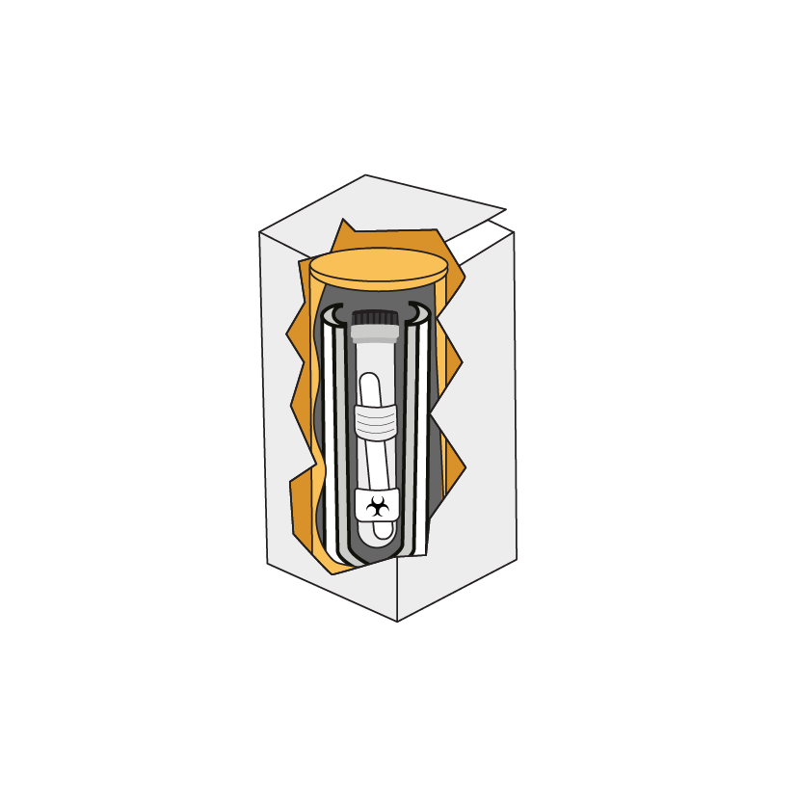
Sample Transport
Notes:
Sample transport

Slide 31
Sample transport
Objective: move a sample from one location to another in a way that is :
Safe
for the person, the community and the environment
Secure
Preserves
the quality of the sample
2 /31
Notes:
When we speak of sample transport, we aim to move a sample from one location, usually a health facility but sometimes a laboratory, to another location for instance a laboratory. We want to do this in a way that is safe – so that neither the person transporting the sample, nor the community or the environment be exposed to what is in the sample -, that is secure from theft for example, and in a way that preserves the quality of the sample so that it can be further analyzed.

Slide 32
Requirements
Readily available procedures for sampling, packaging, and transport
Procedures that take into account the conditions of transport (motorbike, car, duration, etc…)
Readily available sample transfer form to be shared with the samples
Moving any sample from any location to another, domestic or international, must comply with all packaging recommendations
Notes:
There should be readily available procedures for sampling, packaging, and transport.
These procedures should take into consideration the conditions of the transport system: how are the samples going to be transported for example, by motorbike, by car, by plane? how long will the samples need to get to the laboratory? There may be different procedures for different transport mechanisms.
You should also have readily available sample referral or transfer forms to share the patient information along with the samples in a standardized way.

Slide 33
Transport regulations
Where do they come from? Who makes them?
National and international transport regulations
ICAO/IATA transport regulations (air)
Rail, road, and sea traffic agencies
Postal services
Private couriers
2 /33
Notes:
It is critical to follow all applicable regulations when transporting infectious agents.
Regulations for the transport of biological samples an infectious agents come from several international and national organizations to ensure safety, security, and compliance. The key sources include:
The International Air Transport Association (IATA), the International Civil Aviation Organization (ICAO), rail, road and sea traffic agencies, postal services and even private couriers.
You can find training and certifying courses available online.

Slide 34
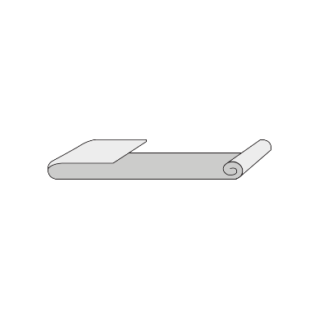
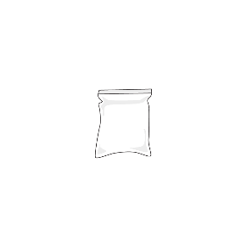
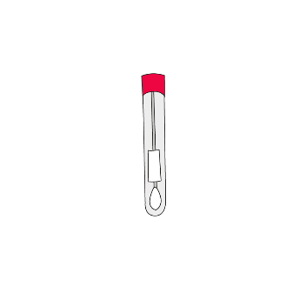
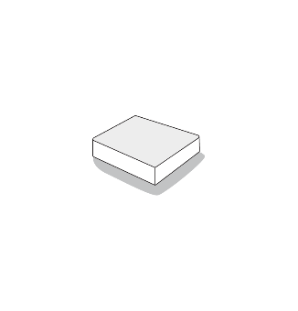

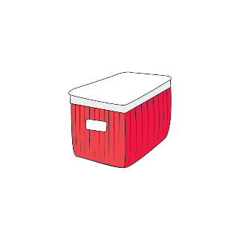

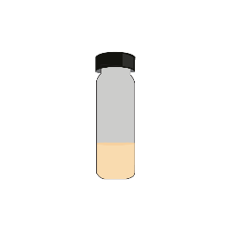
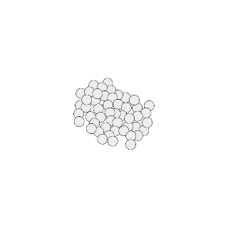
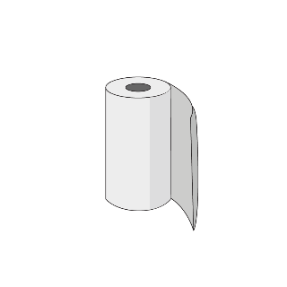
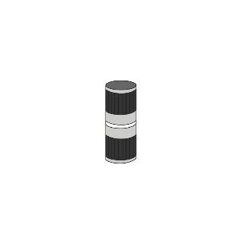
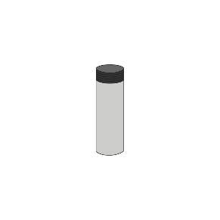
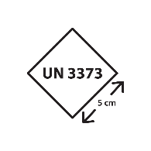
Triple packaging
Each specimen needs to be protected by
  Primary container (stool cup, Cary Blair tube etc…) = material that contains the sample
  Surrounded by absorbent material
  Secondary container (plastic bag, canister etc.)
  Tertiary container (cooler or box etc.)
Leak-proof, sterile, labeled
To absorb potential leakage
To contain leakage
Physical protection against damage and external pressure
Notes:
To transport samples, we use what is called triple packaging.
First each specimen should be protected by a primary container. This is a leak-proof, sterile and labeled container and generally it is a stool cup, or a tube with a swab in Cary Blair for example.
Surrounding the primary container, there should be a layer of absorbent material such as tissue paper. There needs to be enough absorbent material to absorb all the content of the primary container if it leaks.
A secondary container is then used, such as a plastic can with a lid and this is sealed to contain further leakage.
Finally, a tertiary container such as a cardboard box or a cooler is used to protect all samples from physical damages or external pressure.
Triple packaging should be used whether a sample is transported locally in country, or internationally.

Slide 35
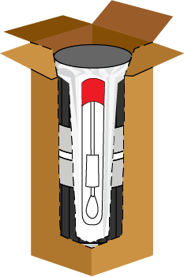
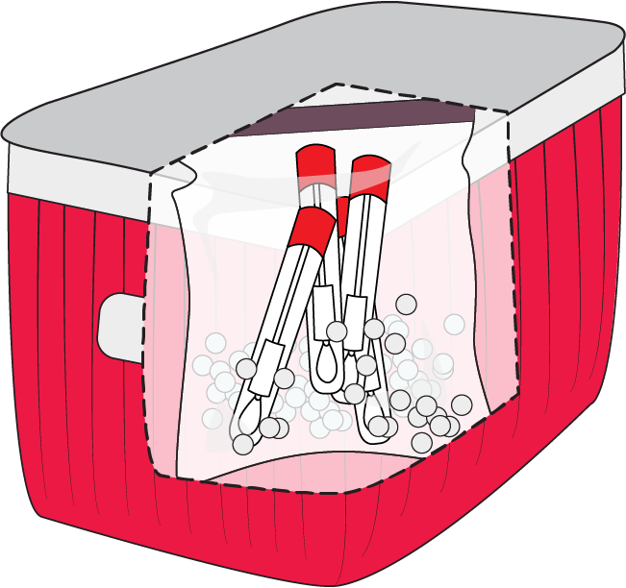
Domestic transport
2 /35
Notes:
In this example, you’ll see an illustration of how the example materials are packaged together for transport in country.

Slide 36
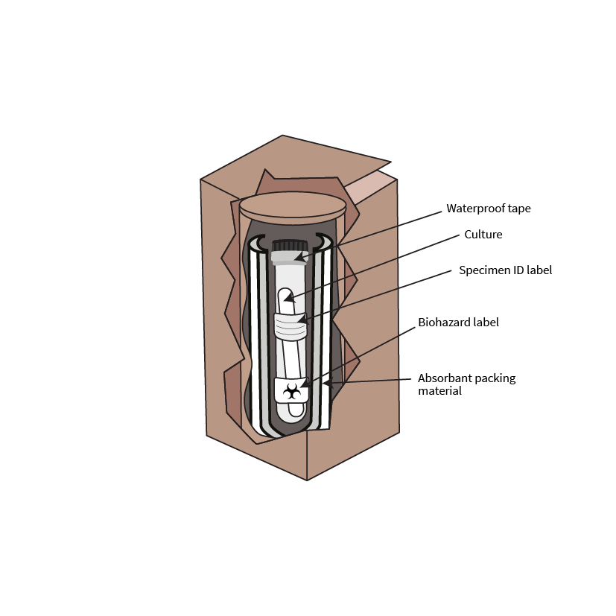
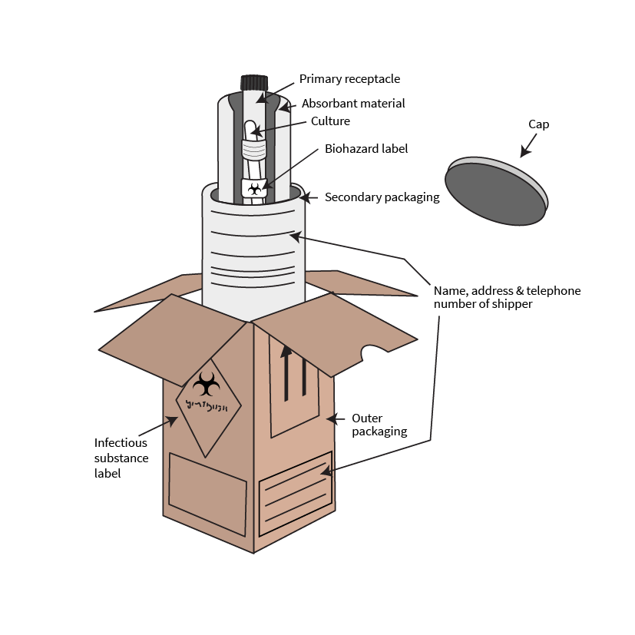
International Transport
International transport must abide by international regulations (IATA).
Specific, labelled packaging may be required.
2 /36
Notes:
For international transport of samples, specific packaging and materials may be required. There are further certifying courses available to individuals responsible for international shipments.

Slide 37
Transport
DOS AND DON’TS
For the best quality of stool samples for cholera testing, stool should be kept at ambient temperature (22°C - 25°C).
If using ice packs, make sure to place them between secondary and tertiary containers and not in direct contact with the stool samples.
In most situations,
ice packs are not needed.
Do not add ice packs unless temperature is expected to
go above 35°C.
Do not leave boxes exposed to direct sun for prolonged periods.
2 /37
Notes:
Cold temperatures decrease the viability of Vibrio cholerae in the stool.
So for the best quality stool samples for cholera testing, the samples should be transported at ambient temperature or temperatures ranging between 22 and 25 degrees.
We do not want to use ice packs unless the temperature is expected to go beyond 35 degrees.
If ice packs are a must, then they should be placed between the secondary and tertiary containers and not directly in contact with the samples.
Do not leave boxes exposed to direct sun for prolonged periods.
Again, in most situations, ice packs are really not needed and could damage the samples.

Slide 38

Referral forms
Notes:
Referral forms

Slide 39
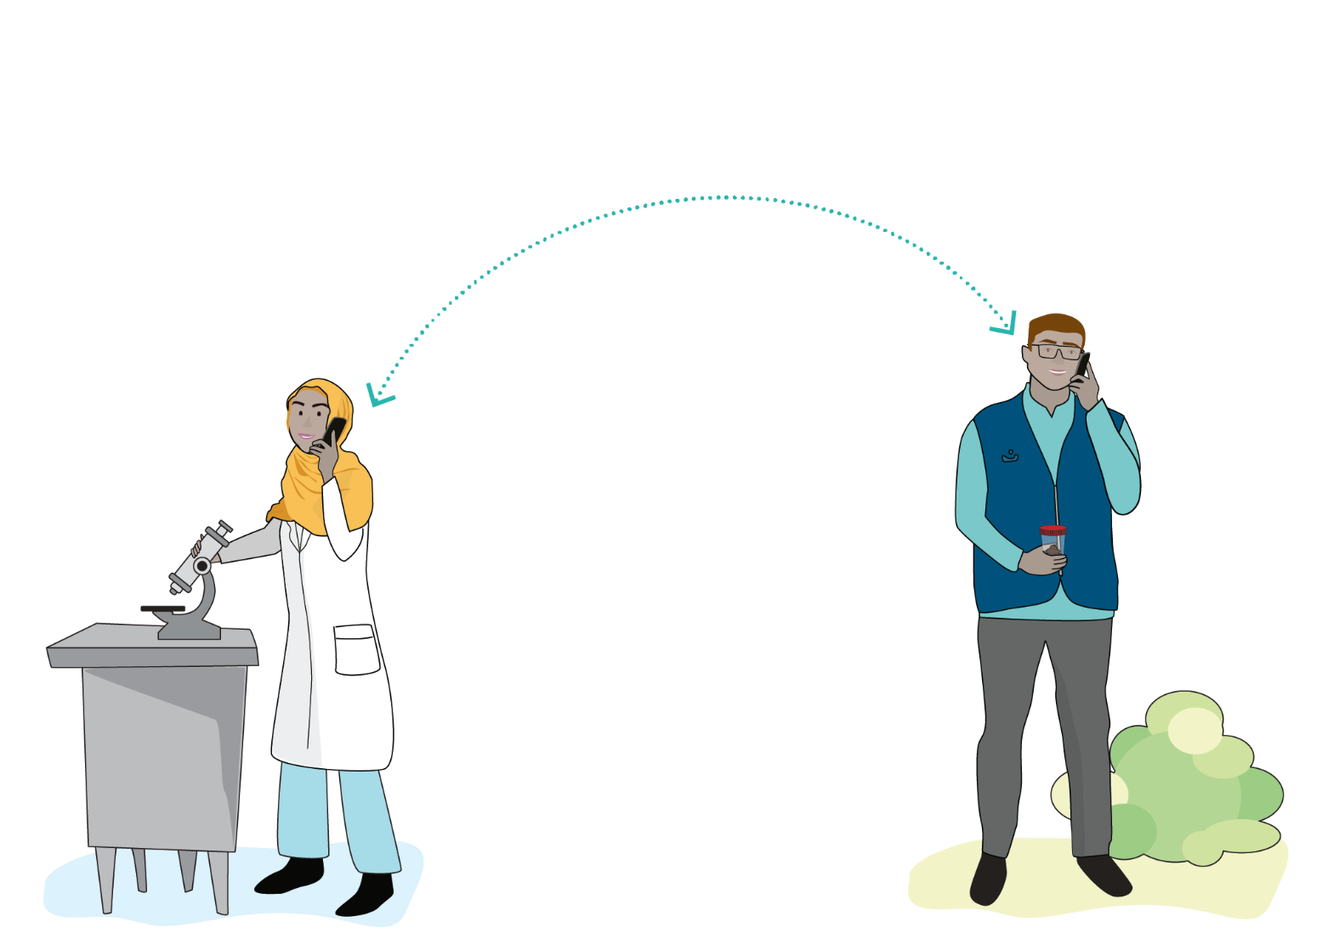
Few considerations!
Communication between field staff and laboratory staff is critical to ensure that good quality specimens are submitted for testing.
!
    Communication should go
    both ways
2 /39
Notes:
Communication between field staff and laboratory staff is critical to ensure that good quality specimens are submitted for testing.
It is important for the field staff to send complete and accurate information about the patient together with the sample.
If there are any questions or missing information, it will be important for the laboratory staff to communicate with the field staff to find the answers. The field staff may also need precious advice from the laboratory about the procedures to use for sample collection and preparation.
Communication should go both ways.

Slide 40
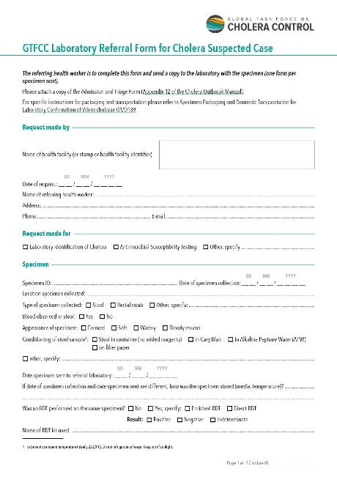
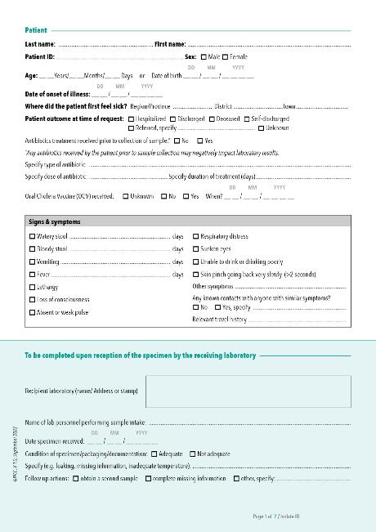
GTFCC Laboratory referral form for cholera suspected case
https://www.gtfcc.org/resources/gtfcc-laboratory-referral-and-results-reporting-forms/
Notes:
Here is an example of a standardized referral form that is filled and accompanies every single sample that is sent to the laboratory. This one was developed by the GTFCC and can be adapted to your needs.

Slide 41
Minimum recommendations for referral
    Unique patient identifier
    Full name, age, gender at birth, address
    Name of the referring health facility
    Date of specimen collection
Result of RDT (if it was performed)
2 /41
Notes:
Sample referral forms hold key information about the patient and the sample. They should include at the very least the following information :
A unique patient identifier and, if used, a unique sample identifier
The name of the patient, age, sex and address
The name of the referring health facility or person
The date of specimen collection
The result of the rapid diagnostic test if one was performed

Slide 42
Sample referral forms are critical
    No information at all
    Missing/incomplete information
Problems in performing the correct test, problems matching results to a patient, surveillance teams get wrong results.
Problems in matching results to patients, surveillance teams misinformed, laboratory cannot draw a full conclusion.
!
Inaccurate picture of
the outbreak!
    Communication is key
Notes:
The information contained in these forms is critical.
Without any of this information, the laboratory may struggle to perform the correct test, or results will be reported for the wrong patients.
Similarly, if the information provided is incomplete, the laboratory will have difficulties matching the results to the correct patients or maybe will not be able to draw full conclusion.
In either case, this will lead to an inaccurate picture of the outbreak.
In both cases the laboratory would probably reject the sample.
Hence communication is key. If you have incomplete information, try to complete the gaps and if it’s not possible, let the laboratory know. Supplying the laboratory with the correct information, using the right forms, clearly labeling the sample and placing the documents and sample referral forms with the sample itself as we mentioned before, is crucial for a successful operation.

Slide 43
Referral and reporting
    Always write and check the patient ID/sample ID so the results can be matched to a patient.
    Use standardized sample referral forms.
    Use one form for samples collected on one patient at one time.
    Complete each form with as much information as possible - Saying you have no information is also information!
    Make sure that all the forms and documents are placed in an impermeable sleeve with the samples in a way they would not become soiled with the samples in case of any leaks.
    If possible, send an electronic copy of the forms to the lab and keep a copy on hand.
    Inform the lab that a sample is on the way!
2 /43
Notes:
Here are a few additional tips.
Always write and double check the patient ID or sample ID.
Use standardized sample referral forms and provide these forms to all health facilities collecting samples.
Use one form for each sample collected from any one single patient.
Complete each form with as much information as possible or specify the instances where the information is not available.
Place the forms and other documents with the samples in an impermeable sleeve, in a way where there will not be dirtied by a leaking sample.
If possible, send an electronic copy or the forms to the laboratory at the same time and keep a copy for your facility.
Inform the laboratory that a sample is on its way.

Slide 44

Links to GTFCC support material
Recommendations for “Public Health Surveillance for Cholera” : https://www.gtfcc.org/resources/public-health-surveillance-for-cholera/
Job Aid “Sample collection”: https://www.gtfcc.org/resources/specimen-collection-preparation-and-packaging-for-transport/
Job Aid “Specimen packaging and domestic transportation” : https://www.gtfcc.org/resources/specimen-collection-preparation-and-packaging-for-transport/
Job Aid “Strain conditioning for international transportation”:
https://www.gtfcc.org/resources/specimen-collection-preparation-and-packaging-for-transport/
"Laboratory referral form" : https://www.gtfcc.org/resources/gtfcc-laboratory-referral-and-results-reporting-forms/
2 /44
Notes:
Here are links to GTFCC documents that further detail everything discussed during this module. Do not hesitate to take a look and print out what you need.

Slide 45
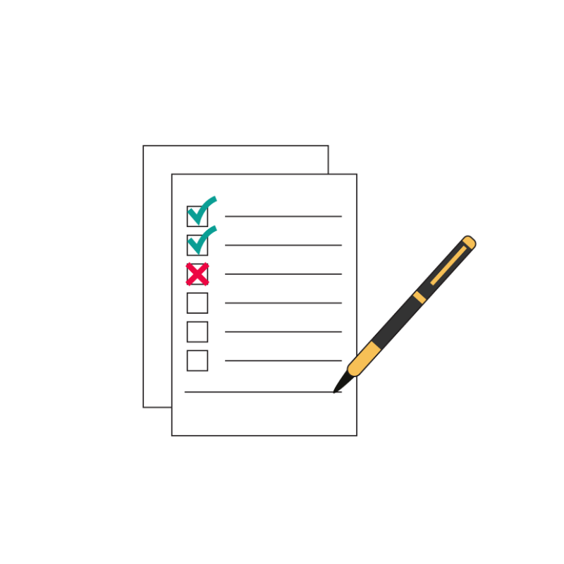
End of module assessment
Notes:
End of module assessment

Slide 46
Assessment
    It is preferable to avoid collecting a sample for cholera testing after antibiotic treatment and this may affect the quality of the sample:
    True or False
    Stool samples can be collected from bedpans that contain traces of disinfectant:
    True or False
    An unpreserved stool sample in a stool collection cup shouldn't be tested by culture in the lab after …………. from collection:
    a. 24 hours b. 7 days c. 2 hours d. 2 days
    Cary Blair swabs should be transported at 4°C:
    True or False
    If ice packs are used during transport, they should not be placed in direct contact with the sample:
    True or False
2 /46

Slide 47
Assessment Answers
    It is preferable to avoid collecting a sample for cholera testing after antibiotic treatment and this may affect the quality of the sample:
    True but sample can still be collected, and the antibiotics recorded on the referral form to refresh your memory go to slide 7
    Stool samples can be collected from bedpans that contain traces of disinfectant:
    False disinfectant kills bacteria and will lead to bad samples to refresh your memory go to slide 11
    An unpreserved stool sample in a stool collection cup shouldn't be tested by culture in the lab after …………. from collection:
    c. 2 hours to refresh your memory go to slide 25
    Cary Blair swabs should be transported at 4°C:
    False refrigerating samples can damage the sample give incorrect test results to refresh your memory go to slide 24
    If ice packs are used during transport, they should not be placed in direct contact with the sample:
    True to refresh your memory go to slide 37
2 /47

