Slide 1
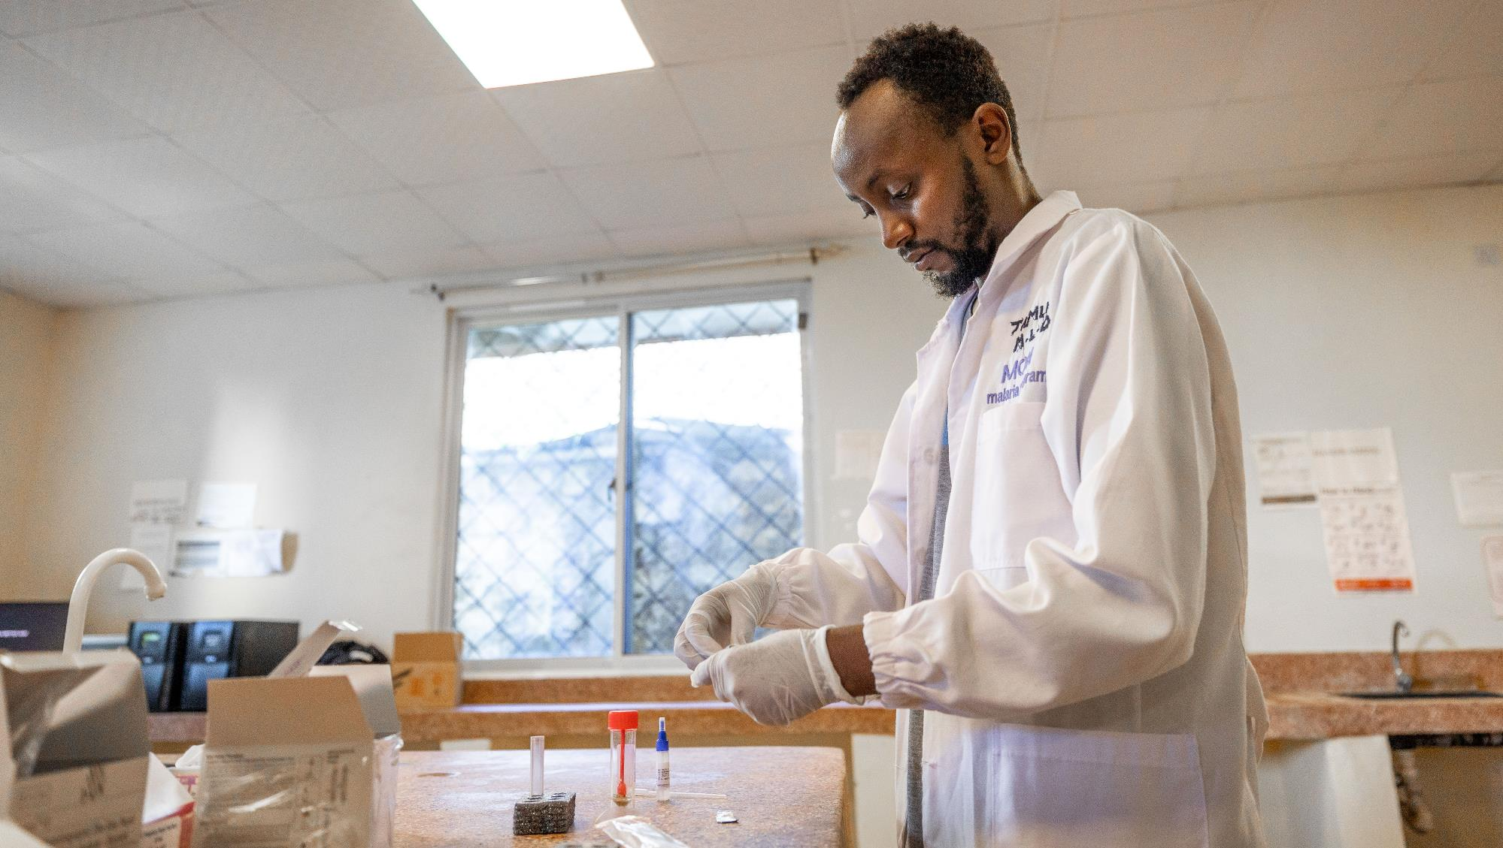
GTFCC recommendations
SAMPLE COLLECTION AND TESTING WITH RAPID DIAGNOSTIC TESTS FOR CHOLERA FOR HEALTH CARE WORKERS
V1.0 November 2024
© WHO / Genna Print
Notes:
Welcome to the GTFCC course on sample collection and testing with rapid diagnostic tests (or RDTs), for cholera, for healthcare workers.

Slide 2
This course was developed by the Laboratory Working Group of the Global Task Force on Cholera Control.
The development of the materials was coordinated by the World Health Organization.
The development of the materials was supported by Cooperative Agreement number GH19-1967 GH002225, funded by the Centers for Disease Control and Prevention. Its contents are solely the responsibility of the authors and do not necessarily represent the official views of the Centers for Disease Control and Prevention or the Department of Health and Human Services.
0 /2
Notes:
The course content was developed by the Laboratory Working Group of the Global Task Force on Cholera Control, or GTFCC. The development of the materials was coordinated by the US Centers for Disease Control and Prevention.

Slide 3
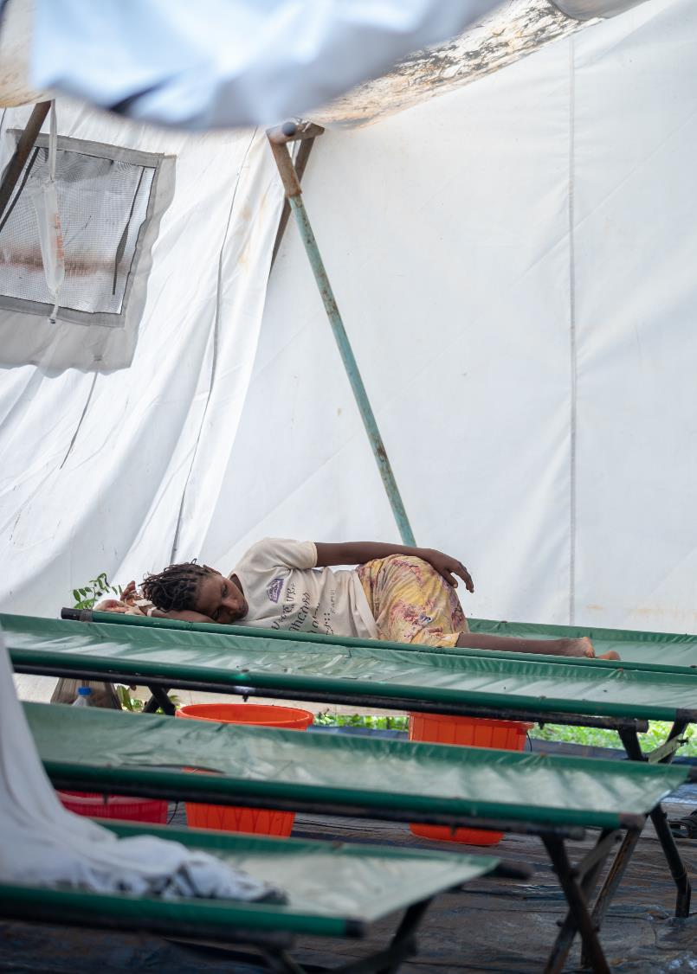
COURSE OUTLINE
© WHO / Mulugeta Ayene
MODULE 1
Introduction to cholera and testing for cholera
MODULE 2
Sample collection, preparation and transport for cholera
MODULE 3
Cholera rapid diagnostic tests (RDTs)
0 /3
Notes:
This course is divided into three modules. In the first module, we will provide you with an introduction to cholera and testing for cholera. In Module 2 we will dive deeper into best practices and procedures for sample collection, preparation and transport for cholera. In Module 3 we will provide you with best practices and procedures for the use of cholera RDTs.

Slide 4
Target audience
Rapid response teams and local health authorities
Nurses, medical doctors, other primary healthcare workers
Laboratory personnel
Anyone who is involved in sample collection, in sample preparation for transport and shipment, in performing Rapid Diagnostic Tests (RDTs) or anyone responsible for the training of staff on these topics.
0 /4
Notes:
This course is designed for rapid response teams, local health authorities, nurses, medical doctors, other primary healthcare workers, and laboratory personnel, basically any individuals who are involved in collecting samples, in preparing samples for transport or shipment, or performing rapid diagnostic tests for cholera or even involved in training on these topics. Individuals who follow this course may be affiliated to ministries of health, Non-Governmental Organizations, or any other organization involved in cholera surveillance or cholera outbreak response.

Slide 5
For a general overview on cholera including prevention and control principles:
Open WHO course Cholera: Introduction
0 /5
Notes:
Before we begin, it may be of interest for you to attend the online OpenWHO course named “Cholera: Introduction” for a general overview on cholera including prevention and control principles.

