Slide 1
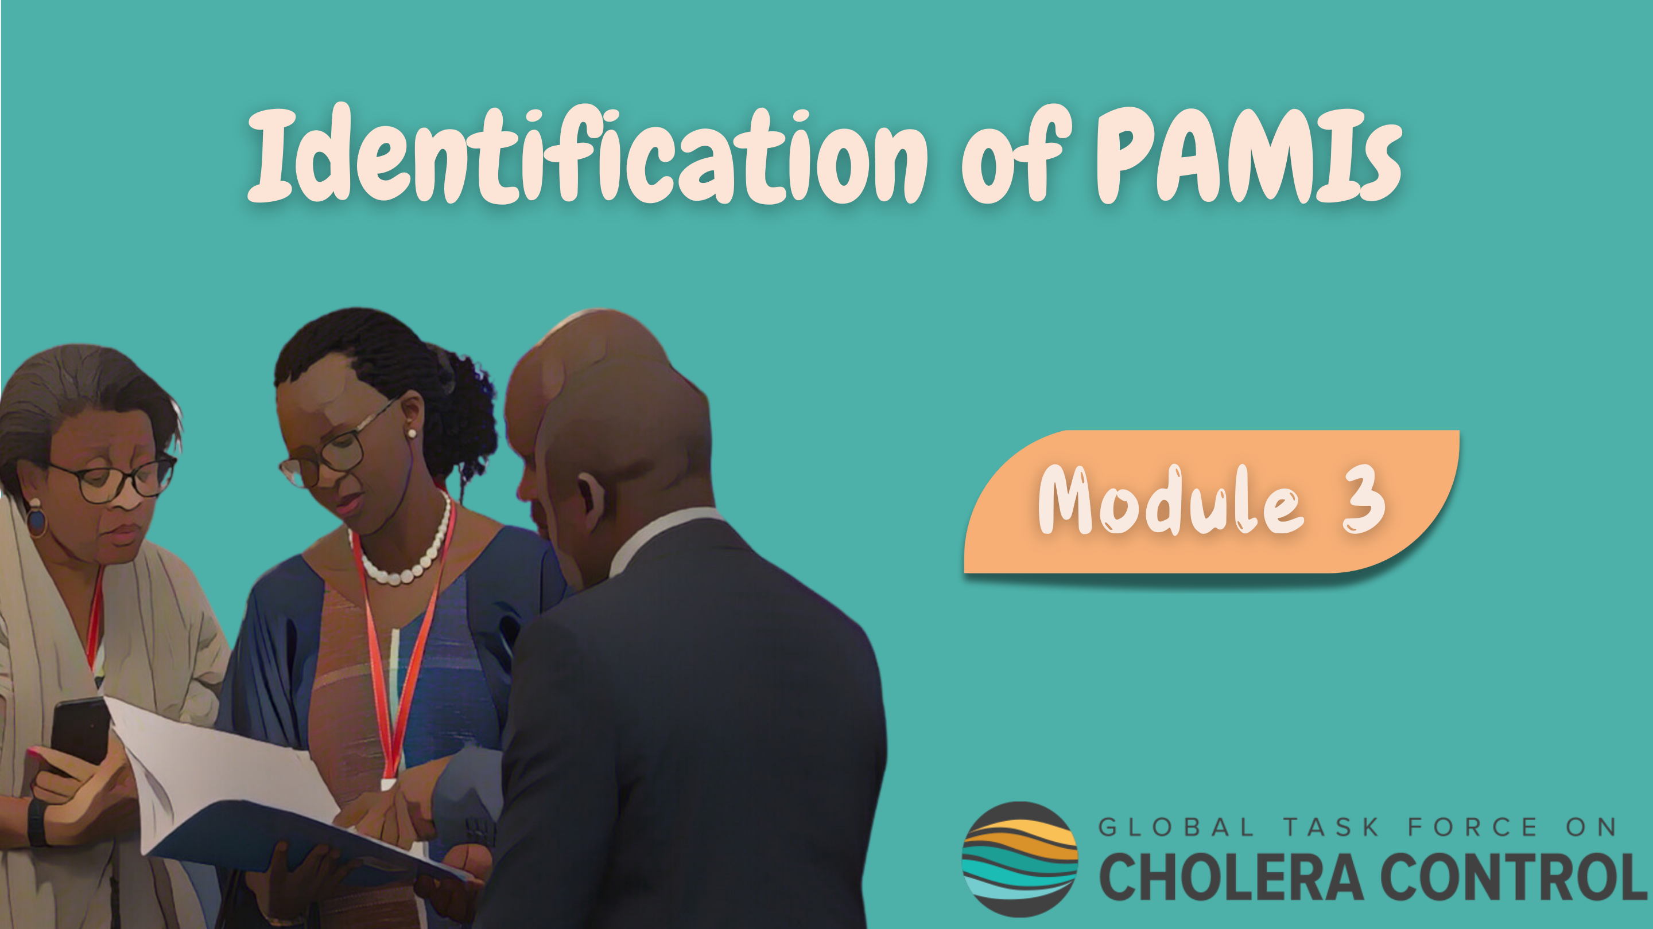
Notes:
Welcome to Module 3 of the GTFCC introduction course on the identification of Priority Areas for Multisectoral Interventions, PAMIs.

Slide 2

Notes:
In this module, we will show you how to access supplementary material online to identify PAMIs.

Slide 3
What will you learn?
Where to find resources on:
Principles for PAMI identification
Identification of PAMIs for cholera control
Identification of PAMIs for cholera elimination
NCP development
Notes:
After completing this module, you will know where to find GTFCC online resources on:
key principles for PAMI identification;
the identification of PAMIs for cholera control;
the identification of PAMIs for cholera elimination;
as well as on NCP development.

Slide 4
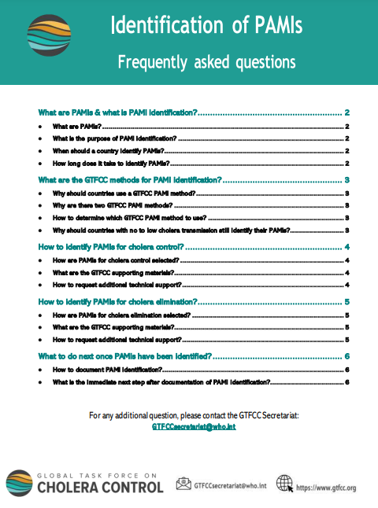
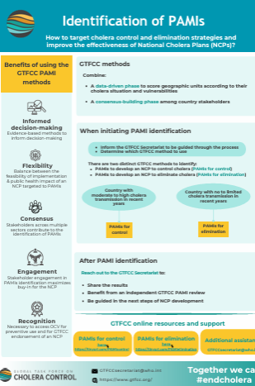
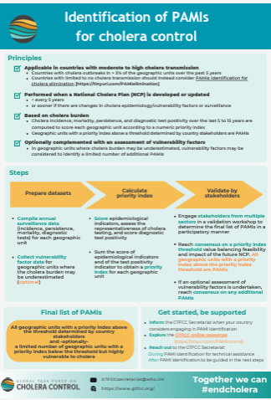
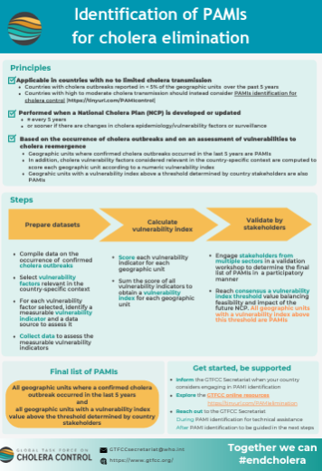
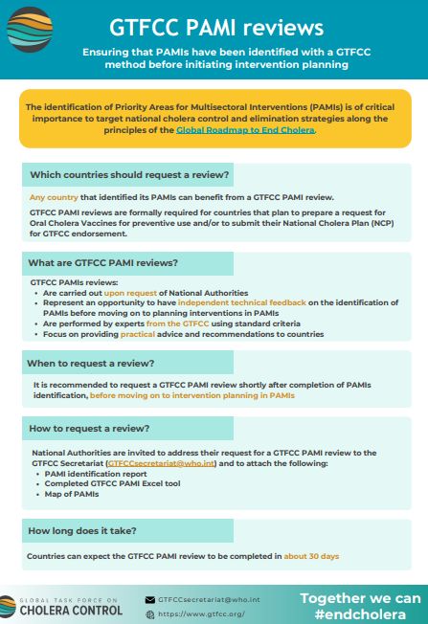
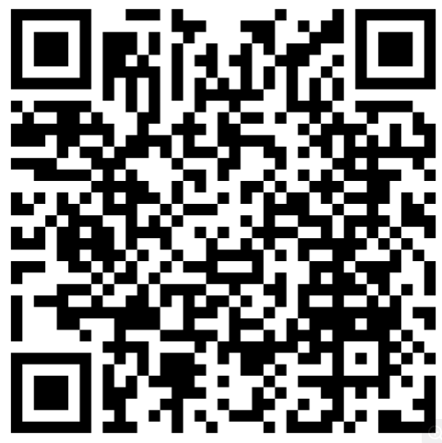
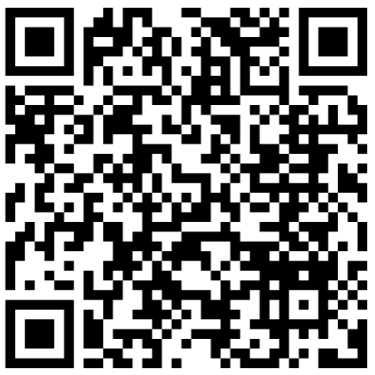
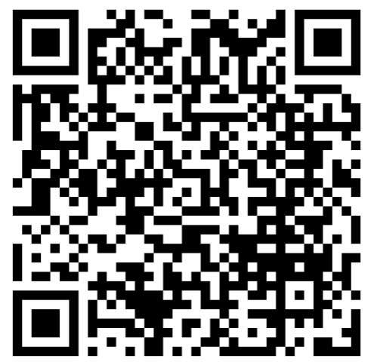
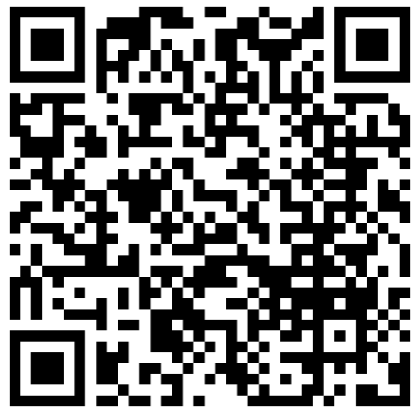
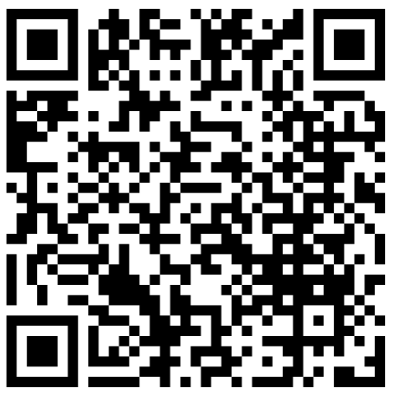
Principles for PAMI identification
https://tinyurl.com/PAMIinformation
FAQ
PAMIs
Control
Elimination
PAMI review
Notes:
You can access summary information on key principles for PAMI identification on a dedicated GTFCC Webpage at https:/tinyurl.com/PAMIinformation.
On this webpage, you will find a FAQ which compiles frequent questions from countries on PAMI identification.
You will also access a one pager on the purpose and principles for PAMI identification, as well as a one pager on key steps to identify PAMIs for cholera control, and a one pager on key steps to identify PAMIs for cholera elimination.
Lastly, you will also access practical information regarding why and how to request a GTFCC PAMI review.
You can also access each document by scanning the QR codes at the bottom of your screen.

Slide 5

PAMIs for cholera control – Online course
https://tinyurl.com/coursePAMIcontrol
Notes:
To learn more about the identification of PAMIs for cholera control, we warmly encourage you to take the dedicated GTFCC online course.

Slide 6
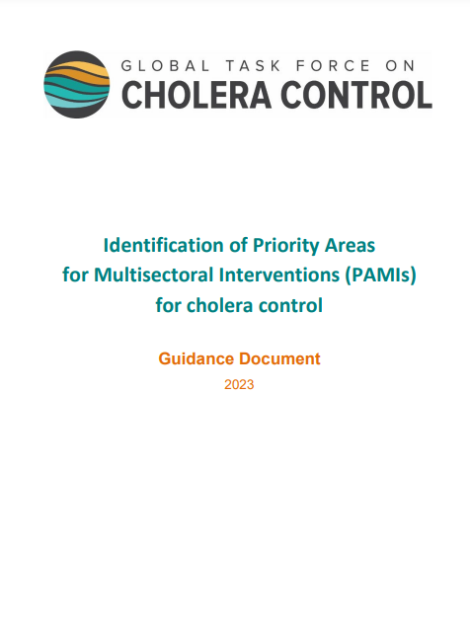
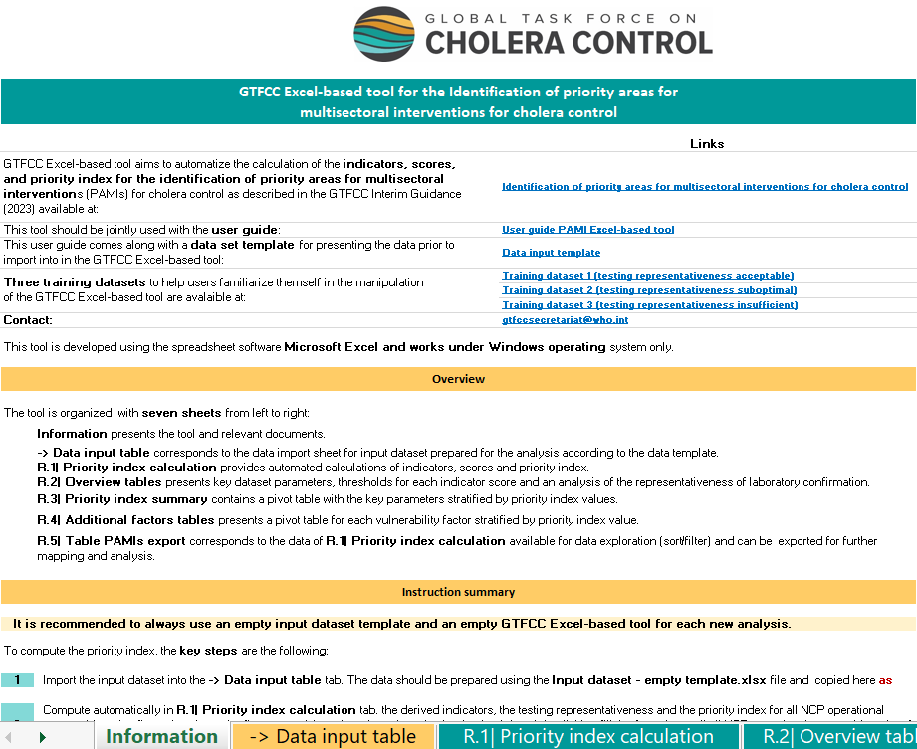
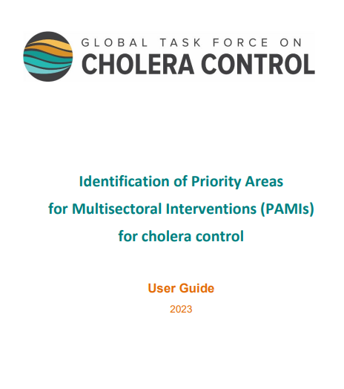
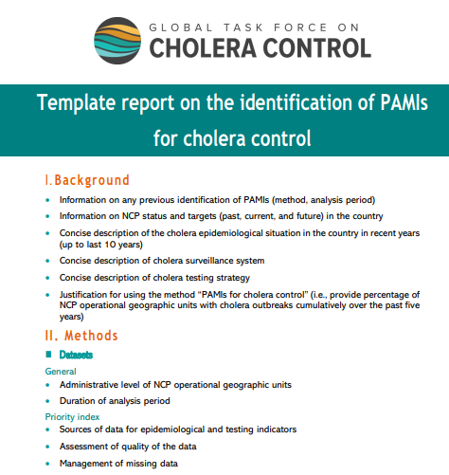
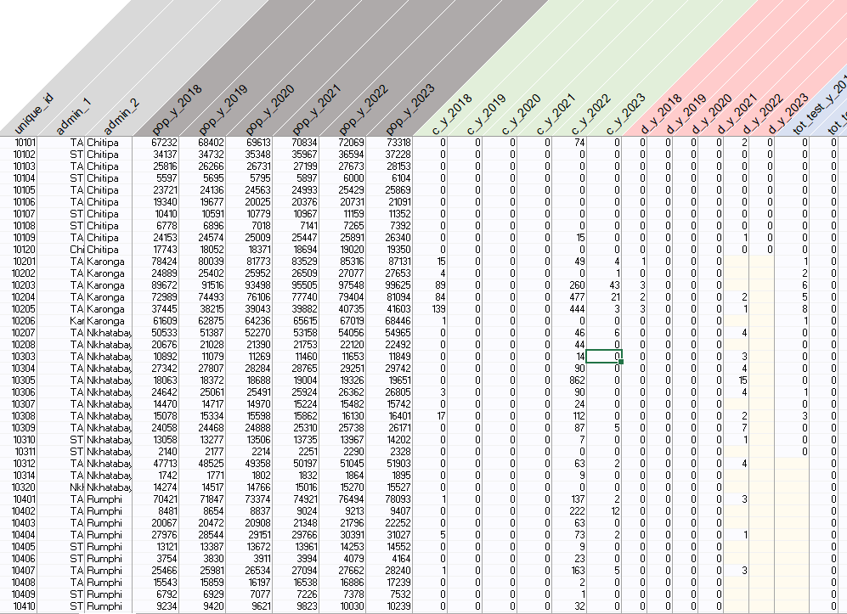
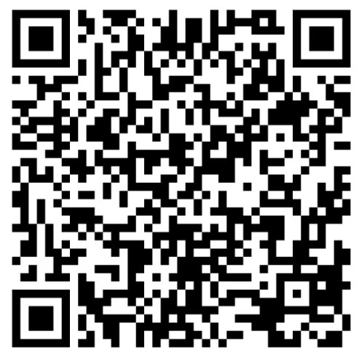
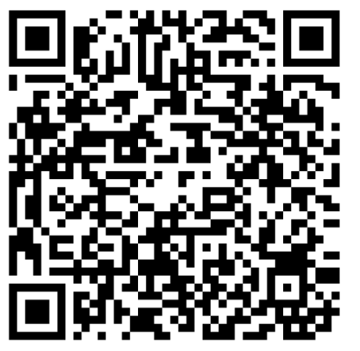
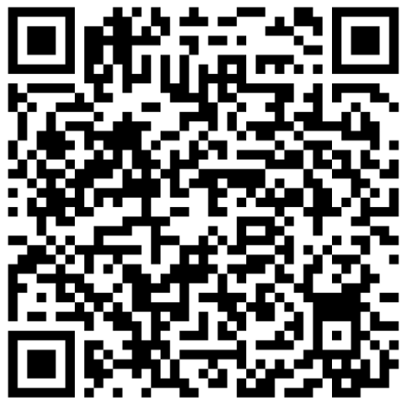
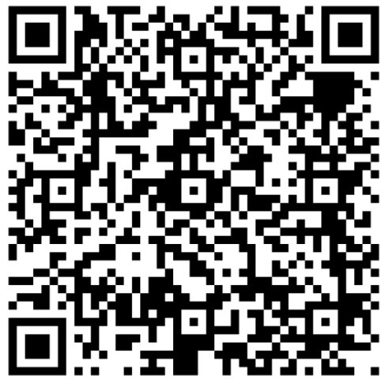
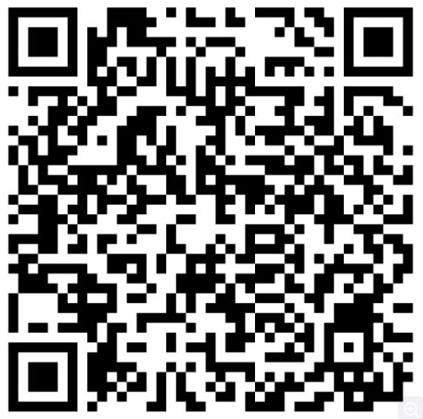
PAMIs for cholera control – Technical resources
https://tinyurl.com/PAMIcontrol
GTFCC method
PAMI Excel tool
User guide
Data model
Template report
Notes:
A comprehensive package of supporting material to identify PAMIs for cholera control is available on a dedicated GTFCC webpage at https://tinyurl.com/PAMIcontrol.
On this webpage, you will find a guidance document that describes the GTFCC method to identify PAMIs for cholera control.
An Excel tool which automatizes all calculations.
A user guide of this Excel tool.
A data model template that you should use to format your data before importing it in the PAMI Excel tool.
And a template report on PAMI identification that we encourage you to follow to prepare a comprehensive report on PAMI identification.
You can also access each document by scanning the QR codes at the bottom of your screen.

Slide 7

PAMIs for cholera elimination – Online course
https://tinyurl.com/coursePAMIelimination
Notes:
To learn more about the identification of PAMIs for cholera elimination, we warmly encourage you to take the dedicated GTFCC online course.

Slide 8
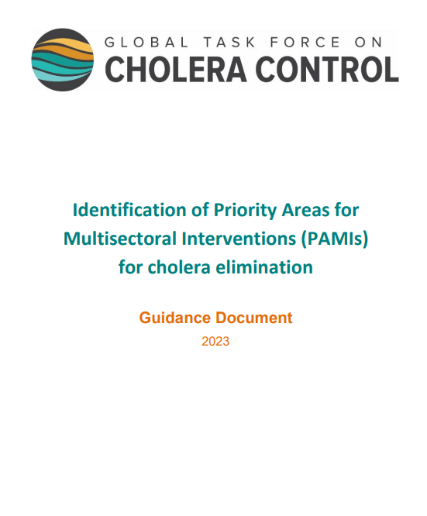
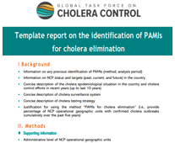
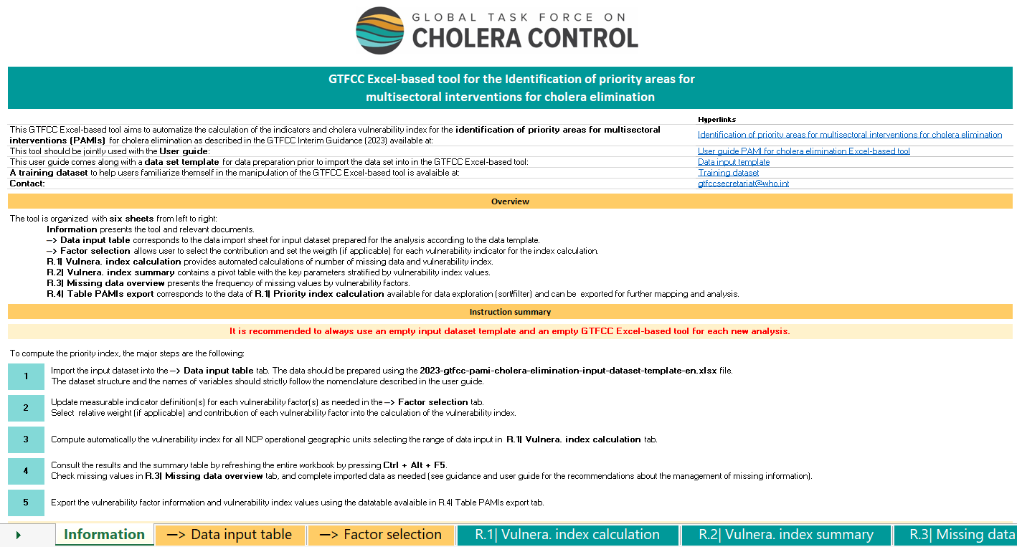
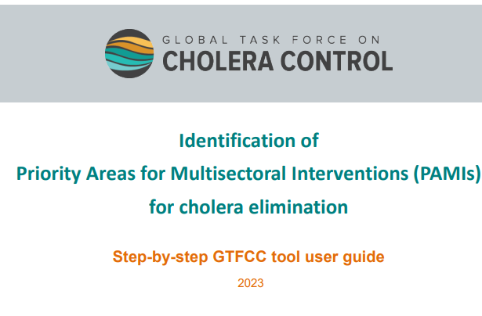
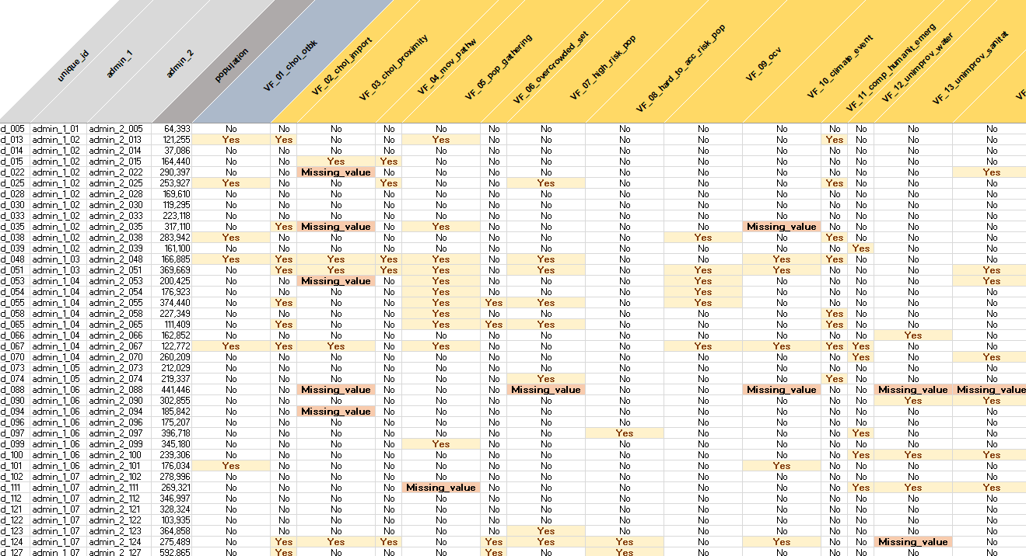
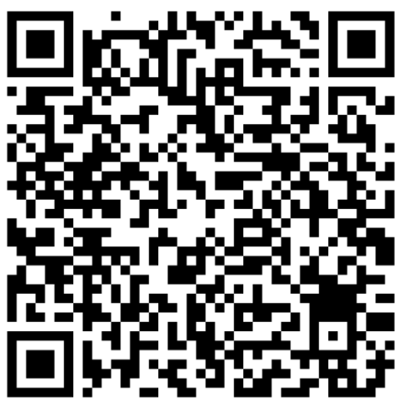
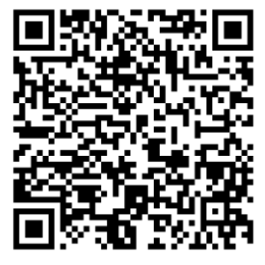
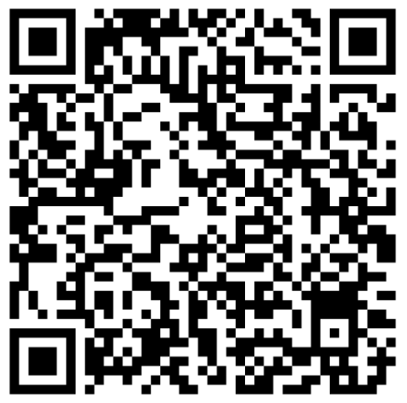
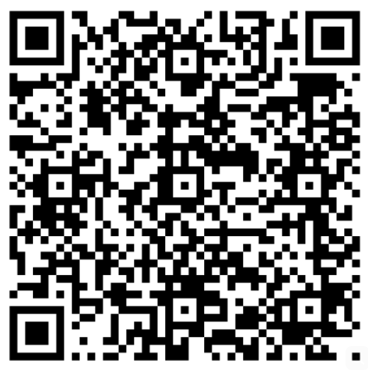
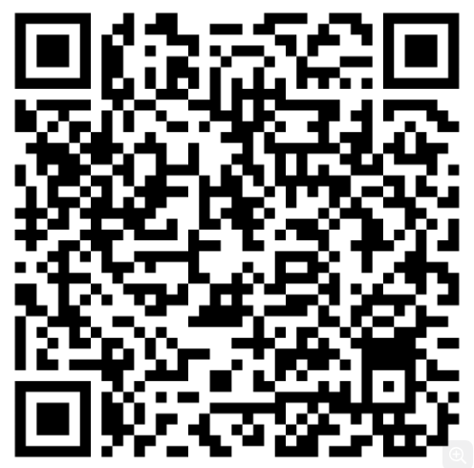
PAMIs for cholera elimination – Technical resources
https://tinyurl.com/PAMIelimination
GTFCC method
PAMI Excel tool
User guide
Data model
Template report
Notes:
A comprehensive package of supporting material to identify PAMIs for cholera elimination is available on a dedicated GTFCC webpage at https://tinyurl.com/PAMIelimination.
On this webpage, you will find a guidance document that describes the GTFCC method to identify PAMIs for cholera elimination.
An Excel tool which automatizes all calculations.
A user guide of this Excel tool.
A data model template that you should use to format your data before importing it in the PAMI Excel tool.
And a template report on PAMI identification that we encourage you to follow to prepare a comprehensive report on PAMI identification.
You can also access each document by scanning the QR codes at the bottom of your screen.

Slide 9
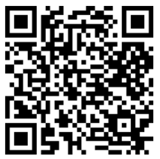
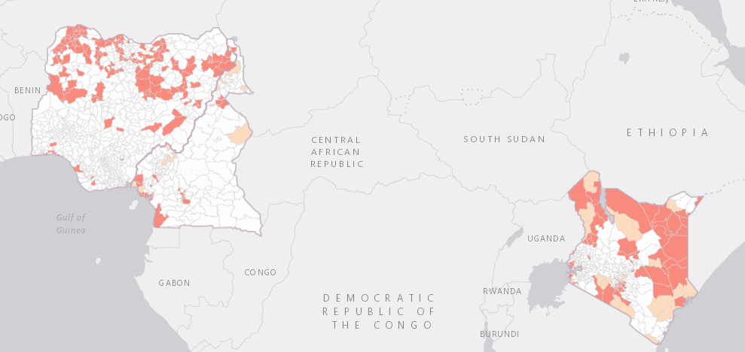
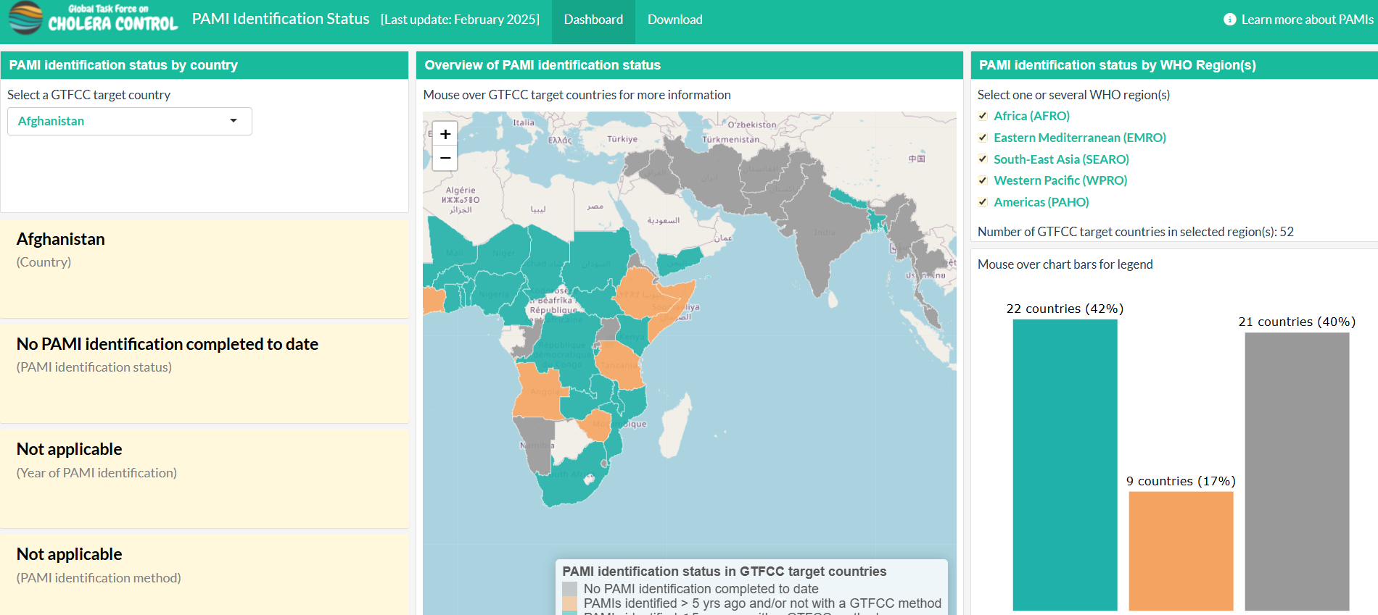

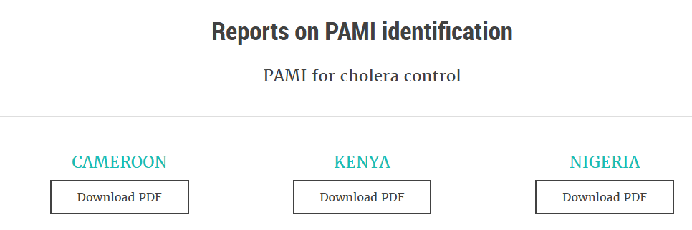

PAMIs in countries
https://tinyurl.com/PAMIcountry
Outcomes of PAMI identification
Status of PAMI identification
Contact the GTFCC Secretariat to:
Update the PAMI identification status of your country
Release the outcomes of PAMI identification
Notes:
Some information on PAMI identification in GTFCC target countries are available on a dedicated GTFCC webpage at https://tinyurl.com/PAMIcountry. You can also access this page by scanning this QR code.
On this webpage, you will find a global map of PAMIs as well as country reports on PAMI identification.
You will also find information on the status of PAMI identification in all GTFCC target countries.
Contact the GTFCC Secretariat to update the PAMI identification status of your country, to contribute to the global map of PAMIs by adding your country data, or to release your country report on PAMI identification.

Slide 10

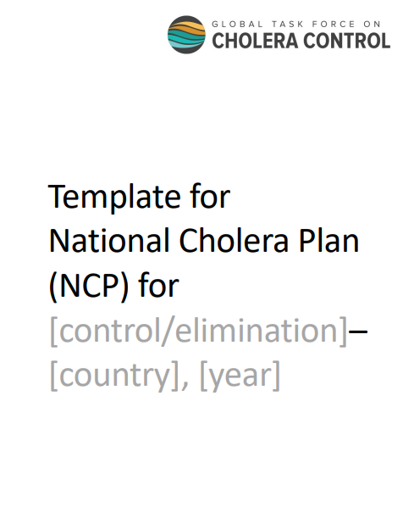

National Cholera Plans (NCPs)
https://www.gtfcc.org/resources/
Global Roadmap
NCP guidance
NCP template
Notes:
To learn more about the development of NCPs targeted to PAMIs, we encourage you to visit the resource section of the GTFCC website, where you will find multiple resources, including the Global Roadmap to End cholera, a guiding document to support countries for the development of their NCP, and an NCP template that we strongly encourage you to use.

Slide 11



Get additional support
For any question or for technical assistance to identify PAMIs,
contact the GTFCC Secretariat
GTFCCsecretariat@who.int
Notes:
For additional information or to request technical assistance to identify PAMIs, please contact the GTFCC Secretariat at GTFCCsecretariat@who.int; we are here to support you.

Slide 12

Notes:
We have now completed the last module! Thank you for taking this course. We hope that you found it useful.
We warmly invite you to continue to learn about PAMIs by taking the GTFCC online course on the identification of PAMIs for cholera control or the GTFCC online course on the identification of PAMIs for cholera elimination.

