Slide 1
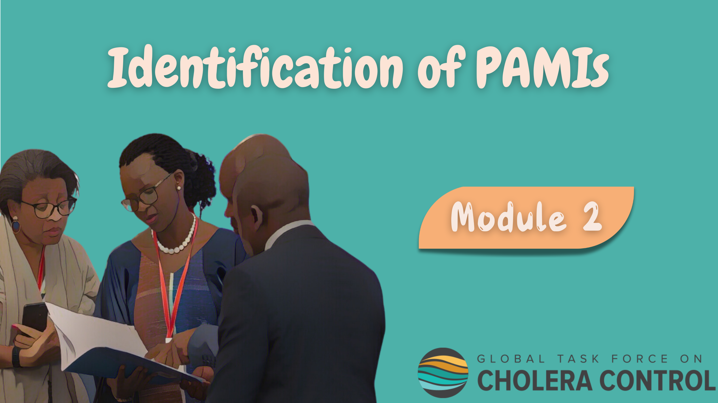
Notes:
Welcome to Module 2 of the GTFCC introduction course on the identification of Priority Areas for Multisectoral Interventions (PAMIs).

Slide 2

Notes:
In this module, we will walk you through key principles to identify PAMIs.

Slide 3
What will you learn?
Why there are two GTFCC methods to identify PAMIs
Which GTFCC method is applicable in your country
Key principles for decision-making on PAMIs
Main steps to identify PAMIs
How to plan ahead for PAMI identification
Notes:
After completing this module, you will be able to:
Understand why there are two GTFCC methods to identify PAMIs;
Determine which GTFCC method is applicable in your country depending on your cholera situation;
Understand the key principles for decision-making on PAMIs;
Describe the main steps to identify PAMIs;
Explain how to plan ahead for PAMI identification.

Slide 4
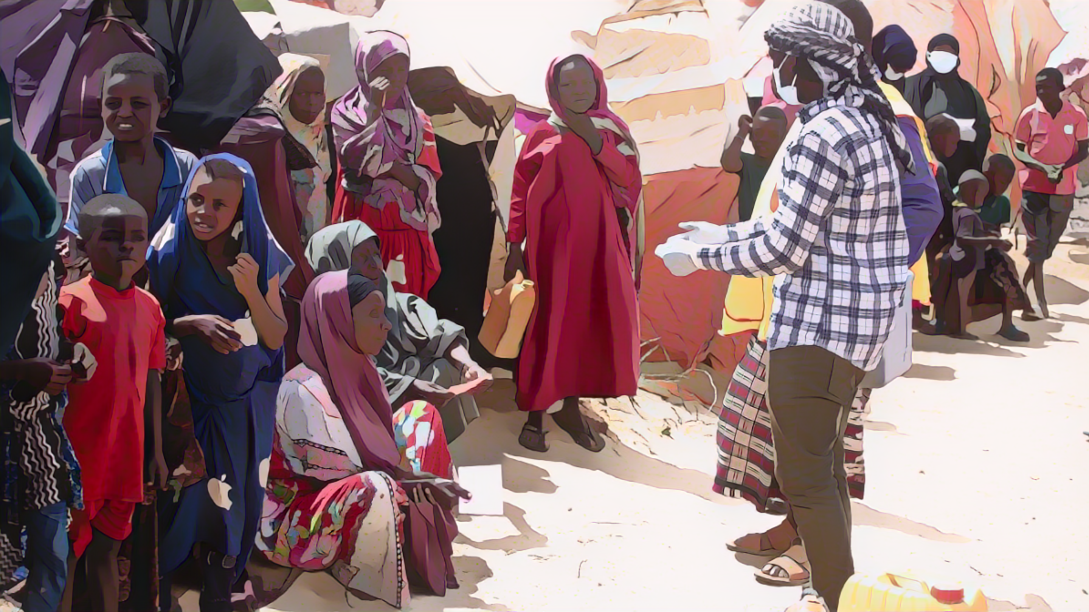
PAMIs for control or for elimination
Photo adapted from: WHO / Ismail Taxta
Notes:
Let’s see when to identify PAMIs for cholera control and when to identify PAMIs for cholera elimination, depending on the country cholera situation.

Slide 5

PAMIs for cholera control
For countries with moderate to high cholera transmission
Countries where ≥ 5% of the geographic units reported cholera in the past 5 years
  Aim at controling cholera with an NCP for control
  PAMIs for control are the geographic units with highest cholera burden
  Over time, these countries will progress from control towards elimination
Notes:
The identification of PAMIs for cholera control is for countries with moderate to high cholera transmission.
As a guiding principle, those are countries where more than 5% of the geographic units reported cholera outbreaks over the past five years.
In these countries, strategies against cholera should aim at controlling cholera with an NCP for cholera control.
In these countries, PAMIs are the geographic units that have had the highest cholera burden in recent years. The focus to identify PAMIs for control is on the cholera burden.
Over time, as progress are achieved to control cholera, these countries will progress towards an elimination objective.

Slide 6
PAMIs for cholera elimination
For countries with no to low cholera transmission
Countries where < 5% of the geographic units reported cholera in the past 5 years
  Aim at eliminating cholera with an NCP for elimination
  PAMIs for elimination are the geographic units most vulnerable to cholera (re)emergence
  As long as vulnerability factors for cholera persist, a risk of cholera (re)emergence remains
  A NCP for elimination is essential to eliminate cholera in a sustainable manner
Notes:
The identification of PAMIs for cholera elimination is for countries with no to low cholera transmission.
As a guiding principle, those are countries where less than 5% of the geographic units reported cholera outbreaks in recent years.
In these countries, strategies against cholera should aim at eliminating cholera.
In these countries, PAMIs are the geographic areas that are the most vulnerable to cholera reemergence. The focus to identify PAMIs for elimination is on vulnerability to cholera.
Implementing multisectoral interventions in PAMIs for elimination is essential to mitigate vulnerability to cholera reemergence in order to achieve cholera elimination in a sustainable manner.

Slide 7
PAMIs for control or elimination?
1. What is the level of geographic units
for PAMIs & the NCP?
2. What has been the cholera situation in these geographic units over the past 5 years?
This is the geographic level at which the NCP will be designed and implemented
This is country-specific
Typically, countries often select:
  Administrative level 2 (e.g., "districts")
or
  Administrative level 3 (e.g., “municipalities”)
Have ≥5% of the geographic units reported cholera in the past 5 years?
Yes
No
Advisable to identify PAMIs for control &
to develop an NCP for control
Advisable to identify PAMIs for elimination & to develop an NCP for elimination
Notes:
For a country to determine whether it should identify PAMIs for control or for elimination, the first step is for this country to determine the relevant geographic level of PAMIs in its specific context.
This is the geographic level at which multisectoral interventions against cholera set in the NCP will be designed and implemented. The corresponding level is country specific. Most often, countries select administrative level 2 which corresponds to the district level, or administrative level 3 which corresponds to the municipality level.
Once a country has determined the geographic level of PAMIs, the next step is to assess the percentage of geographic units where cholera was reported in the past 5 years.
As a guiding principle, if cholera was reported in more than 5% of the geographic units in the past 5 years, it is advisable to identify PAMIs for control in order to develop an NCP to control cholera.
On the other hand, if cholera was reported in less than 5% of the geographic units in the past 5 years, it is advisable to identify PAMIs for elimination to develop an NCP to eliminate cholera.

Slide 8

Principles for decision-making
Photo adapted from: WHO
Notes:
Let’s see the key principles that guide the decision-making on PAMIs.

Slide 9

Reminder from Module 1: Two phases
Principles for decision-making
Identification of PAMIs for control and for elimination follow the
same two phases and the same principles
Data-driven phase
Decision-making phase
Stakeholders from:
Multiple sectors
Multiple levels
Multiple organisations
Decide based on consensus on a country-specific threshold for the numeric index
  All geographic units with an index above this threshold are PAMIs
All geographic units of the country are scored according to a numeric index
This index aims to inform objective decision-making on PAMIs
  Calculated differently for PAMIs for control & for elimination
Notes:
The identification of PAMIs for control and of PAMIs for elimination follow the same two phases and the same principles to guide the decision-making on PAMIs.
The first phase is a data driven phase.
At this phase, all geographic units of the country are scored according to a numeric index. This numeric index is used to inform objective decision making on PAMIs, grounded on data.
How this numeric index is calculated is different to identify PAMIs for control and PAMIs for elimination.
The second phase is the actual decision-making phase on PAMIs, based on consensus.
At this phase, stakeholders from different sectors and representing multiple levels and multiple organizations decide in a participative manner and based on consensus on a threshold for the numeric index calculated at the first phase.
All geographic units that have an index value above this threshold are PAMIs.

Slide 10


Reminder from Module 1: Two phases
Principles for decision-making
Deciding on the index threshold requires to find the
best balance between the feasibility and the impact of the NCP
Threshold set low
Threshold set high
High number of PAMIs
Feasibility of the NCP
Low number of PAMIs
Impact of the NCP
Notes:
To decide on the index threshold, stakeholders must find the best balance between the feasibility and the public health impact of the NCP.
If the threshold is set low, many geographic units will be PAMIs. In that situation, the potential impact of the NCP may be high, however its feasibility may be challenging.
On the other hand, if the threshold is set high, very few geographic units will be PAMIs. In that situation, the feasibility of the NCP may be high, however its potential impact may be limited.
Overall, setting a threshold for the index is about finding the right balance between the feasibility and the impact of the NCP.

Slide 11
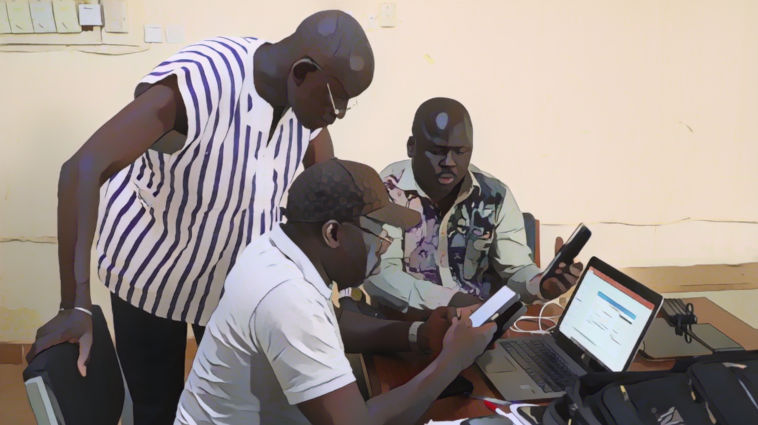
Steps and timelines
Photo adapted from: WHO/Francine Tchouta
Notes:
Identifying PAMIs requires careful planning. We will walk you through key considerations to plan PAMI identification smoothly.

Slide 12
Main steps
Inception
Engage and bring together key stakeholders
Define roles, responsibilities and timelines
Learn about the GTFCC PAMI identification methods & tools
Data compilation & calculations
Data driven phase
Compile and prepare the data to calculate the numeric index
Stakeholder validation
Decision making based on consensus phase
Organize a stakeholder consultation
An onsite workshop is recommended
Documentation
in a report
Write a report on PAMI identification
GTFCC review
Request a GTFCC PAMI review to receive independent technical feedback
Consider the feedback before planning interventions in PAMIs
Notes:
The PAMI identification process has five main steps.
First is the inception of PAMI identification. At this step, country stakeholders engage in PAMI identification and get organized for PAMI identification. They also study the GTFCC PAMI identification method and get familiar with the supporting material.
Then, comes the data driven phase with the compilation of data and the calculation of the numeric index.
This leads to the stakeholder validation phase for decision making on PAMIs based on consensus taking into account the numeric index. This requires a broad consultation of stakeholders and is best achieved in the form of an onsite workshop.
After this, PAMI identification is documented in a PAMI identification report.
Lastly, a GTFCC PAMI review is requested to receive independent technical feedback on PAMI identification.

Slide 13
Planning PAMI identification
PAMI identification usually takes ≈ 6 months
Month 1
Months 2 to 3
Month 4
Month 5
Month 6
Inception
Stakeholder validation
Documentation
GTFCC review
Data compilation and calculation
of index
Notes:
On average, completing all the PAMI identification steps takes about 6 months.
The first month is for the inception of PAMI identification.
On month 2 and 3, data are compiled, and the index is calculated.
On month 4, the stakeholder validation takes place.
On month 5, a comprehensive PAMI identification report is prepared.
Lastly, on month 6, an independent GTFCC PAMI review is performed.

Slide 14

Examples of next steps
Development of the NCP
Assess capacity for each cholera prevention & control pillar and identify priority gaps
Identify strategic objectives by pillar and define corresponding operational plans in PAMIs
Next
(+/-) Development of a multiyear Plan of Action (MYPOA) for preventive Oral Cholera Vaccination (OCV)
If relevant depending on the cholera situation and country strategy against cholera
Notes:
Upon completion of PAMI identification, the next step is to develop an NCP. Capacities in PAMIs are assessed for each cholera prevention and control pillar, and priority gaps are identified accordingly. This then serves to identify strategic objectives for each cholera prevention and control pillar and design operational plans in PAMIs accordingly.
In addition, countries which consider implementing preventive OCV, also have to develop a multiyear plan of action for preventive OCV.

Slide 15

Anticipate next steps
PAMI identification should be carefully planned
to ensure smooth articulation with next steps
Illustration for preventive OCV
PAMI identification takes about 6 months
Developing a multiyear Plan of Action (MYPOA) for preventive OCV takes about 6 months
There are fixed deadlines for submitting MYPOAs (3 submission windows per year)
It is advisable to start PAMI identification about 12 months before the MYPOA submission window targeted
Notes:
PAMI identification should be carefully planned in order to ensure smooth articulation with these next steps.
Let’s illustrate this with preventive OCV.
As we have seen, PAMI identification usually takes about 6 months.
Developing a multiyear plan of action for preventive OCV in PAMIs also takes about 6 months.
There are strict deadlines for countries to submit their multiyear plan of action for preventive OCV.
As a result, PAMI identification should be initiated about 12 months before the preventive OCV submission window targeted by the country.
This requires careful planning and anticipation.

Slide 16

Wrap up
PAMI identification for cholera control
For countries with moderate to high cholera transmission (≥ 5% of the geo units)
Based on the cholera burden
PAMI identification for cholera elimination
For countries with no to limited cholera transmission (<5% of the geo units)
Based on vulnerability to cholera
PAMI identification
Relies on consensus among country stakeholders using a numeric index to guide the decision-making
Takes about 6 months to complete which requires careful planning
Notes:
As we wrap up this module, here are the important points to remember.
PAMI identification for cholera control is for countries with moderate to high cholera transmission. As a guiding principle, these are countries where cholera outbreaks were reported in more than 5% of the geographic units over the past 5 years. PAMIs for control are the geographic units with the highest cholera burden in recent years.
PAMI identification for cholera elimination is for countries with no to limited cholera transmission. As a guiding principle, these are countries where cholera outbreaks were reported in less than 5% of the geographic units over the past 5 years. PAMIs for elimination are the geographic units that are the most vulnerable to cholera reemergence.
Decision making on PAMIs is achieved by consensus among country stakeholders using a numeric index to guide the decision making.
PAMI identification usually takes about 6 months to complete which requires careful planning.

Slide 17

Notes:
Before moving on to the next module, we encourage you to take a short quiz. There are four questions in this quiz.

Slide 18

Question 1
In a country, over the past 5 years, cholera outbreaks were reported in 27% of the geographic units.
What is the best approach in this country?
  This country should identify PAMIs for control and develop an NCP to control cholera
  This country should identify PAMIs for elimination and develop an NCP to eliminate cholera
Notes:
Question 1. In a country, over the past 5 years, cholera outbreaks were reported in 27% of the geographic units. What is the best approach in this country?
This country should identify PAMIs for control and develop an NCP to control cholera.
This country should identify PAMIs for elimination and develop an NCP to eliminate cholera.

Slide 19

Question 1 – Answer
In a country, over the past 5 years, cholera outbreaks were reported in 27% of the geographic units.
What is the best approach in this country?
  This country should identify PAMIs for control and develop an NCP to control cholera
  This country should identify PAMIs for elimination and develop an NCP to eliminate cholera
Notes:
The correct answer is a. Since cholera outbreaks were reported in more than 5% of the geographic units over the past 5 years, this country should identify PAMIs for control and develop an NCP to control cholera.

Slide 20
Question 2
In a country, over the past 5 years, cholera outbreaks were reported in 1% of the geographic units.
What is the best approach in this country?
  This country should identify PAMIs for control and develop an NCP to control cholera
  This country should identify PAMIs for elimination and develop an NCP to eliminate cholera
  Cholera is no longer a concern in this country, investing in multisectoral interventions would be dispendious
Notes:
Question 2. In a country, over the past 5 years, cholera outbreaks were reported in 1% of the geographic units. What is the best approach in this country?
This country should identify PAMIs for control and develop an NCP to control cholera.
This country should identify PAMIs for elimination and develop an NCP to eliminate cholera.
Cholera is no longer a concern in this country, investing in multisectoral interventions would be dispendious.

Slide 21
Question 2 – Answer
In a country, over the past 5 years, cholera outbreaks were reported in 1% of the geographic units.
What is the best approach in this country?
  This country should identify PAMIs for control and develop an NCP to control cholera
  This country should identify PAMIs for elimination and develop an NCP to eliminate cholera
  Cholera is no longer a concern in this country, investing in multisectoral interventions would be dispendious
Notes:
The correct answer is b. Since cholera outbreaks were reported in less than 5% of the geographic units over the past 5 years, this country should identify PAMIs for elimination and develop an NCP to eliminate cholera. Cholera remains a concern and a threat as long as vulnerability to cholera remains.

Slide 22
Question 3
How is the list of PAMIs determined in a country?
  Automatically based on the value of a numeric index
  With qualitative discussions and negotiations among political stakeholders
  Based on consensus among stakeholders taking into account a numeric index to guide objective decision-making
Notes:
Question 3. How is the list of PAMIs determined in a country?
Automatically based on the value of a numeric index.
With qualitative discussions and negotiations among political stakeholders.
Based on consensus among stakeholders taking into account a numeric index to guide objective decision-making.

Slide 23
Question 3 – Answer
How is the list of PAMIs determined in a country?
Automatically based on the value of a numeric index
With qualitative discussions and negotiations among political stakeholders
Based on consensus among stakeholders taking into account a numeric index to guide objective decision-making
Notes:
The correct answer is c. The list of PAMIs is determined based on consensus among stakeholders taking into account a numeric index to guide objective decision-making on PAMIs.

Slide 24
Question 4
How long does it take on average to complete PAMI identification?
  6 weeks
  6 months
  12 months
Notes:
Question 4. This is the last question. How long does it take on average to complete PAMI identification?
6 weeks
6 months
12 months

Slide 25
Question 4 – Answer
How long does it take on average to complete PAMI identification?
  6 weeks
  6 months
  12 months
Notes:
The correct answer is b. From inception of PAMI identification to completion of a GTFCC PAMI review, on average, PAMI identification takes about 6 months.

Slide 26

Notes:
We have now completed this module.

