Slide 1
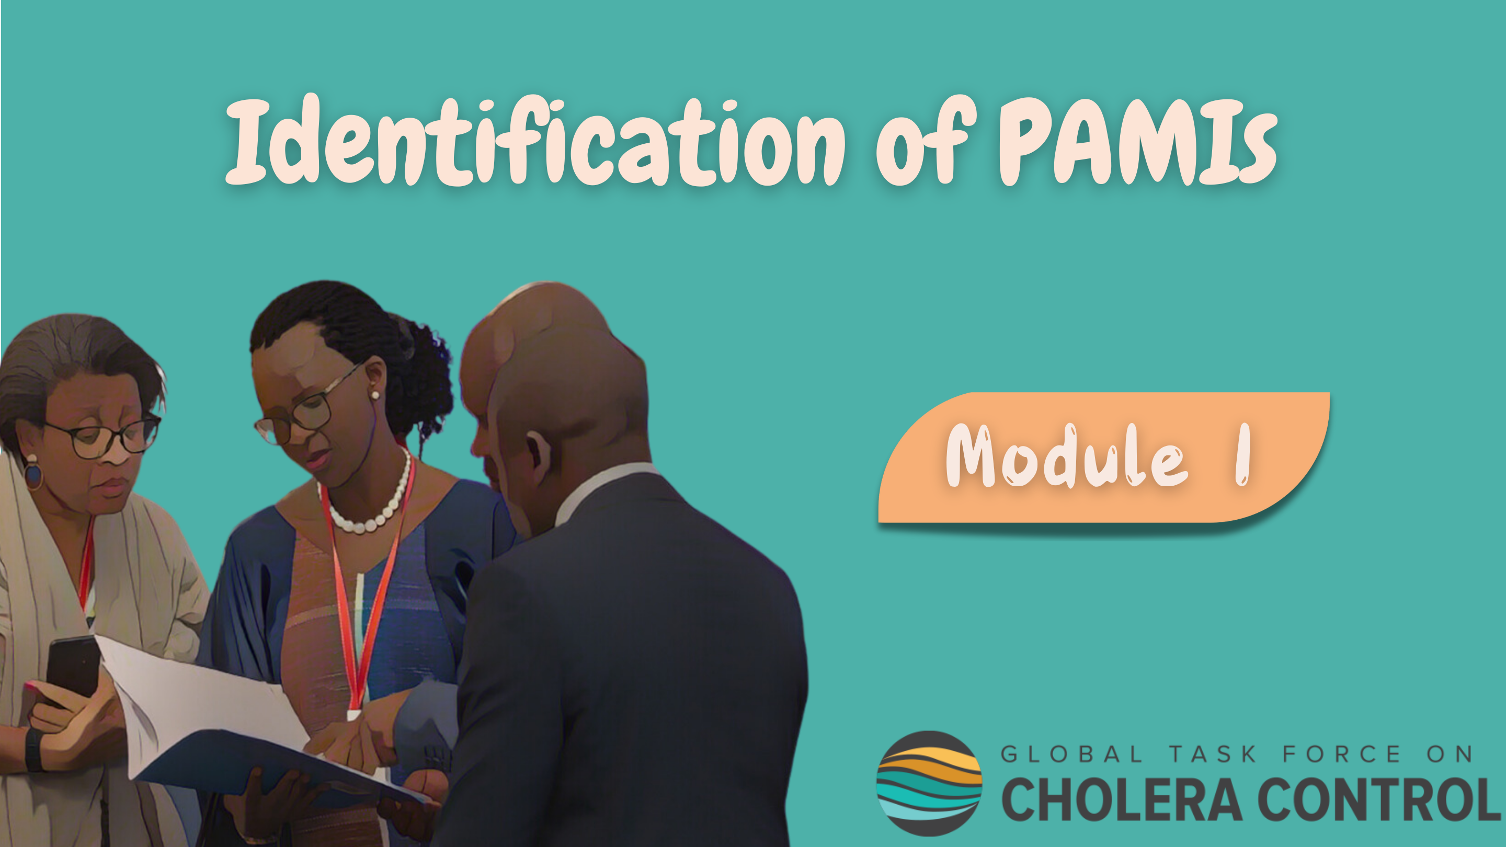
Notes:
Welcome to Module 1 of the GTFCC introduction course on the identification of Priority areas for multisectoral interventions, PAMIs.

Slide 2

Notes:
In this module, you will learn what PAMIs are, and what the overall purpose of PAMI identification is.

Slide 3

What will you learn?
What PAMIs are
How PAMI identification increases the effectiveness and the efficiency of mid to long term strategies against cholera
Key benefits of using GTFCC methods to identify PAMIs
Notes:
After completing this module, you will be able to:
Explain what PAMIs are;
Understand how PAMI identification increases the effectiveness and the efficiency of mid to long term strategies against cholera;
Describe the key benefits of using GTFCC methods to identify PAMIs.

Slide 4
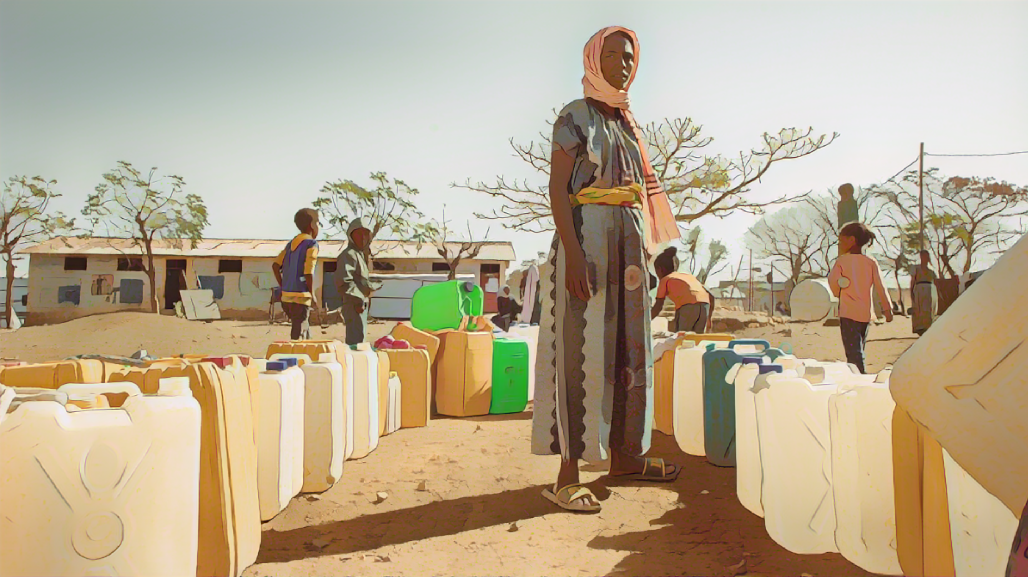
Mid to long term strategies against cholera
Photo adapted from: WHO / Nitsebiho Asrat
Notes:
Let’s see what mid to long term strategies against cholera are.

Slide 5
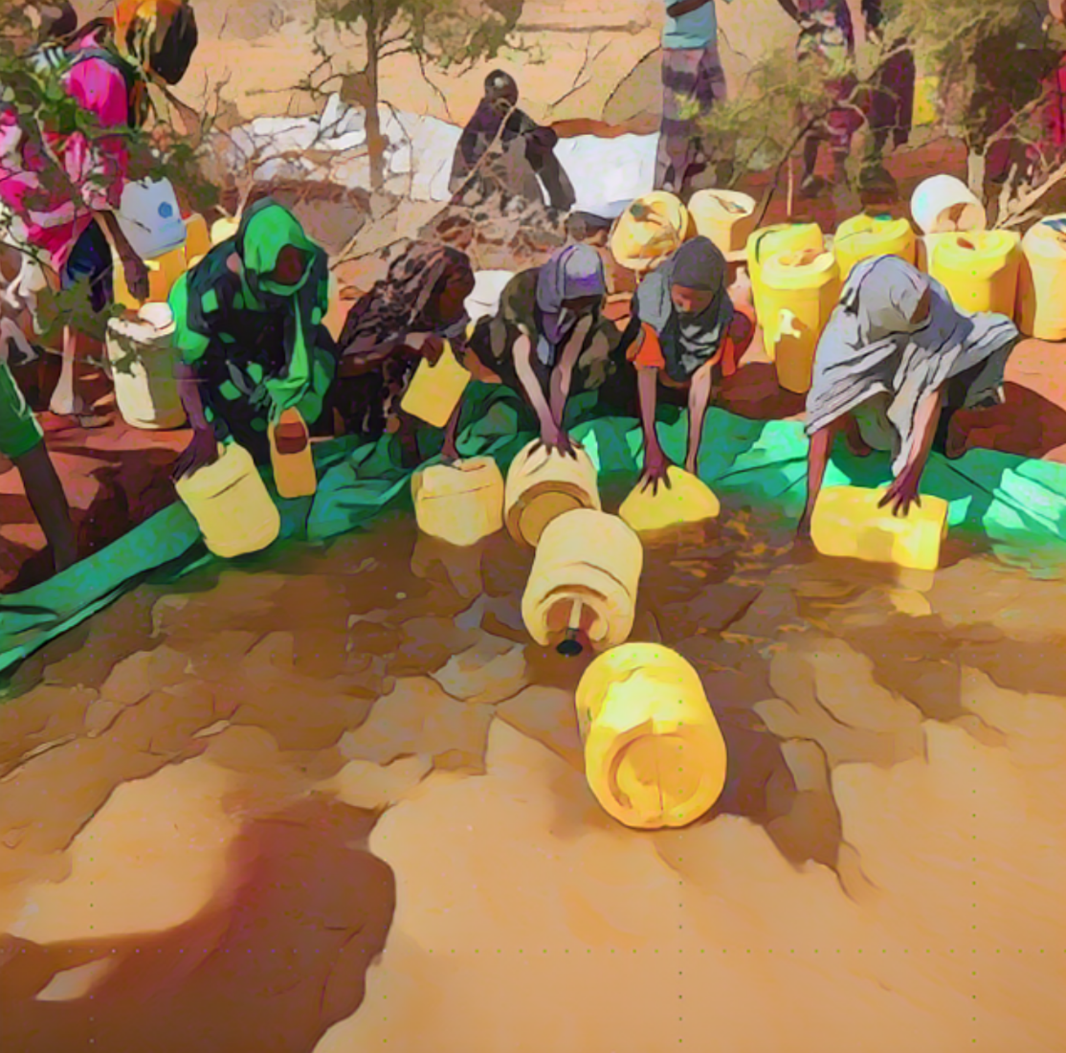
Cholera
Acute diarrhoeal disease
Spread through contaminated food and water
Can spread rapidly and cause large outbreaks
Preventable and treatable
Severe form of the disease can lead to dehydration and death within hours if not treated
Disproportionally impacts the poorest and most vulnerable populations with limited access to Water, Sanitation and Hygiene (WaSH)
Photo adapted from: WHO/Billy Miaron
Notes:
As a reminder, cholera is an acute diarrheal disease which spreads through contaminated food and water.
Cholera can spread rapidly and cause large outbreaks.
Although cholera is preventable and treatable, severe form of the disease can lead to dehydration and death within hours - if not treated.
Cholera is a marker of inequity. It disproportionally impacts the poorest and most vulnerable populations that have limited access to Water, Sanitation and Hygiene, WaSH.

Slide 6
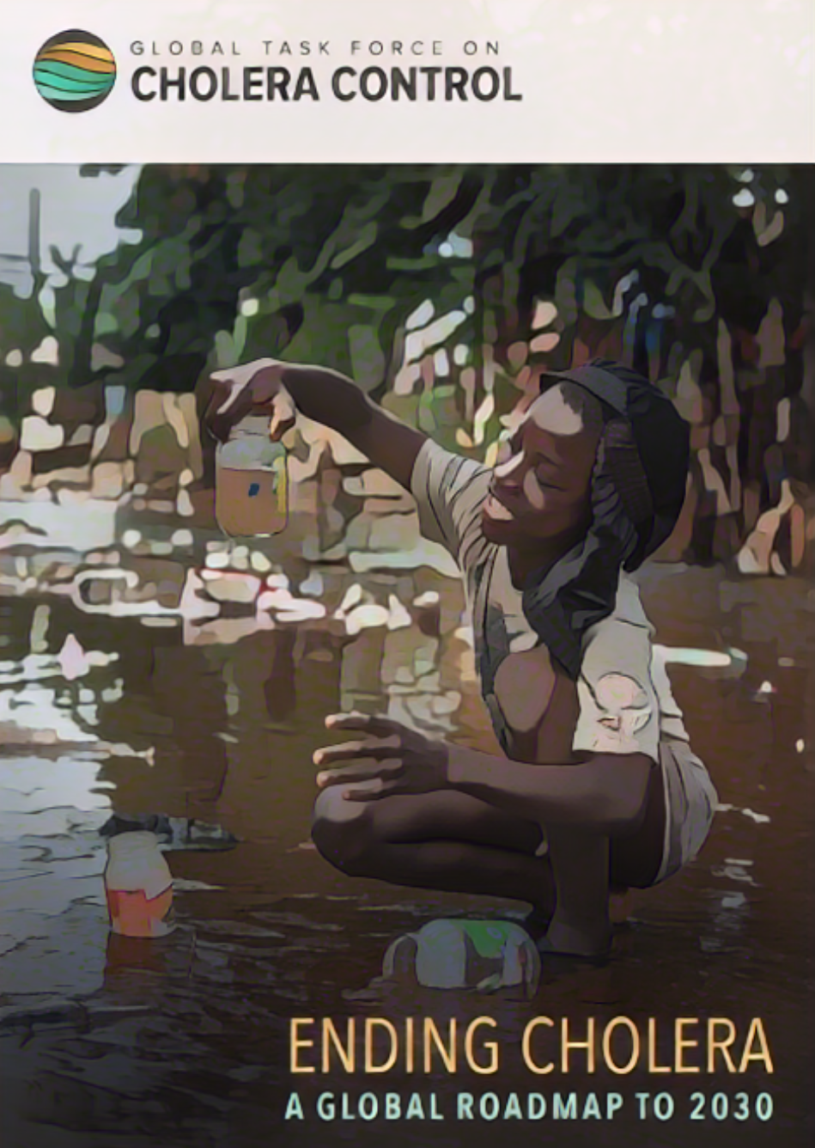

Global Roadmap
  Targets
  90% reduction in cholera deaths
  Cholera elimination in up to 20 cholera affected countries
  Strategies
  Multisectoral mid to long term strategies
  Spatially targeted to priority geographic areas
  Defined in National Cholera Plans (NCPs)
Notes:
In 2017, the Global Taskforce on Cholera Control, GTFCC, launched a Global Roadmap to End cholera. This Global Roadmap aims to achieve a 90% reduction in cholera deaths and cholera elimination in up to 20 cholera affected countries.
The Global Roadmap calls for multisectoral mid-to long term national strategies against cholera that are spatially targeted to priority geographic areas.
These targeted strategies against cholera are defined in National Cholera Plans (NCPs).

Slide 7
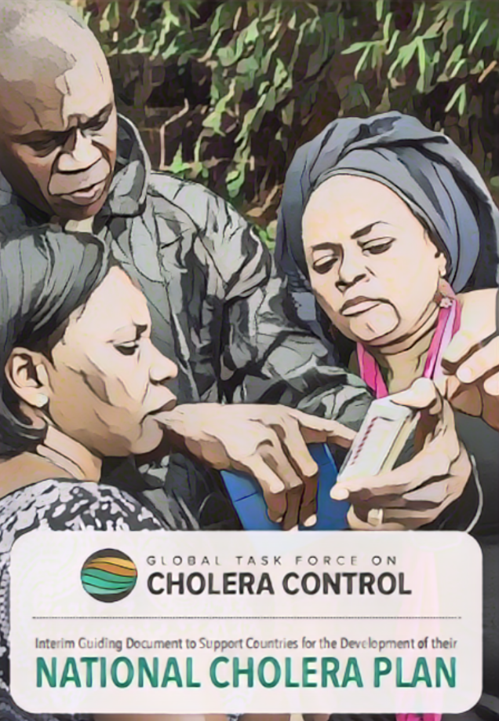
National Cholera Plans
All countries affected by cholera or at risk for cholera are urged to develop an NCP
An NCP is a country-specific and country-led plan
Sets objective and strategies against cholera for about the next 5 years
In countries where there is no to limited cholera transmission
An NCP is to eliminate cholera
In countries where there is moderate to high cholera transmission
An NCP is to control cholera
As progress are achieved to control cholera, those countries also progress towards an elimination objective
Notes:
All countries that are affected by cholera or that are at risk for cholera are urged to develop an NCP.
An NCP is a country specific plan. Its development and its implementation are led by each country.
An NCP sets the country’s objective and operational strategies against cholera for an implementation period of usually 5 years or so.
In countries where there is no to limited cholera transmission, an NCP aims to eliminate cholera.
In countries where there is moderate to high cholera transmission, an NCP aims to control cholera.
Over time, as these countries progress in controlling cholera with an effective NCP, they also progress towards an elimination objective.

Slide 8
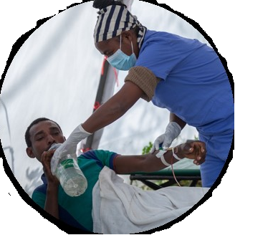

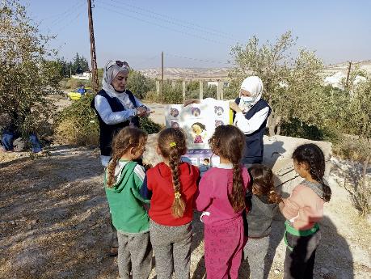
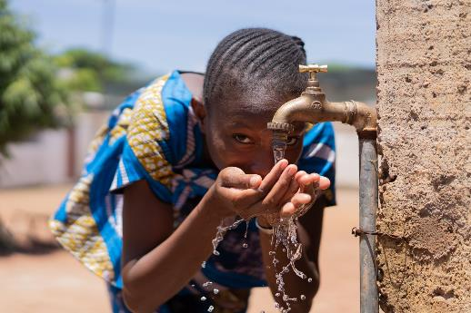
Multisectoral interventions
To be effective, strategies against cholera rely on multisectoral interventions
Case management
Oral Cholera Vaccine (OCV)
Community engagement
Surveillance
WaSH
Notes:
To be effective, strategies against cholera defined in NCPs must be multisectoral and include interventions across all cholera control and prevention pillars. These are: surveillance, case management, vaccination, community engagement and WASH.

Slide 9
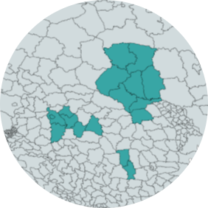
Priority geographic areas
To be efficient, multisectoral strategies against cholera
are targeted to priority geographic areas
Focus efforts and resources where they are expected to have the greatest public health impact
Priority Areas for Multisectoral Interventions (PAMIs)
Formerly referred to as “hotspots”
Notes:
To be efficient, multisectoral strategies against cholera defined in NCPs must be spatially targeted to priority geographic areas.
This is in order to focus efforts and resources against cholera in the geographic areas where multisectoral interventions are expected to have the greatest public health impact.
These geographic areas where strategies and efforts against cholera are focused are the PAMIs, the priority areas for multisectoral interventions against cholera.
In the past, you may have heard about PAMIs being referred to as cholera hotspots. Hotspot is an historical terminology; the underlying concept is similar to PAMIs.

Slide 10

Identification of PAMIs
Photo adapted from: WHO Mukhsindzhon Abidzhanov
Notes:
Let’s see when and how a country should identify PAMIs.

Slide 11


When to identify PAMIs?
PAMIs identification is among the first steps when a country engages in the NCP process
1
2
3
4
Inception
of NCP process
NCP development
NCP implementation
Monitoring of the implementation of the NCP
  1.a. Country commitment
  High level political, technical and financial engagement to control or eliminate cholera
  1.b. PAMI identification
Notes:
The identification of PAMIs is one of the first steps when a country engages in the development or in the update of its NCP.
The NCP process consists of four phases. First is the inception phase, then comes the phase to develop or update the NCP, which is followed by the implementation phase that is continuously monitored.
At the inception phase, country stakeholders commit to engage in cholera control or elimination with an NCP. This requires high level political, technical, and financial commitment. Once this commitment has been secured, the country can initiate to PAMI identification.

Slide 12

When to update PAMIs?
Countries should update PAMI identification ≈ every five years
Countries identify PAMIs when they develop a new version of an NCP (typically ≈ every five years)
Ensure that national strategies remains adequately targeted over time, as the cholera situation evolves
Earlier updates, if there are significant changes in the cholera situation or in vulnerabilities to cholera
Notes:
Typically, PAMI identification should be updated every five years.
An NCP usually has an implementation period of about five years. This means that an NCP should be updated roughly every five years. As countries update their NCP, they also update their PAMI identification. This ensures that strategies set in the updated NCP remain adequately targeted, as the country cholera situation evolves.
In addition, if during the NCP implementation period, there are significant changes in the cholera situation or in the country vulnerability to cholera, it is recommended to update PAMI identification before the term of the NCP implementation period.

Slide 13

How to identify PAMIs?
There are GTFCC methods to identify PAMIs
There are two GTFCC methods to identify PAMIs:
  One is for countries developing an NCP to control cholera
  The other one is for countries developing an NCP to eliminate cholera
Released in 2023, these two methods supersede all previous methods
Using GTFCC methods to identify PAMIs is a prerequisite
  To access OCV for preventive use
  For a country NCP to be endorsed by the GTFCC
Notes:
To identify PAMIs, countries should use the PAMI methods developed by the GTFCC.
There are two GTFCC methods to identify PAMIs. One is for countries aiming to develop or update an NCP to control cholera. The other method is for countries aiming to develop or update an NCP to eliminate cholera.
The GTFCC PAMI methods were released in 2023 and replaced all previous methods.
Importantly, using GTFCC methods to identify PAMIs is a prerequisite for countries to be able to access the Oral Cholera Vaccine for preventive use. It is also a prerequisite for countries to be able to have their NCP endorsed by the GTFCC.

Slide 14







Benefits of GTFCC PAMI methods
GTFCC methods to identify PAMIs are international standards
Using them come with advantages for countries
Data driven for informed decision making
Flexible to take into account local context and resources
Promote consensus
among stakeholders
Foster stakeholder engagement and buy-in for the NCP
Come with supporting material / easy to use
Assistance provided through the GTFCC network upon request
International recognition
Notes:
The GTFCC PAMI methods are international standards. Using these methods comes with major advantages for countries.
First, the GTFCC PAMI methods are data driven methods grounding decision making on PAMIs on the data to inform the decision-making.
In addition, the GTFCC PAMI methods offer some flexibility allowing each country to determine the best balance in its specific context between the feasibility of implementing multisectoral interventions in PAMIs versus the potential public health impact of the future NCP.
Decision making on PAMIs using GTFCC methods promotes consensus building among country stakeholders representing multiple sectors.
As a result, using GTFCC PAMI methods maximizes buy-in and multisectoral engagement in the NCP.
Furthermore, the GTFCC PAMI methods come with a broad package of supporting material making them easy to use.
Countries using GTFCC PAMI methods can also benefit from technical assistance through the network of GTFCC partners.
Lastly, the GTFCC PAMI methods are well recognized international standards, using them is a prerequisite for countries to be able to move forward smoothly in next steps following PAMI identification.

Slide 15
Wrap up
Countries can control and eliminate cholera with multisectoral strategies targeted to priority geographic areas
These areas are the Priority Areas for Multisectoral Interventions (PAMIs)
These strategies are defined in National Cholera Plans (NCPs)
PAMIs and NCPs should be updated periodically (≈ every 5 years)
PAMIs and NCPs can be for cholera control or cholera elimination
Countries should identify PAMIs using GTFCC methods
These methods are recognized internationally
Using a GTFCC PAMI method is a prerequisite to move forward smoothly in next steps (e.g., preventive use of Oral Cholera Vaccine, GTFCC endorsement of an NCP)
Notes:
As we wrap up this module, here are the important points to remember.
Countries can achieve cholera control or elimination with multisectoral strategies spatially targeted to priority geographic areas. These geographic areas are the PAMIs. These strategies are defined in NCPs.
The identification of PAMIs and the NCPs should be periodically updated. Typically, they are updated every five years.
Different methods apply to identify PAMIs depending on whether an NCP aims to control cholera or to eliminate cholera.
Countries should identify PAMIs using GTFCC PAMI methods. The GTFCC PAMI methods are well recognized international standards and using them is a prerequisite for countries to be able to move forward smoothly in the next steps of NCP development and implementation, for example accessing the oral cholera vaccine for preventive use or achieving GTFCC endorsement of their NCP.

Slide 16

Notes:
Before moving on to the next module, we encourage you to take a short quiz. There are three questions in this quiz.

Slide 17

Question 1
What is a National Cholera Plan (NCP)?
  An emergency plan for cholera outbreak response
  A long-term strategic plan to eradicate cholera
  c) A mid to long term actionable plan to control or eliminate cholera
Notes:
Question 1. What is a National Cholera Plan (NCP)?
An emergency plan for cholera outbreak response.
A long-term strategic plan to eradicate cholera.
A mid to long term actionable plan to control or eliminate cholera

Slide 18

Question 1 – Answer
What is a National Cholera Plan (NCP)?
  An emergency plan for cholera outbreak response
  A long-term strategic plan to eradicate cholera
  c) A mid to long term actionable plan to control or eliminate cholera
Notes:
The correct answer is c. An NCP is a mid to long term actionable plan to control or eliminate cholera.

Slide 19
Question 2
What are PAMIs?
  Geographic areas where multisectoral interventions against cholera are expected to have the greatest public health impact
  Geographic areas prioritized for emergency cholera response
  Geographic areas where cholera has recently been introduced
Notes:
Question 2. What are PAMIs?
Geographic areas where multisectoral interventions against cholera are expected to have the greatest public health impact.
Geographic areas prioritized for emergency cholera response.
Geographic areas where cholera has recently been introduced.

Slide 20
Question 2 – Answer
What are PAMIs?
  Geographic areas where multisectoral interventions against cholera are expected to have the greatest public health impact
  Geographic areas prioritized for emergency cholera response
  Geographic areas where cholera has recently been introduced
Notes:
The correct answer is a. PAMIs are the geographic areas where multisectoral interventions against cholera are expected to have the greatest public health impact.

Slide 21
Question 3
What does the acronym PAMI stand for in the context of cholera control and elimination?
  Primary Area for Measures Implementation
  Priority Area for Multisectoral Interventions
  Priority Area for Maximum Involvement
Notes:
Question 3. This is the last question. What does the acronym PAMIs stand for in the context of cholera control and elimination?
Primary Areas for Measures Implementation.
Priority Areas for Multisectoral Interventions.
Priority Areas for Maximum Involvement.

Slide 22
Question 3 – Answer
What does the acronym PAMI stand for in the context of cholera control and elimination?
  Primary Area for Measures Implementation
  Priority Area for Multisectoral Interventions
  Priority Area for Maximum Involvement
Notes:
The correct answer is b. PAMIs are Priority Areas for Multisectoral Interventions.

Slide 23
Notes:
We have now completed this module.

