Slide 1
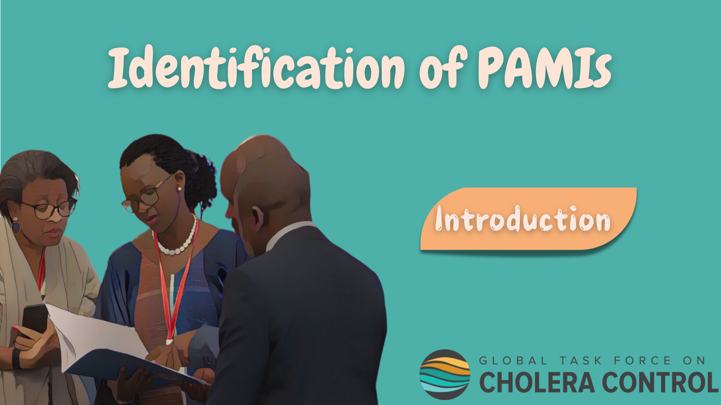
Notes:
Welcome to this GTFCC introduction course on the identification of Priority Areas for Multisectoral Interventions, PAMIs.

Slide 2
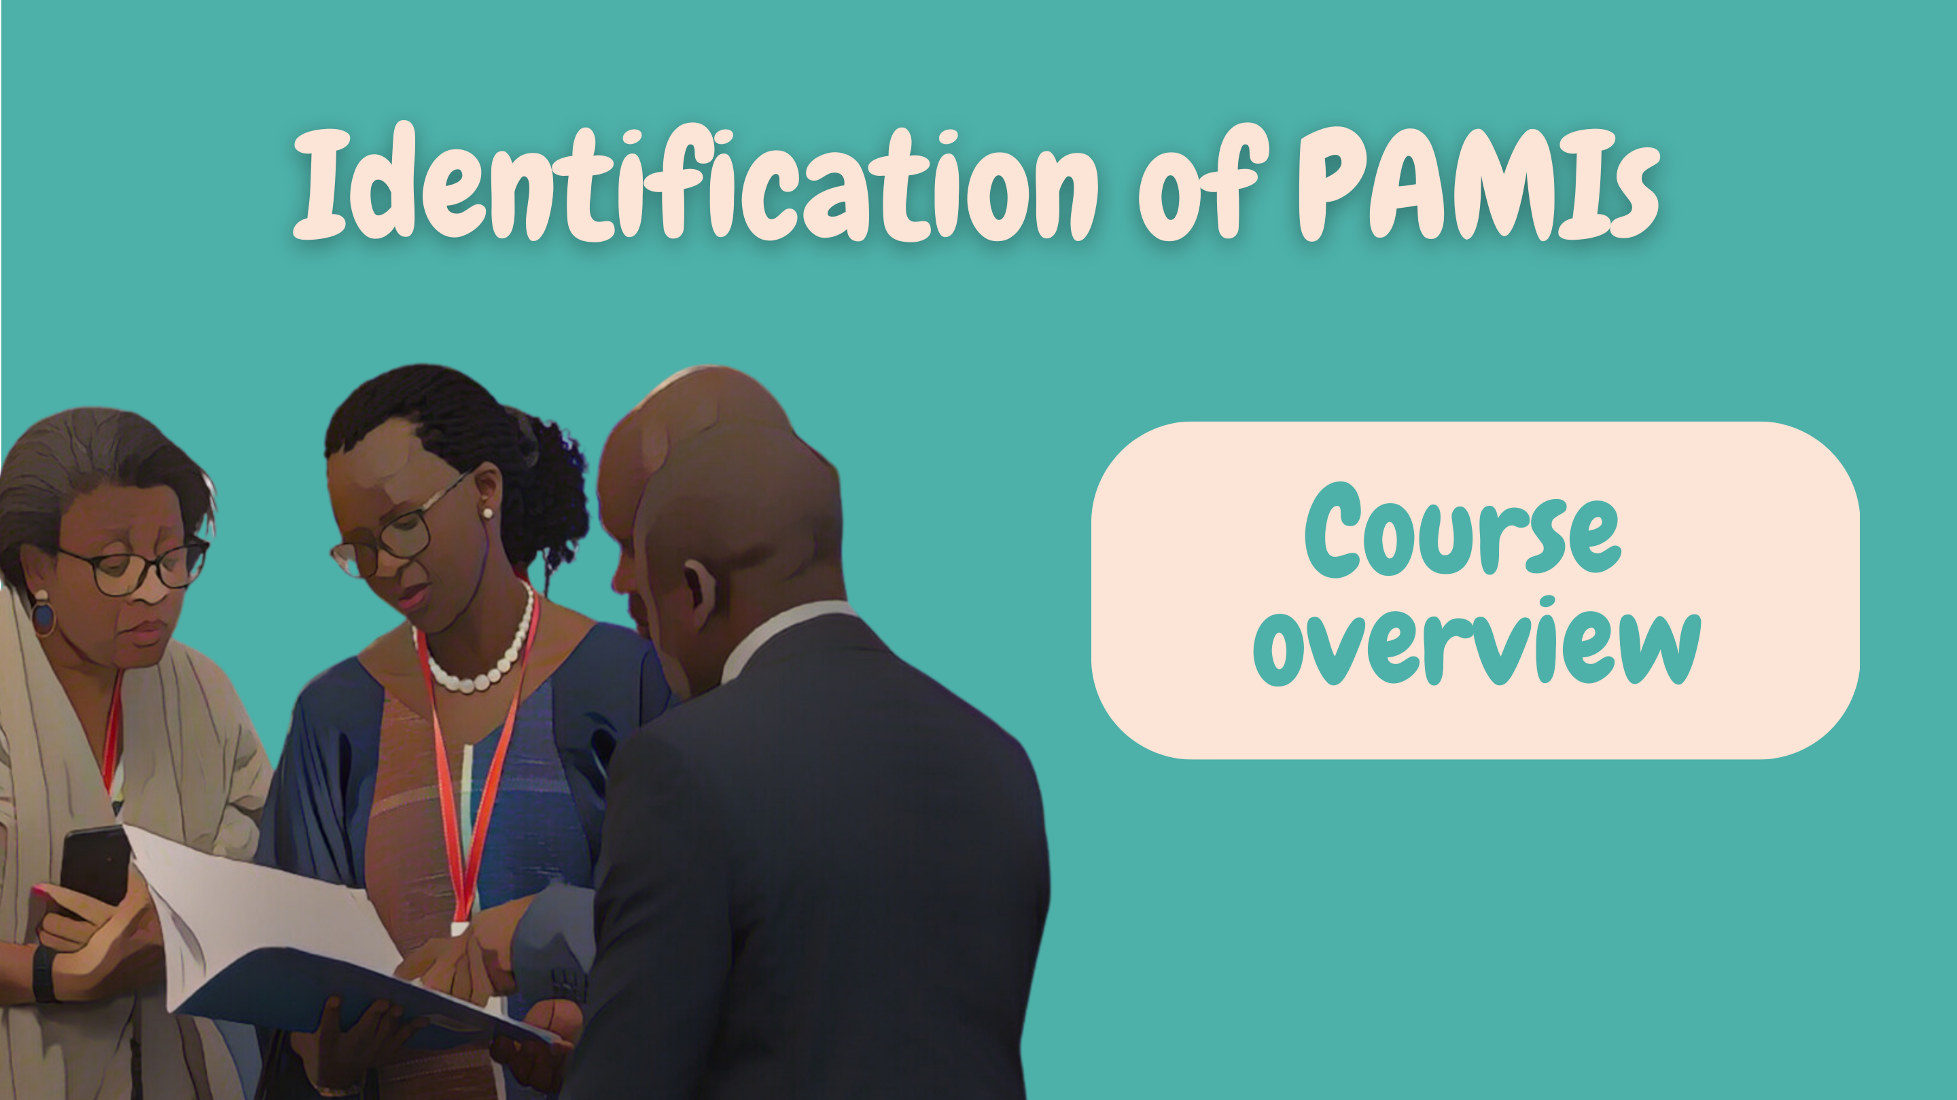
Notes:
This module provides an overview of the course, it will help you get ready to take the course.

Slide 3
Who is this course for?
High-level stakeholders
Engaged in developing or advising on strategies against cholera
(e.g., policy makers, national advisors)
Technical stakeholders
In charge of coordinating or conducting the identification of Priority Areas for Multisectoral Interventions (PAMIs)
(e.g., epidemiologists, data analysts)
Notes:
This course is for high level stakeholders who play a role in developing strategies against cholera or in advising the development of strategies against cholera. This is for example policy makers or national advisors.
Technical stakeholders involved in the identification of PAMIs will also greatly benefit from this course, for example epidemiologists or data analysts.

Slide 4
What will you learn?
How the identification of PAMIs increases the effectiveness & efficiency of mid to long term strategies against cholera
Which GTFCC PAMI method is applicable in your country
Key steps to identify PAMIs
How to plan for PAMI identification
Where to access supplementary online resources
Notes:
After completing all modules of this course, you will be able to:
Explain how identifying PAMIs is essential to increase the effectiveness and the efficiency of mid to long term strategies against cholera;
Determine which GTFCC PAMI method is applicable in your country;
Describe the key steps to identify PAMIs;
Explain how to plan for PAMI identification;
Access supplementary resources online.

Slide 5

What are the modules?
30’
10’
15’
5’
Module 1
What are the PAMIs?
Module 2
Key principles
Module 3
Supporting
material
Notes:
There are three modules in this course.
In Module 1, you will learn about what PAMIs are.
In Module 2, we will walk you through the key principles to identify PAMIs.
Lastly, in Module 3, we will show you where to access online material to identify PAMIs.
This course takes about 30 minutes to complete.

Slide 6



How to learn more?
After completing this course, continue to learn about PAMIs
PAMIs for cholera control
PAMIs for cholera elimination
https://tinyurl.com/coursePAMIcontrol
https://tinyurl.com/coursePAMIelimination
Notes:
After completing this course, we invite you to continue to learn about PAMI identification by taking the GTFCC online course on the identification of PAMIs for cholera control or the GTFCC online course on the identification of PAMIs for cholera elimination, depending on the cholera situation in your country and the PAMI identification method applicable in your context.

Slide 7

Notes:
We have now completed this brief introduction.

