Slide 1
Notes:
Welcome to Module 5 of the GTFCC online course on the identification of PAMIs for cholera elimination.

Slide 2
Notes:
In this module, we will walk you through how to document PAMI identification, and why to go through an external review of PAMI identification.

Slide 3
What will you learn?
Benefits of documenting PAMI identification
When to document PAMI identification
Benefits for countries of GTFCC PAMI reviews
When and how to request a GTFCC PAMI review
Notes:
After completing this module, you will be able to:
Explain the benefits of a thorough documentation of PAMI identification;
Describe when to document PAMI identification;
Explain the benefits for countries of GTFCC PAMI reviews;
Describe when and how to request a GTFCC PAMI review.

Slide 4
Documentation
of PAMI Identification
Photo adapted from: WHO/Alexia Dickinson
Notes:
Let’s start with the documentation of PAMI identification.

Slide 5
Why to document PAMI identification?
Critical analysis
Take a step back to reflect on potential weakness or gaps
Correct them
Traceability
Traceability of method used, decisions, justifications
Reference material for country stakeholders
Notes:
There are key benefits in documenting PAMI identification.
The preparation of the documentation is an opportunity to take a step back and reflect in a critical manner on what has been done or is being done. If any potential weakness or gap is identified, it can then be corrected.
In addition, comprehensive documentation is also essential for traceability. As part of the documentation process, the method used, the decisions made and the justifications for these decisions are recorded. This is particularly useful for future reference.

Slide 6
When to document PAMI identification?
Near real time
To make any necessary improvements in a reactive manner
To avoid losing sight of some discussions and justifications
Initiate the documentation process right from the beginning
and finalize it rapidly after stakeholder validation
Notes:
The recommended approach to document PAMI identification is to do it near real time as opposed to documenting it on completion. This offers major benefits.
First, documenting each step while it is being undertaken allows for near real time improvement as needed. If the documentation is only initiated at the end of PAMI identification, any weakness or gap revealed through the documentation process would be much more difficult to correct.
In addition, documenting each step near real time avoid losing sight of important information.
Overall, it is recommended to initiate the documentation of PAMI identification right from the beginning and to finalize it rapidly after the stakeholder validation.

Slide 7
Document package
Report on PAMI identification
Filled PAMI Excel tool
Map of PAMIs
PAMIs due to the occurrence of cholera outbreaks
PAMIs based on vulnerability index
Notes:
The documentation on PAMI identification should include at a minimum:
A report on PAMI identification,
The filled PAMI Excel tool,
A map showing PAMIs due to the occurrence of cholera outbreaks in recent years and PAMIs based on the vulnerability index.

Slide 8
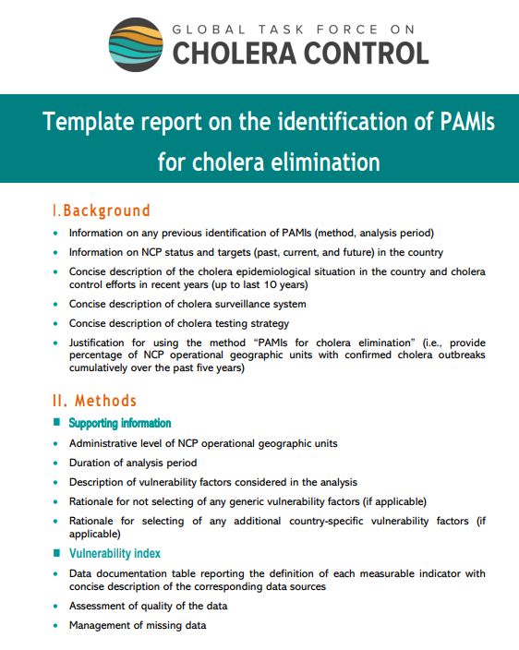
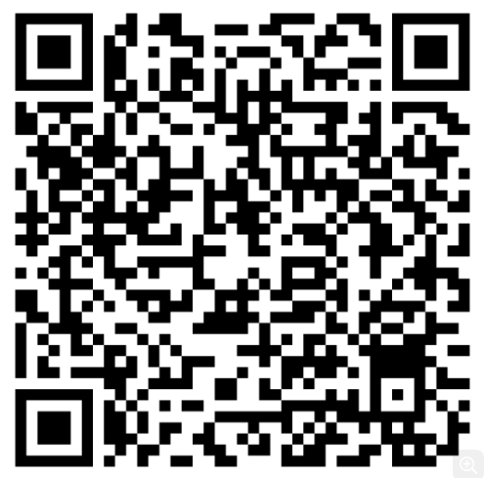
PAMI identification report
Follow the outline of the GTFCC template report
The GTFCC template report is a checklist to
ensure all critical points are covered
Methods
Dataset
Vulnerability index calculation
Stakeholder validation
Outcomes
List of PAMIs due to cholera outbreaks
Vulnerability index threshold
List of PAMIs based on vulnerability index
Final list of PAMIs
Notes:
To prepare a comprehensive report on PAMI identification, we encourage you to follow the outline of the GTFCC template report. You can access this template by scanning this QR code.
Overall, this template report corresponds to a checklist to make sure all critical points are addressed including the methods such as characteristics of the dataset, calculation of the vulnerability index, organization of the stakeholder validation, and the outcomes of PAMI identification such as the list of PAMIs by default due to the occurrence of cholera outbreaks in recent years, the vulnerability index threshold selected and the rationale for selecting this threshold; the list of PAMIs based on their vulnerability index, and the final list of PAMIs.

Slide 9
GTFCC
PAMI reviews
Photo adapted from: WHO
Notes:
Let’s look into external reviews of PAMI identification, also called “GTFCC PAMI reviews”.

Slide 10
What are GTFCC PAMI reviews?
Independent technical reviews:
Upon request of National Authorities
By experts of the GTFCC
Using standard criteria
To determine whether:
PAMI identification was performed in accordance with the GTFCC PAMI method
Any deviations from this method have reasonable technical justifications
Notes:
GTFCC PAMI reviews are independent technical reviews.
They are performed upon request of National Authorities by experts of the GTFCC using standard criteria.
They aim to determine whether PAMI identification was performed in accordance with the GTFCC PAMI method and to ensure that deviations from this method, if any, have reasonable technical justifications.

Slide 11
Benefits of GTFCC PAMI reviews
The identification of PAMIs is to target strategies to eliminate cholera
GTFCC PAMI reviews are an opportunity for countries to receive
Independent technical feedback
Practical and constructive advice and recommendations
In a spirit of partnership against cholera, to support countries in maximizing the effectiveness and efficiency of their NCP
Feedback and recommendations are not prescriptive
Notes:
The identification of PAMIs is of critical importance to target effective and efficient multisectoral strategies to eliminate cholera.
GTFCC PAMI reviews are an opportunity for countries to receive independent technical feedback as well as practical and constructive advice and recommendations.
This is offered to countries in a spirit of partnership to End Cholera in order to support countries in maximizing the effectiveness and efficiency of their NCP.
The feedback and recommendations provided through GTFCC PAMI reviews are not prescriptive; they are for the country consideration.

Slide 12
Countries
The GTFCC supports all countries equally.
Any country that identified PAMIs is welcome to request a GTFCC PAMI review
GTFCC PAMI reviews are mandatory for any country which considers:
Submitting its NCP for GTFCC endorsement
Implementing preventive OCV
Other countries are encouraged to request a GTFCC PAMI review
Notes:
The GTFCC supports all countries equally. Therefore, any country that identified PAMIs is welcome to request a review.
In addition, for countries which consider submitting their NCP for GTFCC endorsement or implementing preventive OCV, GTFCC PAMI reviews are formally mandatory.
Other countries are warmly encouraged to request a review as well, although this is not mandatory for them.

Slide 13
When to request a review?
Request a review as soon as the documentation of PAMI identification is completed
Before planning interventions in PAMIs
Country stakeholders consider feedback / recommendations
Country completes PAMI identification up to documentation
GTFCC performs PAMI review
Country plans interventions in PAMIs
Country submits updated material for review
(optional)
Notes:
A GTFCC PAMI review should be requested as soon as the documentation of PAMI identification is completed, before planning interventions in PAMIs. That way, it is easier for countries to take into account any feedback or recommendations arising from the review.
Here is how the process looks like.
As soon as documenting PAMI identification is completed, countries request a GTFCC PAMI review. Country stakeholders consider the feedback and any recommendation arising from the review. They make adjustments accordingly as needed, and may then submit updated material for a second round of review. When the list of PAMIs has been refined and consolidated as needed, countries then move to designing intervention strategies in PAMIs.

Slide 14
How to request a review?
To request a GTFCC PAMI review
Send a request to: GTFCCsecretariat@who.int
Attach to your request
Report on PAMI identification
Filled PAMI Excel tool
List and map of PAMIs
Feel free to use your national language
The material for review does not have to be in English
It can be in your national language
Notes:
To request a GTFCC PAMI review, simply contact the GTFCC Secretariat at GTFCCsecretariat@who.int.
Attach to your request your PAMI identification report, the filled PAMI Excel tool, the final list of PAMIs, and a map of PAMIs.
You may provide this material in your national language; it is not mandatory to provide it in English.

Slide 15
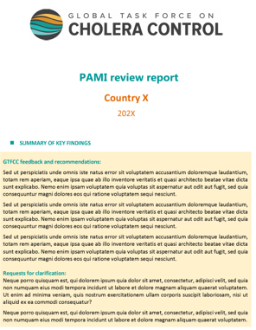
Outcome
A GTFCC PAMI review report is provided within about 30 days
Consider the GTFCC feedback/recommendations
Refine the list of PAMIs in consultation with multisectoral stakeholders as relevant
Optionally, submit updated material for another GTFCC review
Use this report as documentary evidence
Attach your GTFCC PAMI review report to:
Your multiyear plan of action for preventive OCV (if applicable)
Your NCP (if submitted for GTFCC endorsement)
Notes:
You will receive the outcome of the review within about 30 days in the form of a report.
You are encouraged to consider the GTFCC feedback and recommendations to refine the list of PAMIs accordingly in consultation with multisectoral stakeholders.
You may submit the updated material for a second round of review.
You will also use this report as documentary evidence to support your application for preventive OCV and to support your request for GTFCC endorsement of your NCP.

Slide 16
Wrap up
Documentation
Documenting PAMI identification near real time helps identify potential issues and correct them to improve the outcomes of PAMI identification
A GTFCC template report is available to prepare a comprehensive report on PAMI identification
Review
Upon request, the GTFCC performs PAMI reviews to support countries in maximizing the effectiveness and efficiency of their multisectoral strategies against cholera
It is recommended to request a PAMI review before planning interventions in PAMIs
PAMI reviews are mandatory for countries considering submitting their NCP for GTFCC endorsement and/or implementing preventive OCV
Notes:
As we wrap up this module, here are the important points to remember.
Documenting PAMI identification near real time provides insights to identify potential issues and correct them throughout the process to improve the outcomes of PAMI identification.
A GTFCC template report is available, use it to prepare a comprehensive report on PAMI identification.
Upon request, the GTFCC performs PAMI reviews to support countries in maximizing the effectiveness and efficiency of their multisectoral strategies to eliminate cholera.
It is recommended to request a PAMI review before planning interventions in PAMIs.
PAMI reviews are mandatory for countries which consider submitting their NCP for GTFCC endorsement or implementing preventive OCV.

Slide 17
Notes:
Before completing this module, we encourage you to take a short quiz. There are three questions in this quiz.

Slide 18
Question 1
When is it preferable to initiate the documentation of PAMI identification?
Once PAMI identification is completed so that all components are solidified
As soon as PAMI identification is initiated to document the process near real time
Notes:
Question 1. When is it preferable to initiate the documentation of PAMI identification?
a) Once PAMI identification is completed so that all components are solidified.
b) As soon as PAMI identification is initiated to document the process near real time.

Slide 19
Question 1 – Answer
When is it preferable to initiate the documentation of PAMI identification?
Once PAMI identification is completed so that all components are solidified
As soon as PAMI identification is initiated to document the process near real time
Notes:
The correct answer is b. It is preferable to initiate the documentation of PAMI identification as soon as PAMI identification is initiated in order to document the process near real time.

Slide 20
Question 2
Which countries can benefit from a GTFCC PAMI review?
Only countries considering implementing preventive OCV and/or submitting their NCP for GTFCC endorsement can benefit from a GTFCC PAMI review
GTFCC PAMI reviews are offered to any country that has identified PAMIs
Notes:
Question 2. Which countries can benefit from a GTFCC PAMI review?
a) Only countries considering implementing preventive OCV and/or submitting their NCP for GTFCC endorsement can benefit from a GTFCC PAMI review.
b) GTFCC PAMI reviews are offered to any country that has identified PAMIs.

Slide 21
Question 2 – Answer
Which countries can benefit from a GTFCC PAMI review?
Only countries considering implementing preventive OCV and/or submitting their NCP for GTFCC endorsement can benefit from a GTFCC PAMI review
GTFCC PAMI reviews are offered to any country that has identified PAMIs
Notes:
The correct answer is b. Any country that has identified PAMIs can benefit from a GTFCC PAMI review.

Slide 22
Question 3
When is it preferable to request a GTFCC PAMI review?
Rapidly after PAMI identification is completed before planning interventions in PAMIs to facilitate any finetuning in the list of PAMIs as relevant
At the same time as a multiyear plan of action for preventive OCV is submitted or an NCP is submitted for GTFCC endorsement so that all review steps are combined into one
Notes:
Question 3. This is the last question. When is it preferable to request a GTFCC PAMI review?
a) Rapidly after PAMI identification is completed before planning interventions in PAMIs to facilitate any finetuning in the list of PAMIs as relevant.
b) At the same time as an NCP is submitted for GTFCC endorsement so that all review steps are combined into one.

Slide 23
Question 3 - Answer
When is it preferable to request a GTFCC PAMI review?
Rapidly after PAMI identification is completed before planning interventions in PAMIs to facilitate any finetuning in the list of PAMIs as relevant
At the same time as a multiyear plan of action for preventive OCV is submitted or an NCP is submitted for GTFCC endorsement so that all review steps are combined into one
Notes:
The correct answer is a. It is recommended to request a GTFCC PAMI review rapidly after PAMI identification is completed before planning interventions in PAMIs in order to facilitate any finetuning in the list of PAMIs as relevant.

Slide 24
Notes:
We have now completed the last module of the GTFCC online course on the identification of PAMIs for cholera elimination. Thank you for completing this course. We hope that you found it useful.

