Slide 1
Notes:
Welcome to Module 3 of the GTFCC online course on the identification of PAMIs for cholera elimination.

Slide 2
Notes:
In this module, we will show you the PAMI Excel tool, and how to use it.

Slide 3
What will you learn?
Structure and main functions of the PAMI Excel tool
How to upload data in the PAMI Excel tool
How to process calculations in the PAMI Excel tool
How to interpret the outputs generated by the PAMI Excel tool
Notes:
After completing this module, you will be able to:
Describe the structure and the main functions of the PAMI Excel tool;
Upload data in the PAMI Excel tool;
Process calculations in the PAMI Excel tool;
And, interpret the outputs generated by the PAMI Excel tool.

Slide 4
PAMI Excel tool
Automatizes all calculations for the identification of PAMIs
Generates summary outputs for discussion at the stakeholder validation
Notes:
The PAMI Excel tool is here to help you identify PAMIs for cholera elimination. It automatizes all calculations and it generates summary outputs for discussion at the stakeholder validation.

Slide 5
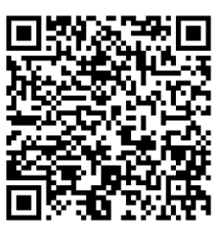
Getting ready
Get ready to manipulate the PAMI Excel tool
Make sure to use Windows
The PAMI Excel tool operates under Windows operating system
1. Get the PAMI Excel Tool
2. Get a dataset to manipulate
3. Have the user guide on hand
Identification Tool
Training dataset
User Guide
https://tinyurl.com/PAMIelimination
Notes:
We encourage you to manipulate the PAMI Excel tool while you are following this module. Let’s get ready for this!
First, the PAMI Excel tool operates under Windows. Make sure you have access to an operating system that is compatible.
Then, make sure you have on hands the PAMI Excel tool, a training dataset to manipulate, and the user guide of the Excel tool.
You can download this material online at https://tinyurl.com/PAMIelimination.
You can also access each document by scanning these QR codes.
With this material on hand, you will be able to follow along throughout this module. Do not hesitate to pause the video as needed to explore the tool and practice using it on your own.

Slide 6
Explore the
PAMI Excel tool
Photo adapted from: WHO / Andrew Esiebo
Notes:
To get started, we are going to quickly walk you through the different sheets of the Excel tool.

Slide 7
Overview of the PAMI Excel tool
Sheet Information
“Read me”
Provides access to reference documents
Provides tips for using the tool
Notes:
The first sheet of the PAMI Excel tool is called “Information”. Basically, this is a ReadMe sheet where you will find links to reference documents and tips regarding how to use the tool.

Slide 8
Overview of the PAMI Excel tool
Sheet Data input table
This is where to upload your data
Reminder from Module 2
Data should be formatted in accordance with the data model template
before upload
Notes:
The next sheet of the PAMI Excel tool is called “Data input table”. This is the sheet where you are going to upload your data for analysis. For the tool to compute the calculations, your data should be formatted in accordance with the GTFCC data model template.

Slide 9
Overview of the PAMI Excel tool
Sheet Factor selection
This is where to set the parameters for the calculations
Notes:
The next sheet of the PAMI Excel tool is called “Factor selection”, this is where you will set the parameters for the calculation of the vulnerability index.

Slide 10
Overview of the PAMI Excel tool
Sheet R.1 | Vulnera. index calculation
This is where all calculations are performed
Notes:
The following sheet of the PAMI Excel tool is called R1 “Vulnerability index calculation”. This is the sheet where all calculations are performed.

Slide 11
Overview of the PAMI Excel tool
Sheets R.2 to R.4
This is where to find the outputs
Each sheet displays different outputs to:
interpret calculations
inform decision-making on PAMIs
Notes:
The last sheets of the PAMI Excel tool are called respectively: R2 “Vulnerability index summary”, R3 “Missing data overview”, R4 “Table PAMI export”. These three sheets display outputs of the PAMI analysis.

Slide 12
Upload data in the PAMI Excel tool
Photo adapted from: WHO / Fabeha Monir
Notes:
To run a PAMI analysis, you have to upload and process your data in the PAMI Excel tool. Let’s see how to do this.

Slide 13
Prepare for the upload
Make sure your data is formatted in accordance with the PAMI data model template
Learn about the data model template in Module 2
Save a local copy of the PAMI Excel tool
If there is a "Protected View" banner, click "Enable Editing"
Notes:
Before using the PAMI Excel tool, make sure that your dataset is formatted in accordance with the PAMI data model template. If you are unsure about what the PAMI data model template is, we encourage you to go back to Module 2 of this course before you continue exploring the PAMI Excel tool.
Save a local copy of the PAMI Excel tool and open it.
If there is a yellow banner which indicates “protected view” when opening the PAMI Excel tool, click “enable editing”.

Slide 14
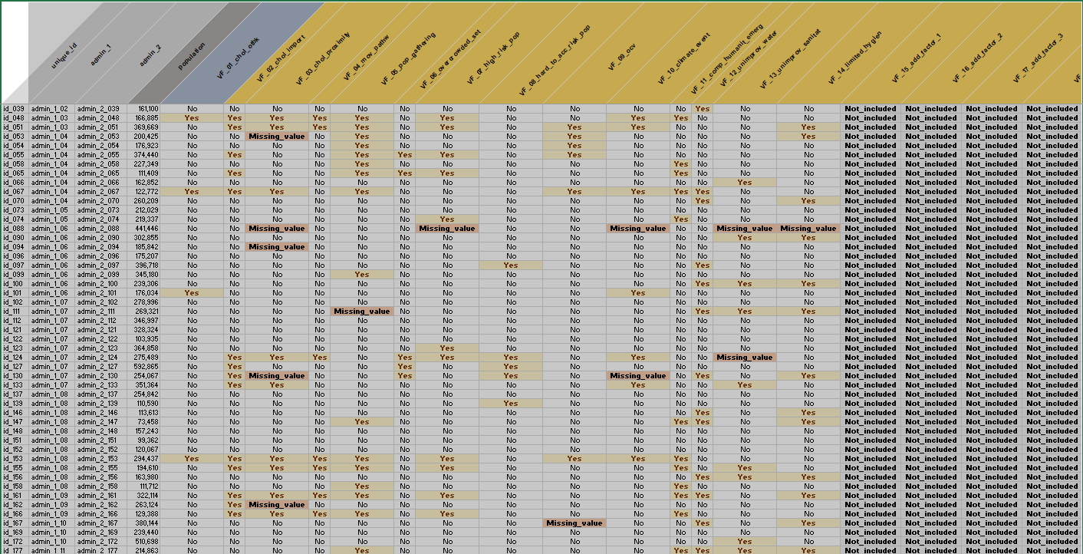
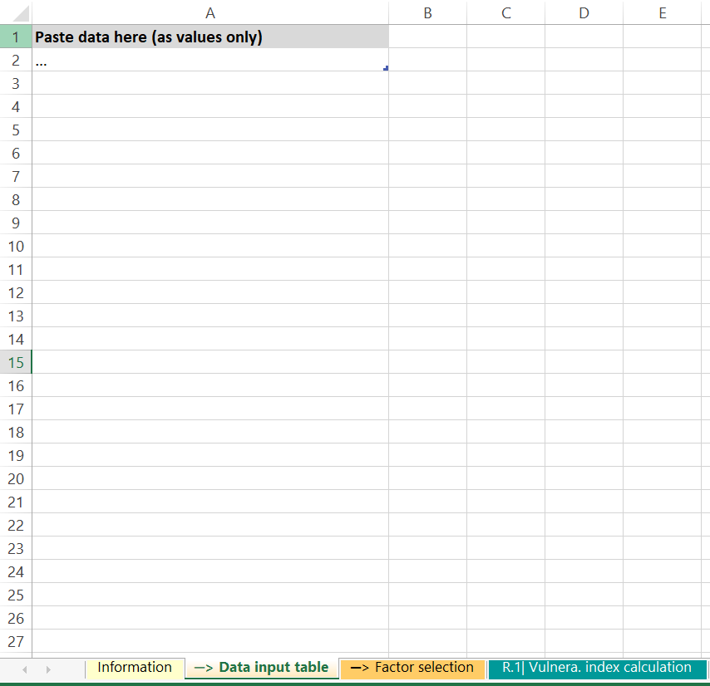
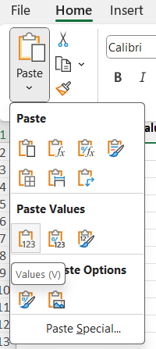
Upload the data
1
Copy your dataset
In your dataset file
Select the entire data range (ctrl +A)
Copy it (ctrl + C)
2
Paste your dataset in the tool
2
In the PAMI Excel tool
In the sheet Data input table
In the grey Cell A1
Paste the data as values only
1
2
3
3
1
Notes:
To upload your data in the PAMI Excel tool, first select and copy your dataset. Press Ctrl + A to select all your data, then press Ctrl + C to copy it.
Next, open the PAMI Excel tool, and go to the sheet “Data input table”.
Go to the grey cell A1, and paste your data as values only.

Slide 15
Set parameters for the calculations
Sheet Factor selection
3
Define measurable indicators
Record the definition of:
Measurable vulnerability indicators
Additional vulnerability factors (if applicable)
4
Select the vulnerability factors to be included
If any generic vulnerability factor is not relevant, exclude it
If any additional vulnerability factor is considered, include it
5
Optionnally, set weights
If justified in the country-specific context, adjust the weights
Notes:
Then, go to the sheet “Factor selection”.
For record keeping and traceability, it is good practice to record the definition of measurable vulnerability indicators as well as the definition of any additional vulnerability factor included in the analysis as applicable.
To do so, fill the columns “vulnerability factors” and “measurable indicators”.
Then, in the column, “selection of factors in the vulnerability index”, select the inclusion status of each vulnerability factor. For example, if any vulnerability factor from the GTFCC indicative list of generic vulnerability factor is not relevant in your country specific context, exclude it from the analysis.
Likewise, if any additional vulnerability factors not included in the GTFCC indicative list of generic vulnerability factors is relevant in your country, make sure to include it in the analysis.
Lastly, and this is optional, if justified in your country specific context, you may set weights to some vulnerability factors. To do so, use the column “indicator weight”.

Slide 16
Include all geo units
6
Include all geo units in the calculations
Check the number of rows with data in the sheet Data input table
In the sheet R.1| Vulnera. index calculation select the data in the first row
Drag down the selection until the number of rows with data in the sheet R.1 is the same as the number of rows with data in the Data input table
Notes:
The next step is to include all the geographic units of your dataset in the calculations.
Check how many rows are filled with data in the sheet “data input table”, then go to Sheet R1 “Vulnerability index calculation”.
In Sheet R1, you will see that calculations have been performed for one row. These are calculations for the first geographic unit of your dataset.
To expand the calculations to all the geographic units of your dataset, select the data in the 1st row.
Then drag down the selection until the number of rows filled with data in the sheet R1 is the same as the number of rows filled with data in the sheet Data input table.
This expands the calculations to all the geographic units of your dataset.

Slide 17
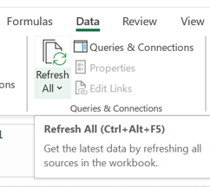
Process the calculations
7
« Refresh » to launch the calculations
Go to the Excel Data tab and click Refresh All
Notes:
Once all geographic units of your dataset have been included in the calculations, the last step is to process the calculations. To do so, in the Excel Data tab, click “Refresh all”.
Now, all PAMI calculations have been performed on your dataset, and outputs have been generated.

Slide 18
Go through
the outputs
Photo adapted from: WHO / Andrew Esiebo
Notes:
Let’s go through the different outputs generated by the PAMI Excel tool.

Slide 19
What is in sheet R.1?
Calculation sheet
All indicators to identify PAMIs are calculated in this sheet
For each row (=each geo unit)
Whether it is an initial PAMI due to the occurrence of cholera outbreaks
Number of vulnerability factors with missing value
Vulnerability index
Notes:
Sheet R1 “Vulnerability index calculation” is a calculation sheet where the following is assessed for each geographic unit of your dataset:
Whether it is a PAMI based on the occurrence of confirmed cholera outbreaks in recent years;
The number of vulnerability factors with missing value;
The vulnerability index.

Slide 20
How to use Sheet R.1?
Do not manipulate nor modify the sheet R.1
Calculations in the sheet R1 are used as the source of data for calculating all outputs (sheets R2 to R4)
Manipulations in the sheet R.1 may interfere with the outputs
Use the sheet R.4 instead
Sheet R.4 shows the same variables as sheet R.1
To sort/manipulate/explore the variables displayed in the sheet R1, use the sheet R4
Notes:
As R1 is a calculation sheet, we recommend you do not manipulate the outputs displayed in sheet R1 in order not to interfere with the calculations.
Instead, sheet R4 of the PAMI Excel tool, Table PAMI export, shows similar outputs and can be manipulated as needed.

Slide 21
What is in sheet R.2?
Proxy on the feasibility of interventions in PAMIs
1
Initial PAMIs
Due to the occurrence of cholera outbreaks in recent years
PAMIs depending on vulnerability index
Geo units
# and % of geo units that are PAMIs
2
3
Population
# and % of population in geo units that are PAMIs
2
3
1
Notes:
Sheet R2 “vulnerability index summary” provides essential figures for discussion at the stakeholder validation, in particular proxy on the feasibility of interventions in PAMIs
The table in sheet R2 provides summary figures on initial PAMIs. These are the geographic units that are PAMIs by default due to the occurrence of cholera outbreaks in recent years.
This table also provides relative and cumulative figures by vulnerability index value.
Cumulative figures on geographic units and on population are proxy to assess the feasibility of the NCP if the vulnerability index threshold was the selected table line.

Slide 22
How to read sheet R.2?
Illustration
If the vulnerability index threshold is set to ≥ 6
27 geo units are PAMIs (accounting for 27% of the geo units)
Population in PAMIs: 619,740 (30% of the population)
Notes:
For example, using fictive data from a training dataset, here is how to read the table displayed in sheet R2. If the vulnerability index threshold was set to 6, then 27 geographic units would be PAMIs (including 20 initial PAMIs) representing in total 27% of the geographic units of the country. The population in PAMIs would be 619,740, accounting for 30% of the country population.

Slide 23
How to use Sheet R.2?
Figures in the sheet R.2 are used to set the vulnerability index threshold
Explore and discuss different threshold scenario at the stakeholder validation for setting the vulnerability index threshold
Determine the best balance between feasibility and impact
Document how the vulnerability index was selected in the report on PAMI identification
Notes:
The table in sheet R2 is used to decide how to set the vulnerability index threshold.
Different scenarios for the vulnerability index threshold are presented at the stakeholder validation and are discussed in a participative manner for stakeholders to determine the best balance between the feasibility and the potential impact of the NCP.
This table can also be included in your report on PAMI identification.

Slide 24
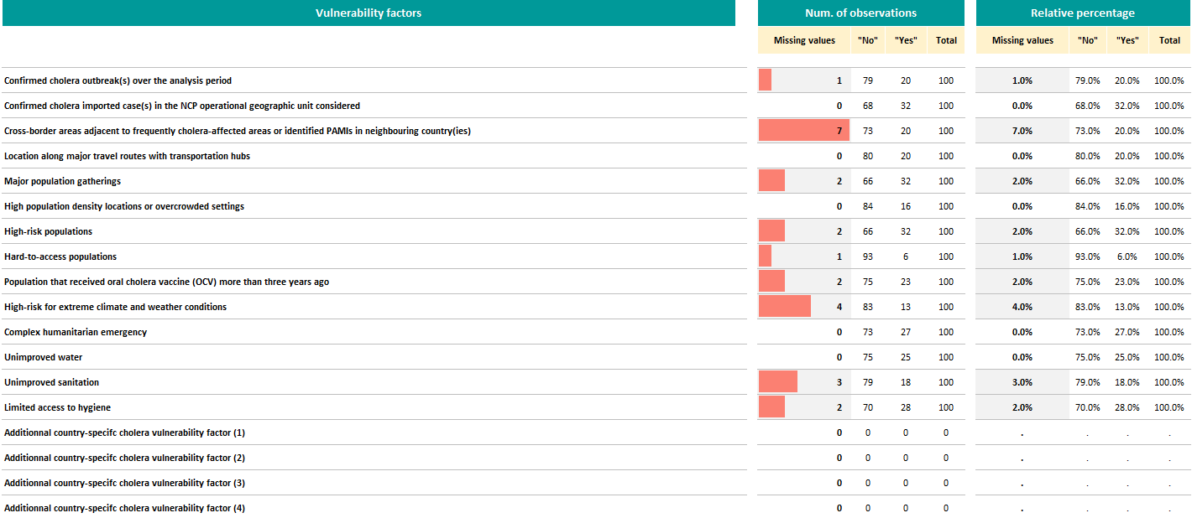
What is in sheet R.3?
Extent of missing data for each vulnerability factor
# of geo units with missing data
Example
There is 1 geo unit with missing value for hard-to-access populations
Notes:
Sheet R3 Missing data overview shows for each vulnerability factor, the number of geographic units with missing data.
For example, using fictive data from a training dataset, there is missing data on the presence or absence of hard-to-access populations in one geographic unit.

Slide 25
How to use Sheet R.3?
Assess data missingness for each vulnerability factor
Guide the discussions on missing data at the stakeholder validation
Remember: all missing data should be filled
Notes:
Use sheet R3 to assess the extent of data missingness.
This is helpful to guide discussions on missing data at the stakeholder validation.
Importantly, all missing data should be filled before any decision is made on PAMIs.

Slide 26
What is in sheet R.4?
Content similar to Sheet R.1
All indicators calculated to identify PAMIs
Notes:
The last sheet of the PAMI Excel tool is sheet R4 “Table PAMI export”. This sheet mirrors the content of the sheet R1 “Priority index calculation”; the same variables are displayed.

Slide 27
How to use Sheet R.4?
Manipulate the data in the sheet R.4
For example, filter or sort the data by vulnerability index value or filter missing values
Export a copy of the sheet R.4
This export can be used for:
Importation in a statistical software
Importation in a GIS software to map PAMIs
Notes:
You can manipulate the content of sheet R4 as needed. Feel free to explore the outputs by filtering and sorting the values.
You can also export the content of sheet R4 to import it in a statistical software for further analysis or to import it in a GIS software to map PAMIs.

Slide 28
Wrap up
The PAMI Excel tool computes all calculations and generates the following outputs
Sheet R.2| Vulnera. index summary
Summary figures on the geo units and population in PAMIs
Useful to set the vulnerability index threshold
Sheet R.3| Missing data overview
Extent of missing values for each vulnerability factor
Useful to address missing data
All missing data must be filled before making any decision on PAMIs
Sheet R.4| Table PAMIs Export
Summarizes all calculations
Useful for GIS mapping of PAMIs, additional analysis, etc
Notes:
As we wrap up this module, here are the important points to remember.
The PAMI Excel tool computes all calculations for the identification of PAMIs for elimination. It also generates the following outputs:
Sheet R2 “Vulnerability index summary” provides summary figures on the geographic units and the population in PAMIs depending on the vulnerability index threshold selected. These figures are essential to set the vulnerability index threshold at the stakeholder validation.
Sheet R3 “Missing data overview” shows the extent of missing values for each vulnerability factor. This is useful to guide discussions on the best strategy to handle missing data for each vulnerability factor. All missing data must be filled before making any decision on PAMIs.
Lastly sheet R4 “Table PAMIs Export” summarizes all calculations. It can be used for additional analysis.

Slide 29
Learn more
Watch videos to see how to use the PAMI Excel tool
https://tinyurl.com/tutoexcelPAMIelimination
Get ready to use the PAMI Excel tool
Upload data in the PAMI Excel tool
Explore the outputs of the PAMI Excel tool
Notes:
Beyond this module, we encourage you to watch video tutorials to see the PAMI Excel tool in action.
At https://tinyurl.com/tutoexcelPAMIelimination or by scanning the QR code at the bottom of your screen, you will access three video tutorials: one to help you get ready to use the PAMI Excel tool, one to show you how to upload data in the PAMI Excel tool, and the last one to explore the outputs of the PAMI Excel tool.

Slide 30
Practice
Practice using the PAMI Excel tool with an exercise
Access the exercise
Check your answers
https://tinyurl.com/PAMIeliminationPractice
https://tinyurl.com/PAMIeliminationAnswers
Takes about 15 minutes to complete
Notes:
To practice using the PAMI Excel tool, we also encourage you to take a short exercise.
You can access this exercise at https://tinyurl.com/PAMIeliminationPractice, or by scanning the QR code.
Completing the exercise takes about 15 minutes.
Then check your answers at https://tinyurl.com/PAMIeliminationAnswers or by scanning the QR code.
Practicing using the tool is the best way to get comfortable using it like a pro!

Slide 31
Notes:
We have now completed this module.

