Slide 1
Notes:
Welcome to Module 1 of the GTFCC online course on the identification of PAMIs for cholera elimination.

Slide 2
Notes:
In this module, we will walk you through the GTFCC method to identify PAMIs for cholera elimination.

Slide 3
What will you learn?
How the vulnerability index is calculated
How the vulnerability index guides decision-making
How the final list of PAMIs is determined at the stakeholder validation
Next steps following the stakeholder validation
Notes:
After completing this module, you will be able to:
Understand how the vulnerability index is calculated;
Understand how the vulnerability index guides the decision-making on PAMIs;
Explain how the final list of PAMIs is determined at the stakeholder validation;
Describe the next steps following the stakeholder validation.

Slide 4
PAMIs for cholera elimination
Identification of PAMIs for cholera elimination
For countries with no to low cholera transmission
Countries where < 5% of the geographic units reported cholera in the past 5 years
To target spatially an NCP to eliminate cholera in a sustainable manner
Other countries
Identify PAMIs for cholera control
Develop an NCP to control cholera
https://tinyurl.com/coursePAMIcontrol
Notes:
The identification of PAMIs for cholera elimination is for countries where in recent years there has been no to low cholera transmission.
As a guiding principle, these are countries where less than 5% of the geographic units reported cholera over the past five years.
In these countries, the identification of PAMIs is to effectively guide the spatial targeting of an NCP to eliminate cholera.
Countries with no to low cholera transmission remain at risk for cholera reemergence if vulnerabilities for cholera persist. Therefore, implementing an NCP for cholera elimination is essential to eliminate cholera as a threat to public health in a sustainable manner.
Other countries, meaning countries where more than 5% of the geographic units reported cholera over the past five years, should instead identify PAMIs for cholera control in order to guide the spatial targeting of an NCP to control cholera. If this corresponds to your country’s situation, we encourage you to go to the dedicated GTFCC online course.

Slide 5
PAMIs for cholera elimination - Overview
PAMIs for elimination are the geographic units most vulnerable to cholera
Data-driven phase
Decision-making phase
Stakeholders from:
Multiple sectors
Multiple levels
Multiple organizations
Decide based on consensus on a vulnerability index threshold
All geographic units are scored according to a vulnerability index
Guides objective decision making to prioritize most vulnerable geographic units
All geographic units with cholera outbreaks in recent years and those with a vulnerability index ≥ threshold are PAMIs
Notes:
In a nutshell, identifying PAMIs for cholera elimination is about identifying geographic units that are the most vulnerable to the reemergence of cholera outbreaks..
There are two main phases to identify PAMIs for cholera elimination.
The first phase is driven by the data. At this phase, all geographic units of the country are scored according to a numeric vulnerability index.
Calculating this index aims to guide objective decision-making in order to ensure that PAMIs for cholera elimination are indeed the geographic units which are most vulnerable to cholera reemergence.
The second phase is the actual decision-making on PAMIs.
Decision making on the list of PAMIs is achieved by consensus among country stakeholders representing various sectors, different levels and multiple organizations.
These stakeholders decide together, by consensus, on a threshold for the vulnerability index calculated at the first phase.
All geographic units where cholera outbreaks were reported in recent years as well as those with a vulnerability index above this threshold are then PAMIs for elimination.

Slide 6
Data driven phase
Calculation of the vulnerability index
Photo adapted from: WHO
Notes:
Let’s dive in the data driven phase leading to the calculation of the vulnerability index.

Slide 7
Assessment of vulnerability
Vulnerability to cholera is assessed with:
Occurrence of confirmed cholera outbreaks in recent years (≥ past 5 years)
Presence of vulnerability factors increasing the risk of cholera outbreaks
Geographic scale of the assessement
Most appropriate geographic level to implement the NCP
Country-specific
Typically, administrative level 2 or administrative level 3
Notes:
The vulnerability to cholera reemergence is assessed taking into account two dimensions, the occurrence of confirmed cholera outbreaks in recent years, considering at least the past 5 years, and the presence of vulnerability factors associated with an increased risk of cholera outbreaks.
Vulnerability to cholera reemergence is assessed for each geographic unit of a country.
The geographic level of this assessment is the geographic level at which multisectoral interventions against cholera will be implemented in the NCP. The corresponding level is country specific. This means that each country determines the most appropriate geographic level to coordinate the implementation of targeted multisectoral interventions against cholera.
Most often, countries consider administrative level 2 or administrative level 3, however different geographic levels may also be considered.

Slide 8
Final list of PAMIs for cholera elimination
List of PAMIs
Geo units
Confirmed cholera outbreak(s) in ≥ the past 5 years
Yes
No
Vulnerability Index ≥ country-specific threshold
Yes
No
PAMIs
Not PAMIs
Notes:
Let’s see how the list of PAMIs for cholera elimination is established taking into account these two dimensions of vulnerability.
By default, all geographic units where confirmed cholera outbreaks were reported in the past 5 years are PAMIs for elimination. In countries meeting the conditions to identify PAMIs for elimination, only a few geographic units will be PAMIs based on this criterion.
Therefore, in addition, all geographic units that have a vulnerability index above a country-specific threshold are also PAMIs for elimination.
Other geographic units are not PAMIs.

Slide 9
Occurrence of cholera outbreaks
If a confirmed cholera outbreak was reported in a geo unit in recent
years, this geo unit is vulnerable to cholera: it is a PAMI for elimination
Definitions
Confirmed cholera outbreak
At least one locally acquired confirmed cholera case reported in the geo unit
Locally acquired cholera case
Infection acquired in the geo unit considered
Assessment of the occurrence of outbreaks
Performed for at least the past 5 years with retrospective surveillance data
Notes:
By default, geographic units where a confirmed cholera outbreak was reported in recent years are PAMIs for elimination. This is because de facto the recent occurrence of a confirmed cholera outbreak demonstrates high vulnerability to cholera.
There has been a confirmed cholera outbreak in a geographic unit if there has been at least one locally acquired confirmed cholera case reported in this geographic unit.
A locally acquired cholera case is a case who was infected in the geographic unit considered. This is by opposition to an imported cholera case who was infected outside of the geographic unit considered.
To identify PAMIs for elimination, the occurrence of confirmed outbreaks is assessed in each geographic unit for at least the past 5 years, using retrospective surveillance data.

Slide 10
Vulnerability to cholera
Geo units where confirmed cholera outbreaks were NOT reported in recent years
but which are highly vulnerable to cholera are are also PAMIs
Vulnerability to cholera
Assessed with number of vulnerability factors present
Captured in vulnerability index
Vulnerability factors
Associated with a risk of
Introduction of cholera
Onset of a cholera outbreak
Spread of a cholera outbreak
Notes:
To achieve sustainable cholera elimination, geographic units where confirmed cholera outbreaks were not reported in recent years but which are assessed as highly vulnerable to cholera are also PAMIs for elimination.
Vulnerability to cholera is captured through the number of vulnerability factors present in a geographic unit, as reflected in the vulnerability index.
A vulnerability factor is a factor which may increase the risk of introduction of cholera, or onset of a cholera outbreak, or spread of a cholera outbreak.

Slide 11
Generic vulnerability factors
To help countries identify vulnerability factors, there is an
GTFCC indicative list of generic vulnerability factors
These indicators are generic as they are expected to be relevant in most countries
Recommended to consider all of these factors
Except if duly justified in the country-specific context
This list is indicative as it can be complemented with additional factors
As relevant in country-specific context
Notes:
To identify vulnerability factors to be considered in the PAMI analysis, countries are invited to consider the indicative list of generic vulnerability factors developed by the GTFCC.
These factors are considered generic because there are expected to be relevant in most countries. As a result, it is recommended to consider all the generic vulnerability factors to identify PAMIs for elimination, except if there are solid justifications to consider that any of these generic factors is not relevant in a country-specific context.
In addition, in some countries, additional vulnerability factors not included in the indicative list may also be associated with an increased risk of cholera outbreaks in the country-specific context. If so, they should also be considered in the PAMI analysis. As a result, the GTFCC indicative list can be customized and supplemented with additional vulnerability factors as relevant in the country-specific context.
We are now going to walk you through the generic vulnerability factors included in the GTFCC indicative list.

Slide 12
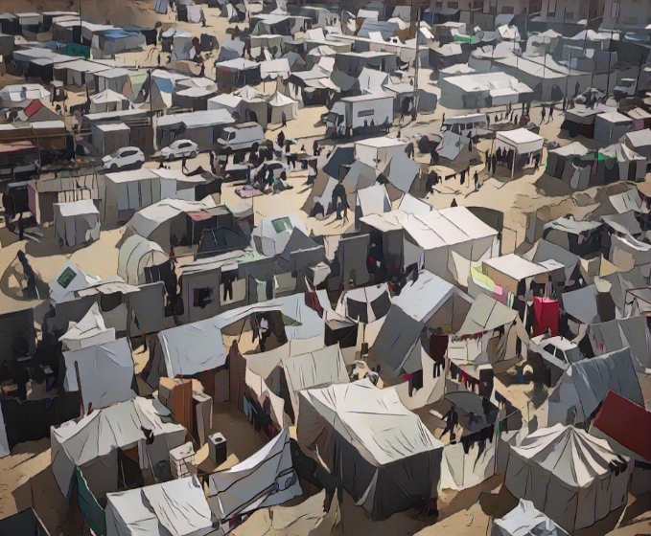
Generic vulnerability factors
Imported cholera case(s) in recent years
Location adjacent to frequently affected areas or PAMIs in neighbouring countries
Location along major travel routes with transportation hubs
Major population gatherings
For example: religious or pilgrimage gatherings, nomadic or pastoralist population gatherings
High population density or overcrowded settings
For example: urban slums, refugees or Internal Displaced People (IDPs) camps
Photo adapted from: WHO
Notes:
Generic vulnerability factors include the occurrence of any imported cholera case in recent years. The presence of this factor demonstrates vulnerability to cholera introduction.
Then is being adjacent to frequently cholera-affected areas in a neighboring country or being adjacent to a PAMI in a neighboring country. This factor is associated with an increased risk of cholera introduction.
Next is being located along major travel routes with transportation hubs. This factor can increase both the risk of cholera introduction and the risk of spread of a cholera outbreak.
Hosting major population gatherings can also be associated with an increased risk of cholera introduction. For example, population gatherings might be religious or pilgrimage gatherings or nomadic or pastoralist population gatherings.
High population density or overcrowded settings such as for example urban slums, refugees camps or Internal Displaced People camps may be at higher risk of onset or spread of a cholera outbreak.

Slide 13
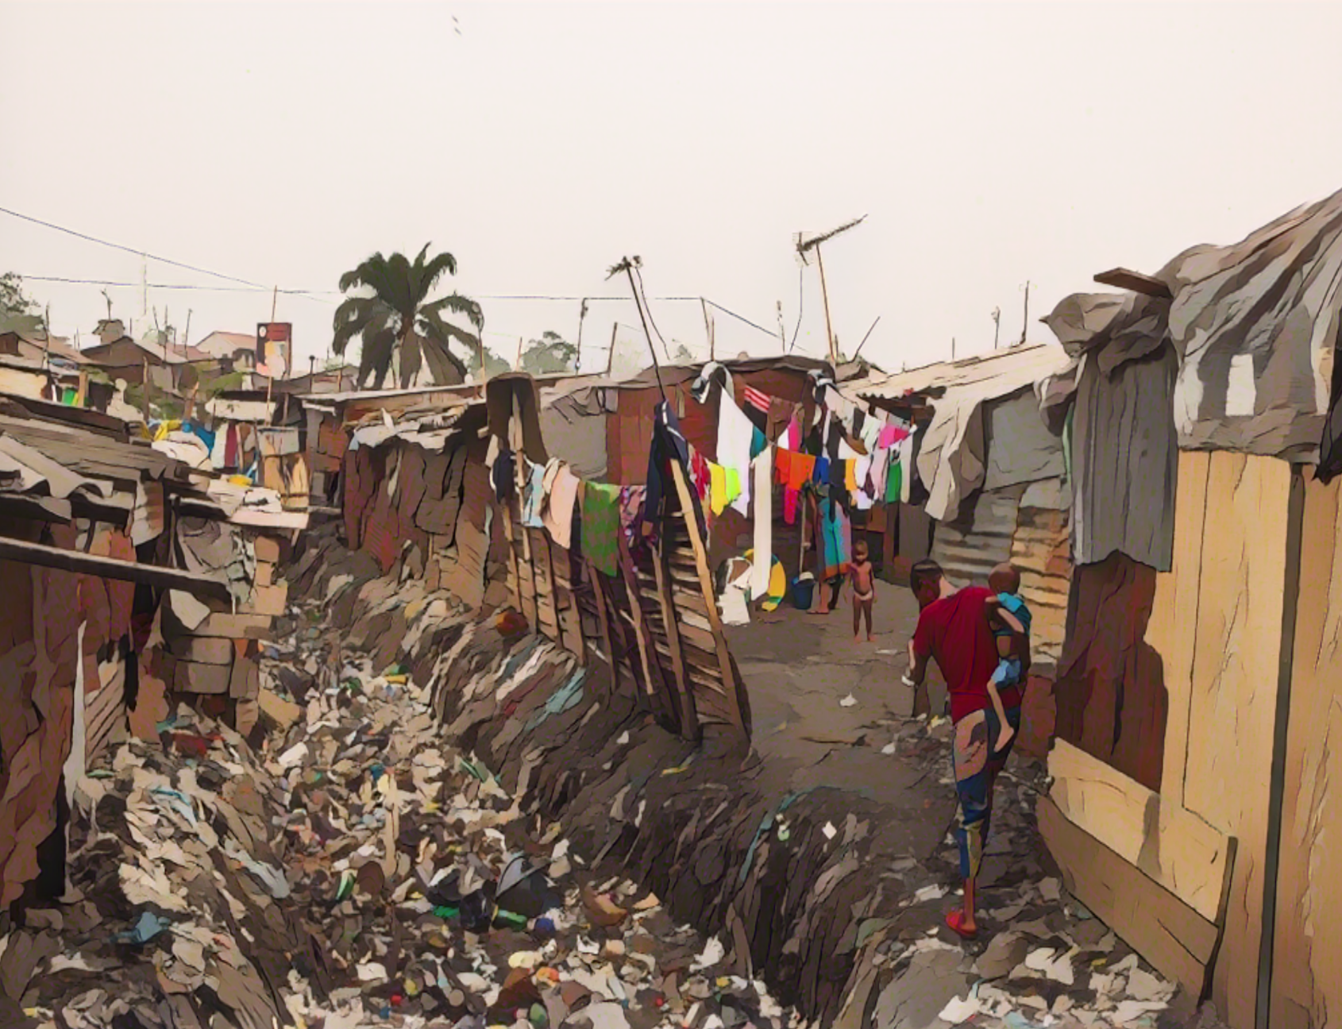
Generic vulnerability factors
High-risk populations
For example: seasonal workers, fishermen, miners in informal settlements
Hard-to-access populations
Oral cholera vaccine (OCV) more than three years ago
Especially in the absence of concomitant improvement in WASH
Risk for extreme climate and weather conditions
For example: droughts, floods
Complex humanitarian emergencies
Photo adapted from: WHO/Eduardo Soteras Jalil
Notes:
Geographic units with high-risk populations, for example seasonal workers, fishermen or miners in informal settlements may be at higher risk of onset or spread of a cholera outbreak.
Hard-to-access populations live in an area which is not regularly accessible to health services and which have an increased risk of onset of an outbreak, including a cholera outbreak.
Geographic units where vaccination against cholera was implemented more than 3 years ago may remain at risk, especially if concomitant to OCV, there have not been significant WASH improvements.
Extreme climate and weather conditions, for example droughts or floods, may be associated with an increased risk of cholera transmission.
Complex humanitarian emergencies might hamper surveillance and response capacities which may result in an increased risk of outbreak, including a cholera outbreak.

Slide 14
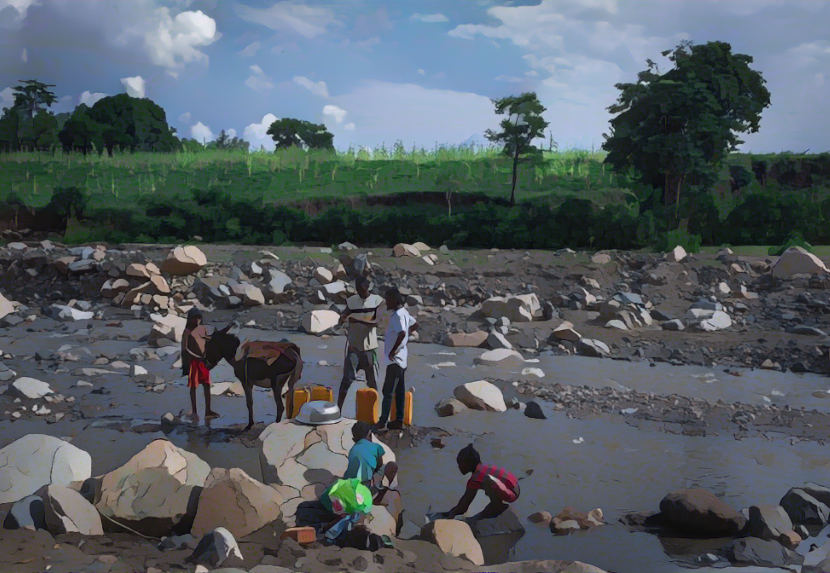
Generic vulnerability factors
Unimproved water
Population using unimproved water source or surface water
Unimproved sanitation
Population using unimproved sanitation facilities or practicing open defecation
Limited access to hygiene
Population with no handwashing facility on premises
Photo adapted from: WHO/Mulugeta Ayene
Notes:
Lastly, suboptimal WASH levels are well known cholera vulnerability factors.
The use of unimproved water sources or of surface water; the use of unimproved sanitation facilities or open defecation; or the absence of handwashing facility on premises are associated with increased vulnerability to cholera.
We have now gone through all the generic vulnerability factors of the GTFCC indicative list.

Slide 15
Additional vulnerability factors
Countries consolidate the list of relevant vulnerability factors
with criteria for assessing their presence/absence
Additional vulnerability factor(s)
Factors associated with an increased risk of introduction of cholera, onset, or spread of a cholera outbreak in the country-specific context
Scoping review, expert consultations
Assessment of the presence/absence of each vulnerability factor
Vulnerability indicators: measurable and associated with a data source
Time period
Epidemiological indicators (e.g., imported cases) assessed for the past 5 years
Other indicators assessed with the most up-to-date data sources available
Notes:
Building on the indicative list of generic vulnerability factors, country stakeholders consolidate the list of vulnerability factors to be considered in their PAMI analysis, and identify criteria to assess the presence or absence of each factor at the geographic unit level.
In particular, stakeholders may assess whether in addition to the generic vulnerability factors of the indicative list, any additional vulnerability factor is of particular relevance in their local context.
This would be any factor associated in the country-specific context with an increased risk of introduction of cholera, onset of a cholera outbreak, or spread of a cholera outbreak. Additional vulnerability factors may be identified with a scoping review or expert consultations.
Once the list of vulnerability factors has been consolidated, it is necessary to define a measurable vulnerability indicator associated with a data source to assess the presence or absence of each factor.
Regarding the time period considered to assess vulnerability:
Epidemiological indicators (for example the occurrence of imported cholera cases) are assessed for the past 5 years.
All other indicators are assessed with the most up-to-date data source available.

Slide 16
Measurable vulnerability indicators
Illustration
Vulnerability factors
Measurable vulnerability indicators
High population density
Number of inhabitants >1,000 per km²
At risk populations
Percentage of IDPs ≥ 5% of the population
Unimproved water
> 30% of the population using unimproved service level or surface water, or
> 15% of the population using surface water
Notes:
Let’s illustrate the definition of measurable vulnerability indicators with a few examples. These are fictive examples; relevant measurable vulnerability indicators must be adapted in each country.
High population density is a vulnerability factor. However, if it is not better defined with a measurable vulnerability indicator, it is not possible to assess in an objective and reproductible manner whether there is high population density in a geographic unit. This is why an indicator that is measurable must be defined. For example, an indicator to measure high population density may be a number of inhabitants greater than 1 000 inhabitants per square kilometer. This is measurable, and can be assessed in an objective and reproductible manner.
Following a similar principle, to measure whether the vulnerability factor “at risk populations” is present in a geographic unit, the following indicator might be considered: percentage of internally displaced people (IDP) equal or above 5% of the population in a geographic unit.
As a last example, the vulnerability factor “unimproved water” might be measured as above 30% of the population of the geographic unit using unimproved service level or surface water or above 15% of the population of the geographic unit using surface water.

Slide 17
Scoring of vulnerability indicators
Using measurable vulnerability indicators, the presence of each
vulnerability factor is assessed and scored in each geo unit
1
0
Present
Score: 1 point
Absent
Score: 0 point
Notes:
Measurable vulnerability indicators are used to assess the presence or the absence of each vulnerability factor in each geographic unit, and to score it.
If a vulnerability factor is assessed as present in a geographic unit, the score is 1 point.
If a vulnerability factor is assessed as absent in a geographic unit, the score is 0.

Slide 18
Calculation of vulnerability index
The vulnerability index is the sum of the scores of all vulnerability factors
Weights
By default, all vulnerability factors have an equal weight
Different weights may be considered if justified in the country-specific context
Notes:
Once the presence or absence of all vulnerability factors has been scored in all geographic units, the vulnerability index can be calculated.
The vulnerability index is the sum of the scores of all vulnerability factors. It is calculated for each geographic unit.
By default, all vulnerability factors have the same weight in this sum. However, if justified in the country-specific context, setting different weights may be considered.

Slide 19
Calculation of vulnerability index
Example
In a geo unit:
No cholera outbreak was reported in the last 5 years
The presence of vulnerability factors was assessed
Vulnerability factor A: 0 (absent)
Vulnerability factor B : 1 (present)
Vulnerability factor C : 1 (present)
Vulnerability factor D : 1 (present)
Vulnerability factor E: 0 (absent)
Vulnerability index = 3
(3 vulnerability factors present)
Notes:
Here is an example to illustrate the calculation of the vulnerability index.
Let’s imagine a geographic unit where no cholera outbreak was reported in the last 5 years.
In this geographic unit, two vulnerability factors were assessed as absent, and 3 vulnerability factors were assessed as present.
The vulnerability index is 3, this corresponds to the number of vulnerability factors present in this geographic unit.

Slide 20
PAMI Excel tool
A PAMI Excel Tool computes all calculations
Learn about:
How to prepare the data in Module 2
How to use the PAMI Excel tool in Module 3
Notes:
We have now gone through all the steps for the calculation of the vulnerability index.
It is important for you to understand how the vulnerability index is calculated, however, you will not have to actually perform these calculations yourself. They are all automatized in a GTFCC PAMI Excel tool.
You will learn more about this tool in the next modules of this course.

Slide 21
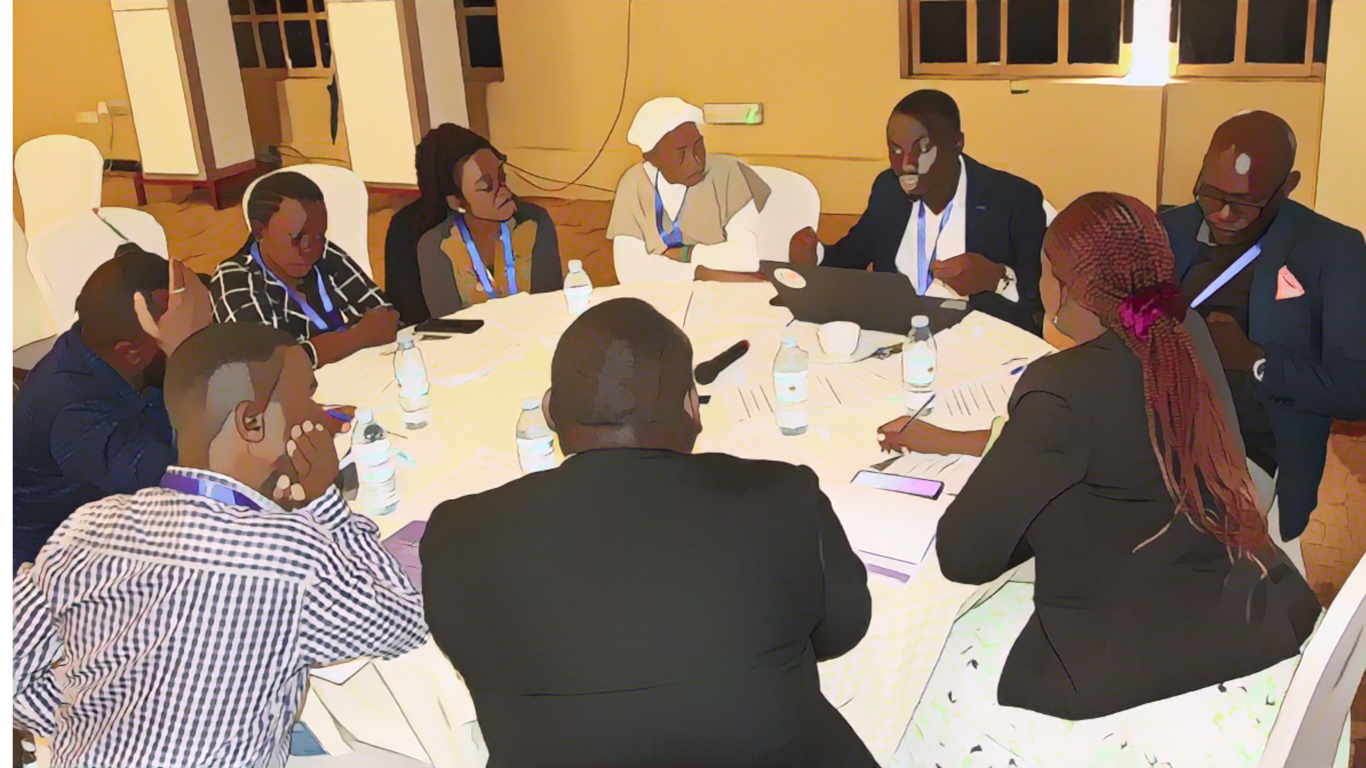
Decision-making phase
Building consensus
Photo adapted from: WHO
Notes:
This completes the PAMI data driven phase. We will now look into the decision-making phase.

Slide 22
Stakeholder validation
Consensus among multiple stakeholders on PAMIs taking into account:
Cholera outbreaks in recent years
Vulnerability index
To determine the list of PAMIs, stakeholders
Fill all missing data
Agree on a vulnerability index threshold
Learn how to organize a PAMI stakeholder validation in Module 4
Notes:
Decision making on PAMIs is achieved by consensus among multiple country stakeholders taking into account the cholera situation in recent years and the vulnerability index.
To determine the list of PAMIs, first if there are any missing data, stakeholders complement the assessment of the presence or absence of vulnerability factors. Then, they decide on a vulnerability index threshold.
You will learn more about how to organize a successful PAMI stakeholder validation in Module 4 of this course.

Slide 23
Vulnerability index threshold
The vulnerability index guides objective decision-making on PAMIs
A vulnerability index threshold set by consensus
All geo units with vulnerability index ≥ threshold are PAMIs in addition to geo units with confirmed cholera outbreaks in recent years
Threshold balances the feasibility and the impact of the NCP
Threshold set low
Threshold set high
High number of PAMIs
Feasibility of the NCP
Low number of PAMIs
Impact of the NCP
Notes:
The vulnerability index is critical to guide decision making on PAMIs. A vulnerability index threshold is determined by consensus, and all geographic units which have a vulnerability index above the selected threshold are PAMIs. This is in addition to geographic units where cholera outbreaks were reported in recent years which by default are always PAMIs.
To decide on the vulnerability index threshold, stakeholders must balance both the feasibility and the impact of the NCP.
If the vulnerability index threshold is set low, many geographic units will be PAMIs. In that situation, the potential impact of the NCP may be high, however, the feasibility of implementing multisectoral interventions in PAMIs may be challenging.
On the other hand, if the vulnerability index threshold is set high, very few geographic units will be PAMIs. In that situation, the feasibility of the NCP may be high, however the potential impact of the NCP may be low.
Overall, setting a threshold for the index is about finding the right balance between feasibility and impact.

Slide 24
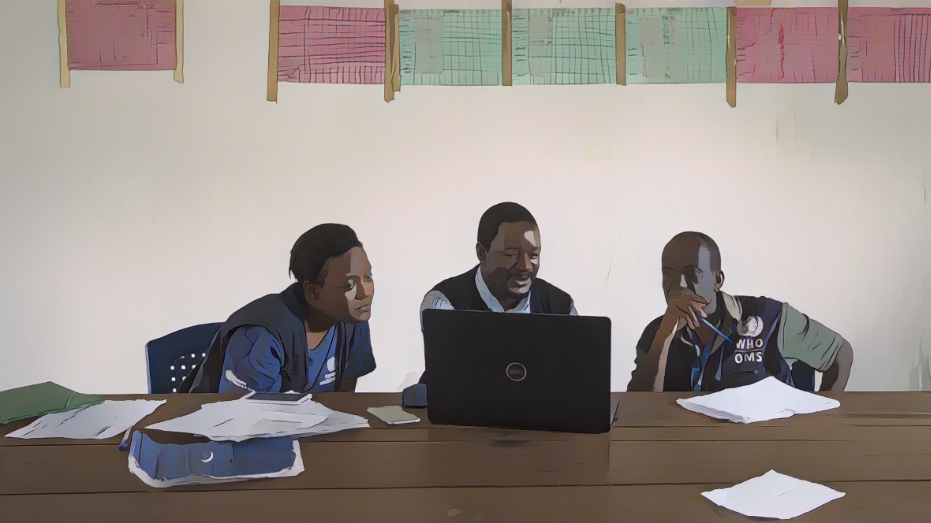
Next steps
Documentation and review
Photo adapted from: WHO / Lindsay Mackenzie
Notes:
Once country stakeholders have reached a consensus on the list of PAMIs, the next steps are to document PAMI identification and to go through an external review.

Slide 25
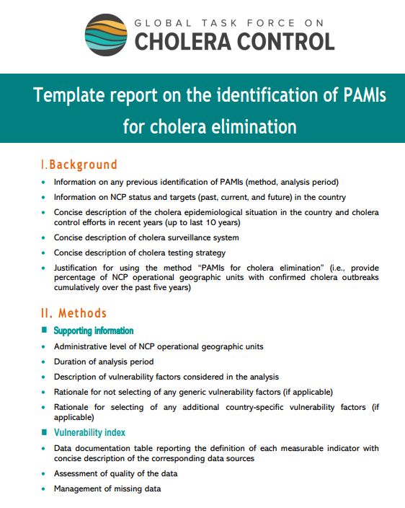
Documentation
PAMI identification is documented in a report to describe:
Method and outcomes
Decisions and justifications
To prepare a comprehensive report,
follow the GTFCC template report
Learn how to prepare a report on PAMI identification in Module 5
Notes:
PAMI identification should be documented in a report to describe the method used and the outcomes as well as the decisions made and their justification. This is essential to ensure the traceability of PAMI identification and for future reference.
To prepare a comprehensive report on PAMI identification, we encourage you to follow the GTFCC template report.
You will learn more about how to document PAMI identification in Module 5 of this course.

Slide 26
GTFCC PAMI reviews
Independent technical reviews of PAMI identification for countries to receive:
Independent technical feedback
Practical advice and recommendations
Mandatory for countries planning to
Request OCV for preventive use
Submit their NCP for GTFCC endorsement
Learn about GTFCC PAMI reviews in Module 5
Notes:
The GTFCC performs independent technical reviews of PAMI identification.
These reviews represent an opportunity for countries to receive independent technical feedback and practical advice and recommendations as needed to help optimize the spatial targeting of their ncp.
GTFCC PAMI reviews are offered to all countries and are mandatory for countries which plan to request OCV for preventive use or to request a GTFCC endorsement of their NCP.
You will learn more about GTFCC PAMI reviews in Module 5 of this course.

Slide 27
Wrap up
For countries where < 5% of the geographic units reported cholera over the past 5 years
Data driven phase
Identify geographic units with reported cholera outbreaks
Identify vulnerability factors and measurable indicators
Capture the presence of vulnerability factors in the vulnerability index
Decision-making phase
Stakeholders agree on a vulnerability index threshold
PAMIs are geo units
With confirmed cholera outbreaks in recent years or
With a vulnerability index above the selected threshold
Notes:
As we wrap up this module, here are the important points to remember.
The identification of PAMIs for cholera elimination is for countries where less than 5% of the geographic units reported cholera over the past 5 years.
At the first phase of PAMI identification, data on the occurrence of cholera outbreaks in recent years are compiled. Vulnerability factors which increase the risk of cholera introduction, onset of a cholera outbreak, or spread of a cholera outbreak in the country-specific context are identified. The presence or absence of each vulnerability factor in each geographic unit is then assessed with a measurable indicator and combined into a vulnerability index.
The second phase is to decide on the list of PAMIs, taking into account the occurrence of cholera outbreaks in recent years and the vulnerability index. Country stakeholders agree by consensus on a vulnerability index threshold balancing the feasibility and the potential impact of the NCP. By default, all geographic units where cholera outbreaks occurred in recent years are PAMIs for elimination. All geographic units that have a vulnerability index above the selected threshold are also PAMIs for elimination.

Slide 28
Notes:
Before moving on to the next module, we encourage you to take a short quiz. There are three questions in this quiz.

Slide 29
Question 1
Which geo units are always PAMIs for cholera elimination?
Geographic units with Internally Displaced People (IDP)
Geographic units where a confirmed cholera outbreak was reported in recent years
Geographic units with high population growth
Geographic units with limited access to health care
Notes:
Question 1. Which geographic units are always considered PAMIs for cholera elimination?
a) Geographic units with Internally Displaced People (IDPs).
b) Geographic units where a confirmed cholera outbreak was reported in recent years.
c) Geographic units with high population growth.
d) Geographic units with limited access to health care.

Slide 30
Question 1 – Answer
Which geo units are always considered for cholera elimination?
Geographic units with Internally Displaced People (IDP)
Geographic units where a confirmed cholera outbreak was reported in recent years
Geographic units with high population growth
Geographic units with limited access to health care
Notes:
The correct answer is b. By default, geographic units where a confirmed cholera outbreak was reported in recent years are always PAMIs for elimination regardless of their vulnerability index.

Slide 31
Question 2
How is vulnerability to cholera assessed to identify PAMIs for cholera elimination?
Presence of factors increasing the risk of onset of a cholera outbreak
Occurrence of confirmed cholera outbreak in recent years
Level of access to safely managed drinking water below the target of the sustainable development goals
Presence of factors increasing the risk of introduction of cholera, onset of a cholera outbreak, or spread of a cholera outbreak
Notes:
Question 2. How is vulnerability to cholera assessed to identify PAMIs for cholera elimination?
a) Presence of factors increasing the risk of onset of a cholera outbreak.
b) Occurrence of confirmed cholera outbreak in recent years.
c) Level of access to safely managed drinking water below the target of the sustainable development goals.
d) Presence of factors increasing the risk of introduction of cholera, onset of a cholera outbreak, or spread of a cholera outbreak.

Slide 32
Question 2 – Answer
How is vulnerability to cholera assessed to identify PAMIs for cholera elimination?
Presence of factors increasing the risk of onset of a cholera outbreak
Occurrence of confirmed cholera outbreak in recent years
Level of access to safely managed drinking water below the target of the sustainable development goals
Presence of factors increasing the risk of introduction of cholera, onset of a cholera outbreak, or spread of a cholera outbreak
Notes:
The correct answer is d. To identify PAMIs for cholera elimination, vulnerability to cholera is assessed with presence of factors increasing the risk of introduction of cholera, onset of a cholera outbreak, or spread of a cholera outbreak.

Slide 33
Question 3
What is the objective of the stakeholder validation for PAMI identification?
Stakeholder validation of the distribution of resources across all regions for eliminating cholera
Stakeholder decision on a threshold for the vulnerability index
Stakeholder validation of preparedness plans for all cholera prevention and control pillars
Notes:
Question 3. This is the last question. What is the objective of the stakeholder validation for PAMI identification?
a) Stakeholder validation of the distribution of resources across all regions for eliminating cholera.
b) Stakeholder decision on a threshold for the vulnerability index.
c) Stakeholder validation of preparedness plans for all cholera prevention and control pillars.

Slide 34
Question 3 – Answer
What is the objective of the stakeholder validation for PAMI identification?
Stakeholders validation of the distribution of resources across all regions for eliminating cholera
Stakeholders decision on a threshold for the vulnerability index
Stakeholders validation of preparedness plans for all cholera prevention and control pillars
Notes:
The correct answer is b. At the stakeholder validation, stakeholders decide on a vulnerability index threshold.

Slide 35
Notes:
We have now completed this module.

