Slide 1
Notes:
Welcome to Module 4 of the GTFCC online course on the identification of PAMIs for cholera control.

Slide 2
Notes:
In this module, we will provide you some insights on how to organize a successful PAMI stakeholder validation.

Slide 3
What will you learn?
Objectives of the stakeholder validation
How to prepare a PAMI validation workshop
How to run a PAMI validation workshop
How to foster consensus on the list of PAMIs
Notes:
After completing this module, you will be able to:
Explain the objectives of the stakeholder validation;
Describe how to prepare a PAMI validation workshop;
Describe how to run a PAMI validation workshop;
And, understand approaches to foster consensus on the list of PAMIs.

Slide 4
Stakeholder validation
Objectives
Agree on the priority index threshold
Optionally, agree on a limited number of additional PAMIs
Expected outcome
Final list of PAMIs
Buy-in from all parties
Preferred format
On-site workshop (e.g., 3 days)
Fosters participative discussions
Encourages collaboration across sectors / stakeholders
Notes:
The PAMI stakeholder validation is an important moment for the identification of PAMIs for cholera control. This is when a priority index threshold is decided and, optionally, additional PAMIs based on vulnerability to cholera are agreed upon.
The outcome of a successful stakeholder validation is the final list of PAMIs with strong buy-in from all parties.
To achieve the validation of PAMIs in a participative manner, it is recommended that the stakeholder validation be organized in the form of an on-site workshop.
Experience shows that a 3-day workshop is ideal to achieve stakeholder validation.
A key benefit of hosting the stakeholder validation as an onsite workshop is not only to foster participative discussions. Experience shows that onsite PAMI workshops also encourages collaboration across stakeholders which is essential for the successful continuation of the NCP process.

Slide 5
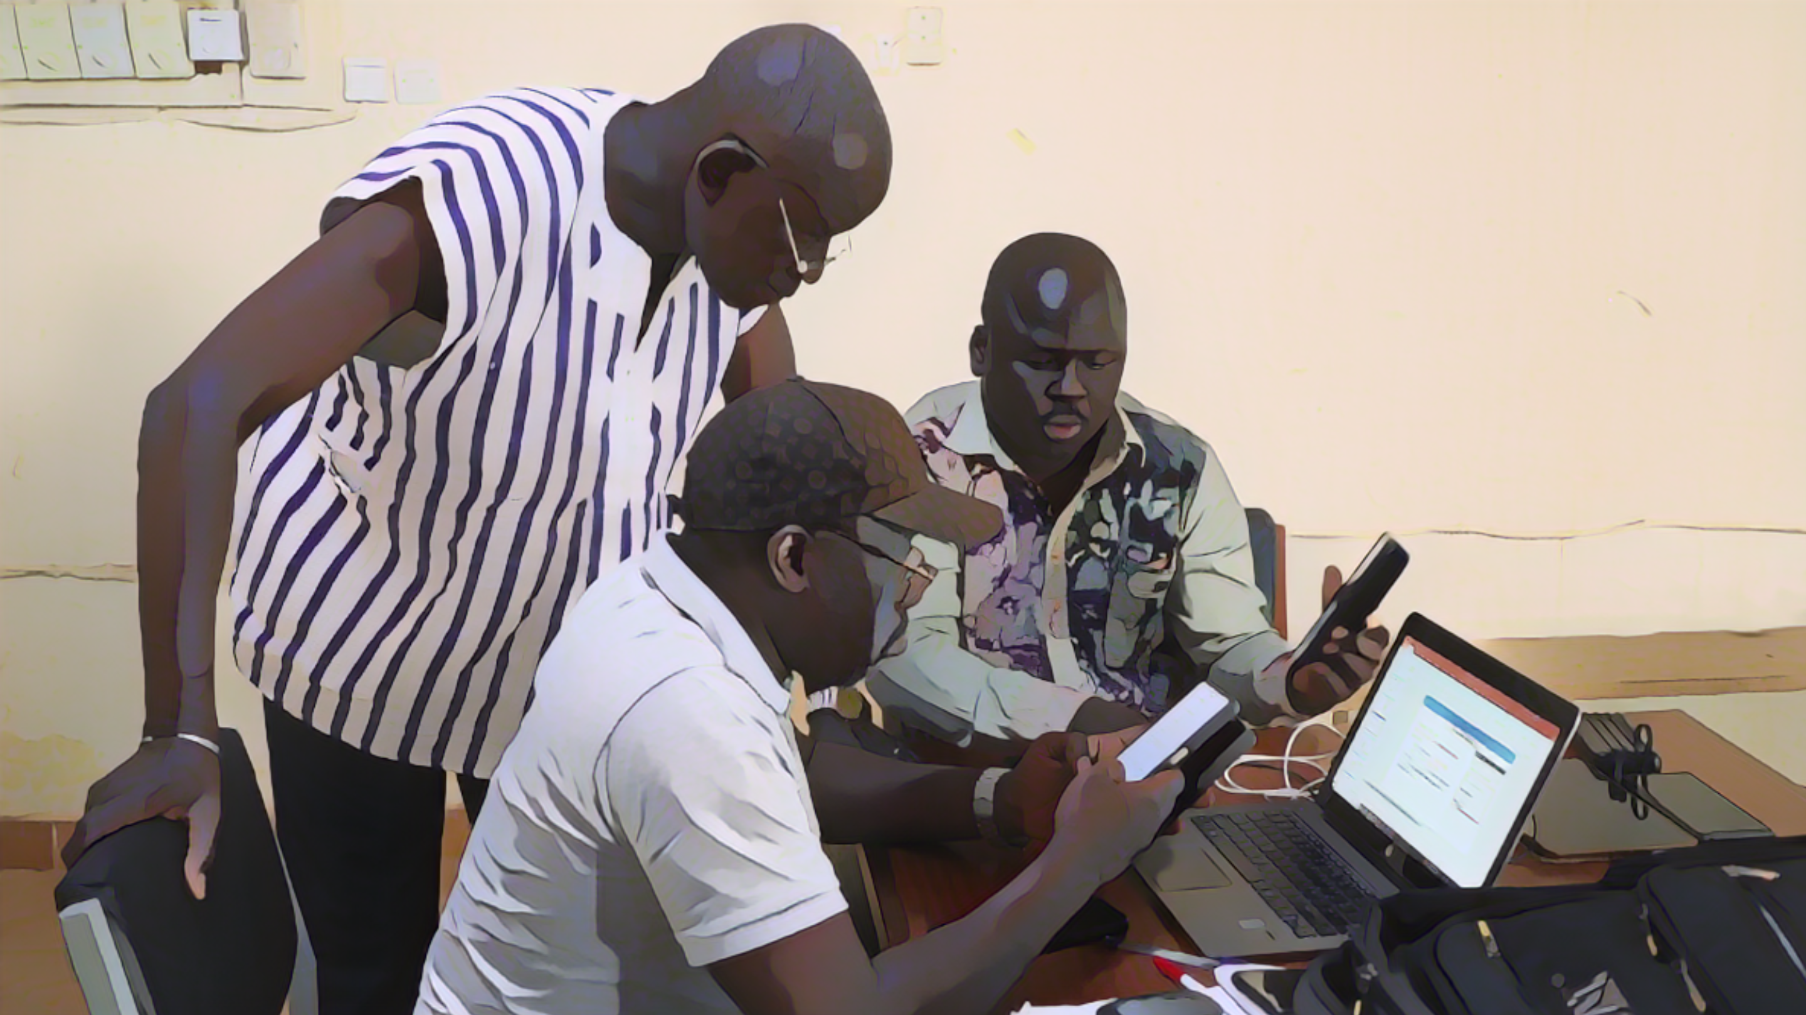
Preparation of
stakeholder validation
Photo adapted from: WHO/Francine Tchouta
Notes:
Critical to a successful PAMI validation workshop is a thorough preparation of this important event.

Slide 6
Preparation steps
Preparation and anticipation are key success factors
Identify relevant stakeholders to be invited
Prepare the agenda
Send out the invitations
Arrange the logistics
Prepare the supporting material/visuals
Confirm and brief speakers and facilitators
Appoint and brief a chair
Identify and brief note-takers
Notes:
Careful preparation and anticipation are key success factors.
Plan ahead to identify relevant stakeholders to be invited, prepare the agenda. Make sure to send out invitations well in advance to maximize attendance. Make the necessary arrangements for the logistics of the workshop. Prepare the supporting material and the visuals that will be displayed at the workshop. Confirm and brief speakers and facilitators. Do not forget to appoint and to brief a chair, and make sure to identify and to brief note-takers.

Slide 7
Participants
The stakeholder validation is multisectoral
Multiple sectors
Public health
Water, Hygiene, and Sanitation (WaSH)
Finance
Immunization
Etc
Multiple levels
National
Sub-national
Organizations and partners playing a role in cholera control
Notes:
When establishing the list of participants, make sure that the PAMI validation will be as multisectoral as possible. Consider inviting multiple sectors beyond the public health sector, such as WASH, finance, immunization, and so on. It is also advisable to invite representatives from different levels, ensuring that both the national level and subnational levels are represented.
Overall, make sure that all organizations and partners that play an active role in cholera control in your country are given a chance to be involved in the PAMI validation.

Slide 8
Example of agenda
Indicative only
Day 1. Set the scene
Welcome and introduction / icebreaker
Opening remarks
Update on cholera in the country
Epidemiological situation
Strategies to control cholera - Progress & challenges
Updates from cholera prevention & control pillars
GTFCC method to identify PAMIs for cholera control
Outcomes of the data driven PAMI identification phase
Priority index
Additional PAMIs and vulnerability factors
Key findings and limitations
Notes:
Here is an example of a possible agenda for a PAMI workshop. Of course, this is indicative and is only provided as a basis for customization.
The focus of the first day can be to set the scene, as all participants may not yet be familiar with PAMIs.
As background, updates on the cholera situation in your country can be presented covering the epidemiological situation, the cholera control strategies that have been implemented, along with the progress achieved and the challenges that have been faced. Cholera control pillar specific updates may also be very insightful.
Then, you can bring participants up to speed on PAMI identification by walking them through the PAMI identification method.
Lastly, present the outcomes of the first phase of PAMI identification, including the priority index and considerations for additional PAMIs based on vulnerability factors.
Bring up for discussion, not only the key findings of the first phase of PAMI identification, but also and as importantly their potential limitations.

Slide 9
Example of agenda
Indicative only
Day 2. Discuss the list of PAMIs in a participative manner
Priority index threshold
Plenary session to introduce scenarios for setting the threshold
Group sessions to assess the scenarios
Plenary reporting from each group
Additional PAMIs (optional)
Plenary session to discuss lack of reliability of the priority index
Group sessions to propose additional PAMIs
Plenary reporting from each group
Notes:
The focus of the second day can be on discussing the list of PAMIs in a participative manner.
To discuss how to set the priority index threshold, different scenarios can be outlined in a plenary session. Then, these scenarios can be discussed in group sessions. Each group can then report in a plenary session on its thoughts and findings.
If additional PAMIs based on cholera vulnerability are considered in your country, a similar approach can be followed to discuss additional PAMIs, mixing plenary sessions and group sessions.

Slide 10
Example of agenda
Indicative only
Day 3. Reach consensus on the list of PAMIs & organize next steps
Wrap up of Day 2
Address any pending questions
Decide on the final list of PAMIs
Plan immediate next steps
Role, responsibilities, timelines for the PAMI identification report
Timelines and responsible stakeholder for requesting a GTFCC PAMI review
Set the way forward
Way forward and timelines for NCP development
Way forward and timelines for multi-year vaccination plan (if applicable)
Closing remarks
Notes:
The third and last day of the workshop is the moment to reach an agreement among all participants on the final list of PAMIs and to get organized for next steps.
Building on outcomes from day 2, a consensus should be reached on the priority index threshold as well as, if applicable in your country, a consensus on the list of additional PAMIs.
The next steps to be organized are the preparation of the report on PAMI identification and of the request for a GTFCC PAMI review. For those, roles and responsibilities should be assigned, and timelines should be set.
Lastly, the way forward for NCP development should also be discussed as well as, if applicable in your country, the way forward to develop a multi-year plan of action for preventive OCV.

Slide 11
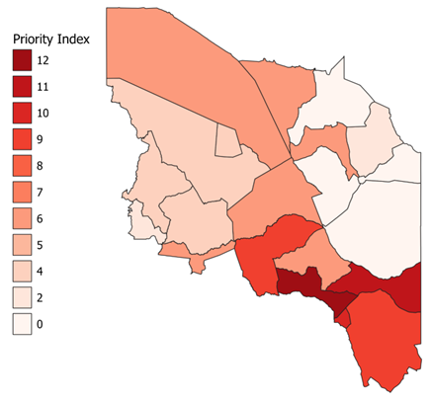
Supporting material
Prepare visuals to streamline discussions and decisions on PAMIs
Sheet R.3 of the PAMI Excel tool
Priority Index Summary
To guide discussions on the priority index threshold
Shapefile with priority index values
To map PAMIs
Geo units by priority index value
Fictive country
Notes:
As part of the preparation of the PAMI workshop, visuals and supporting material that will be displayed at the workshop should be prepared in advance.
At a minimum, this should include supporting material to discuss scenarios for setting the priority index threshold, for example similar to sheet R3 of the PAMI Excel tool.
In addition, shapefiles with priority index values should also be prepared in order to map PAMIs.

Slide 12
Tips to run a
stakeholder validation
Photo adapted from: WHO/Francine Tchouta
Notes:
We will now go through a few tips to run a successful stakeholder validation.

Slide 13
Objective decision making
The chair & facilitators play a key role in fostering decision-making
based on data and oriented towards operational implications
Display the supporting material/visuals prepared prior to the workshop
Encourage participants to back up personal opinions with facts
Discuss practical and operational implications
Notes:
The chair and the facilitators play a key role to keep a sound decision-making process on track. This means ensuring that decisions on PAMIs are grounded on data and take into account operational implications.
To keep a sound decision-making process on track, displaying the supporting material and the visuals prepared ahead of the workshop helps focus the attention and the discussions on data.
In addition, the chair and the facilitators should encourage participants not to bring up personal opinions or impressions but as much as possible documented facts.
Lastly, it is essential that the practical and operational dimensions of PAMI identification be carefully considered in the decision-making process, in particular the feasibility of the NCP.

Slide 14
Group sessions
Benefits
Increase opportunities for all participants to actively engage in the discussions
Channel convergent expertise and knowledge for time-effective discussions
Groups’ composition
By cholera prevention & control pillar
Facilitates technical discussions on feasibility and practical considerations
By region
Facilitates discussions on local context and specific challenges (e.g., additional PAMIs)
Tips for effective group sessions
Explain objectives and provide guiding questions to each group
Assign roles (facilitator, note-taker, rapporteur)
Notes:
Group sessions in break-out are useful tools for a participative and engaging process.
Group sessions give all participants greater opportunities to actively engage in the discussions compared to plenary sessions. In addition, group sessions can make the discussions more time effective by bringing together in a group, the participants who have convergent expertise and knowledge.
Groups can be formed by cholera prevention and control pillar. This is helpful for example to discuss technical and practical considerations.
Alternatively, groups can also be formed by regions. This is helpful for example to discuss specificities of the local context in particular to discuss additional PAMIs based on local vulnerability factors.
For group sessions to be effective and fully beneficial, it is essential that each group be briefed on the objective of the session and be provided with an outline to structure the discussions such as guiding questions.
In addition, a facilitator, a note-taker, and a rapporteur should be designated in each group.

Slide 15
Documentation
Discussions and decisions along with supporting justifications are documented throughout the workshop for traceability of the decision-making process
Key roles of note takers
Record the discussions
Flag decisions made without sufficient justification
Keep track of any unresolved discussions to ensure they get addressed
Tips for note takers
Use a copy of sheet R5 of the PAMI Excel tool to record discussions on geo units
Columns may be added as needed
Notes:
Throughout the workshop, discussions, decisions, and justifications for the decisions should be documented for traceability of the decision-making process.
Note takers play a key role in ensuring comprehensive record keeping.
In addition, during the workshop, note takers also support the chair and facilitators by flagging any decisions made without sufficient justifications. They also keep track of any unresolved discussions and make sure that they get addressed and solved.
Note takers are encouraged to use the sheet R5 of the PAMI Excel tool to record discussions on specific geographic units. To that end, they may add columns in sheet R5 as needed.

Slide 16
Consensus building
at the stakeholder validation
Photo adapted from: WHO/ Tini Media
Notes:
Decisions on PAMIs are always made by consensus. We will walk you through the approaches that can facilitate consensus building.

Slide 17
Consensus
Consensus means that all participants are overall onboard with the decision
Participants should reach a consensus on:
Priority index threshold
Whether there is a need to consider additional PAMIs
If so, the list of additional PAMIs
Reaching consensus is facilitated by objective decision-making
Grounding discussions on data and operational considerations limits divergent opinions that may rely on personal impressions or unrealistic aspirations
Notes:
Reaching a consensus means that all participants are overall onboard with the decisions.
At the workshop, a consensus should be reached on three main dimensions:
First, the priority index threshold;
Then, whether or not there is a need to consider additional PAMIs based on vulnerability factors;
And, if so, the list of additional PAMIs.
As a general principle, consensus building is facilitated by objective decision-making grounded on data and operational considerations. This helps keep the decision-making process on track, setting aside personal opinions or impressions as well as unrealistic aspirations.

Slide 18
Consensus on priority index threshold
Different scenarios for setting the priority index threshold are discussed
Depending on the threshold what are:
The # & % of geo units that are PAMIs?
The # & % of the population in PAMIs?
Depending on the threshold what are:
The % of cases in PAMIs?
The % of deaths in PAMIs?
What is the expected feasibility?
What is the expected impact?
What is the best balance between
feasibility and impact?
Notes:
To reach a consensus on the priority index threshold, different scenarios are discussed focusing on two dimensions.
First, the expected feasibility of the NCP taking into account the number and the percentage of geographic units that would be PAMIs as well as the number and the percentage of the country population in PAMIs, depending on the selected threshold.
The other dimension is the potential public health impact of the NCP taking into account the percentage of cholera cases and the percentage of cholera deaths in PAMIs, depending on the selected threshold.
Deciding on the threshold focuses on finding the best balance between these two dimensions in the country-specific context.

Slide 19
Consensus on the need for additional PAMIs
The risk that the priority index may underestimate the cholera burden
is assessed for geo units with a priority index below the threshold
Considering additional PAMIs is relevant if for some geo units there are tangible arguments that the priority index lacks reliability
If there is consensus on the need to consider additional PAMIs, the list of geo units with lack of reliability of the priority index is also discussed and agreed on
Notes:
To reach a consensus on whether or not there is a need to consider additional PAMIs based on vulnerability factors, the first step is to assess and agree on whether the priority index may underestimate the cholera burden in any specific geographic unit with a priority index below the selected threshold value.
If for specific geographic units there are tangible arguments that indicate that the priority index is likely to be less reliable in those units than in other units, then it is relevant to look into their vulnerability to cholera.
A consensus should be reached on the list of geographic units which have a priority index value below the selected priority index threshold, and which also have lack of reliability of the priority index.

Slide 20
Consensus on additional PAMIs
Vulnerability to cholera is considered in conjunction with
the feasibility of targeting additional PAMIs
To select additional PAMIs
The geo units most vulnerable to cholera should be prioritized
Feasibility of targeting additional PAMIs in the NCP should be assessed
The list of additional PAMIs is narrowed down until there is consensus that targeting all PAMIs is achievable
Notes:
To reach a consensus on the list of additional PAMIs, the vulnerability to cholera is considered together with the feasibility of the NCP.
Selecting additional PAMIs is a prioritization exercise. Geographic units that are most vulnerable to cholera should be prioritized, and the list of additional PAMIs should be narrowed down until implementing multisectoral interventions in PAMIs, including additional PAMIs, is considered realistically feasible.

Slide 21
Wrap up
Consensus on the list of PAMIs is driven by the data and by operational considerations
Justifications for all decisions are documented for traceability of the decision-making process
The stakeholder validation is a key opportunity to maximize buy-in and multisectoral engagement in the NCP
Notes:
As we wrap up this module, here are the important points to remember.
Consensus building on the list of PAMIs is driven by the data and by operational considerations.
Justifications for all decisions should be documented for traceability of the decision-making process.
The collaborative and participative discussions held at the stakeholder validation represent a key opportunity to maximize buy-in and multisectoral engagement in the NCP.

Slide 22
Notes:
Before moving on to the next module, we encourage you to take a short quiz. There are three questions in this quiz.

Slide 23
Question 1
What is an expected benefit of having consensus from all parties on the final list of PAMIs?
It increases confidence that indicators are statistically significant
It ensures that all personal opinions and impressions are duly considered
It maximizes stakeholder engagement in the future NCP
It reduces the need for follow up training sessions
Notes:
Question 1. What is an expected benefit of having consensus from all parties on the final list of PAMIs?
a) It increases confidence that indicators are statistically significant.
b) It ensures that all personal opinions and impressions are duly considered.
c) It maximizes stakeholder engagement in the future NCP.
d) It reduces the need for follow up training sessions.

Slide 24
Question 1 – Answer
What is an expected benefit of having consensus from all parties on the final list of PAMIs?
It increases confidence that indicators are statistically significant
It ensures that all personal opinions and impressions are duly considered
It maximizes stakeholder engagement in the future NCP
It reduces the need for follow up training sessions
Notes:
The correct answer is c. Consensus from all parties on the final list of PAMIs maximizes stakeholder engagement in the future NCP.

Slide 25
Question 2
Why group sessions might be useful at a stakeholder validation workshop?
To extend the duration of the workshop
To channel convergent expertise/knowledge for more effective discussions
To limit the number of participants
To create closer bounds between participants
Notes:
Question 2. Why group sessions might be useful at a stakeholder validation workshop?
To extend the duration of the workshop.
To channel convergent expertise and knowledge for more effective discussions.
To limit the number of participants.
To create closer bounds between participants.

Slide 26
Question 2 – Answer
Why group sessions might be useful at a stakeholder validation workshop?
To extend the duration of the workshop
To channel convergent expertise/knowledge for more effective discussions
To limit the number of participants
To create closer bounds between participants
Notes:
The correct answer is b. Group sessions are a useful tool at the stakeholder validation to help bring together convergent expertise and knowledge in order to have more effective discussions.

Slide 27
Question 3
What is the preferred way to assess the vulnerability to cholera of a geographic unit?
Historical anecdotes
Personal opinions
Common assumptions about this geographic unit
Recent and reliable data sources on vulnerability
Notes:
Question 3. This is the last question. What is the preferred way to assess the vulnerability to cholera of a geographic unit?
a) Historical anecdotes.
b) Personal opinions.
c) Common assumptions about this geographic unit.
d) Recent and reliable data sources on vulnerability.

Slide 28
Question 3 – Answer
What is the preferred way to assess the vulnerability to cholera of a geographic unit?
Historical anecdotes
Personal opinions
Common assumptions about this geographic unit
Recent and reliable data sources on vulnerability
Notes:
The correct answer is d. The preferred way to assess the vulnerability to cholera of a geographic unit is through recent and reliable data sources on vulnerability.

Slide 29
Notes:
We have now completed this module.

