Slide 1
Notes:
Welcome to this GTFCC online course on the identification of Priority Areas for Multisectoral Interventions, PAMIs, for cholera control.

Slide 2
Notes:
This module provides an overview of the course, and will help you get ready to take this course.

Slide 3
Who is this course for?
Technical professionals
Directly involved in PAMI identification for cholera control
(e.g., epidemiologists, data managers, workshop facilitators, report writers, etc)
Notes:
This course is for technical professionals directly involved in PAMI identification for cholera control. For example, epidemiologists, data managers, workshop facilitators, report writers, and so on.

Slide 4
What will you learn?
Method and steps to identify PAMIs for control
What the “priority index” is
How to prepare the data
How to use the PAMI Excel tool
Objectives & format of the stakeholder validation
How to document PAMI identification and request a review
Notes:
After completing all modules of this course, you will be able to:
Describe the method and the steps to identify PAMIs for cholera control;
Understand what the “priority index” is;
Describe how to prepare the data for the PAMI analysis;
Understand how to use the PAMI Excel tool;
Explain the objectives and the recommended format of the PAMI stakeholder validation;
Explain how to document PAMI identification and how to request an external review.

Slide 5
What are the modules?
1h30
25’
20’
15’
15’
10’
Module 1
Method
Module 2 Data preparation
Module 3
PAMI
Excel tool
Module 4
Stakeholder validation
Module 5
Document
& Review
Notes:
There are five modules in this course.
In Module 1, we will go through the method to identify PAMIs for cholera control.
In Module 2, we will explain how to prepare the data for the PAMI analysis.
In Module 3, we will show you how to use the PAMI Excel tool which automatizes all calculation.
In Module 4, we will describe how to organize a successful PAMI stakeholder validation.
Lastly, in Module 5, we will explain how to document PAMI identification and how to request an external PAMI review.
This course takes about 1 hour and a half to complete.

Slide 6
When to take this course?
Completing the GTFCC online course
Identification of PAMIs is a prerequisite
https://tinyurl.com/coursePAMIintro
Notes:
Before taking this course, we strongly recommend you first take the GTFCC introduction course on PAMI identification - if you have not already done so.

Slide 7
How to navigate this course?
Take this course at your own pace
You can take the entire course at once
or
You can take the different modules at different times
as PAMI identification progress in your country
Notes:
Feel free to navigate this course at your own pace. You may take the entire course at once or you may decide to go through each module at different times as PAMI identification is progressing in your country.

Slide 8
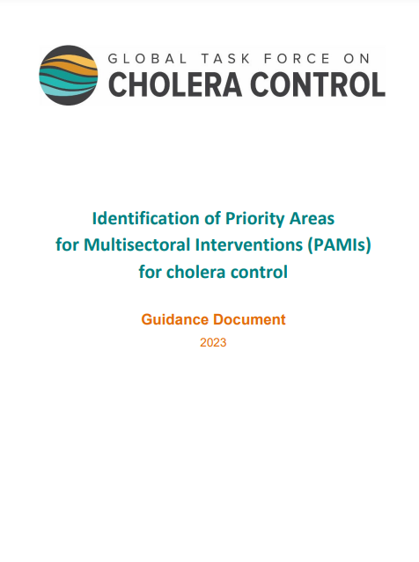
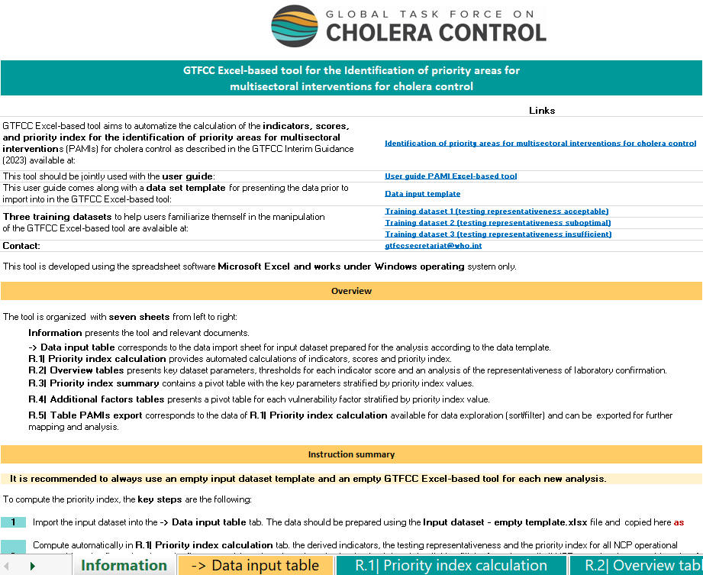
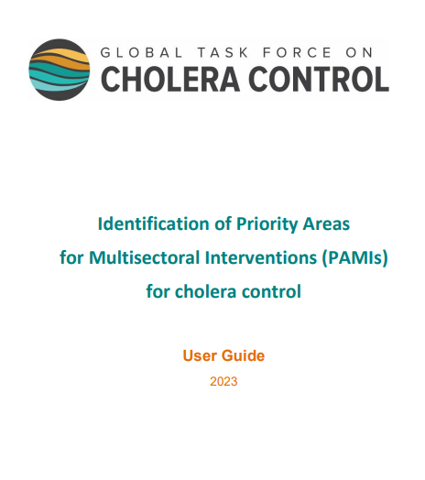
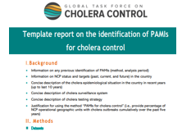
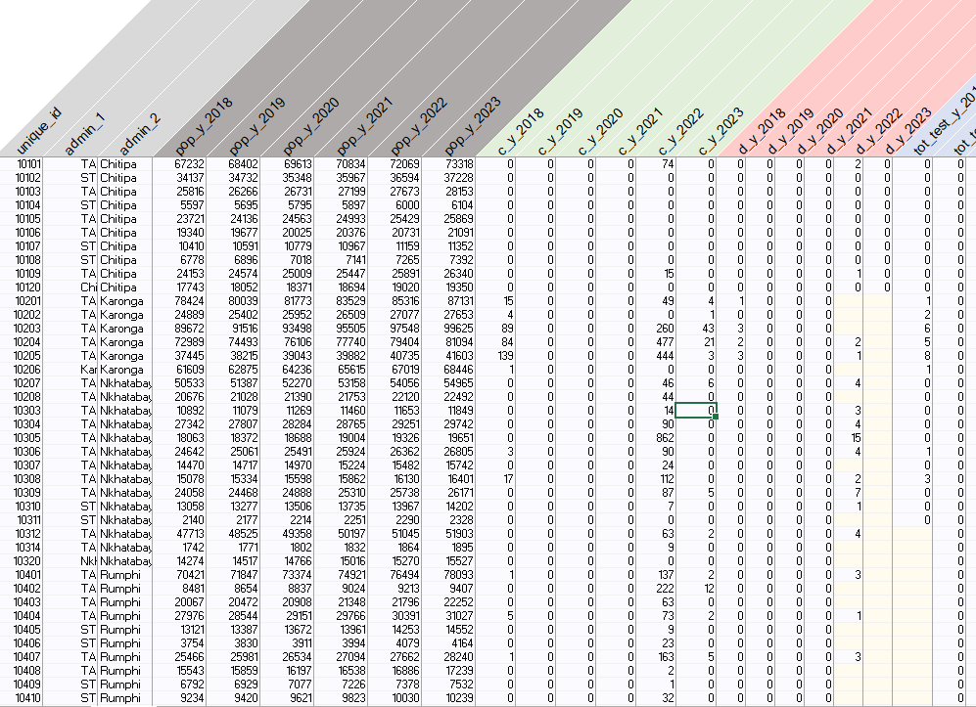
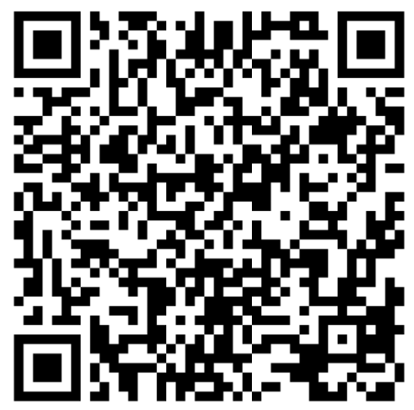
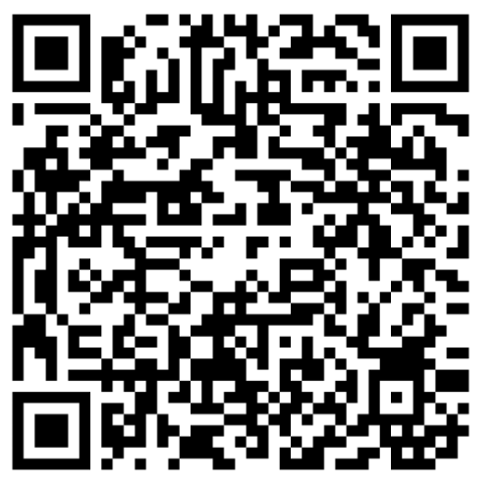
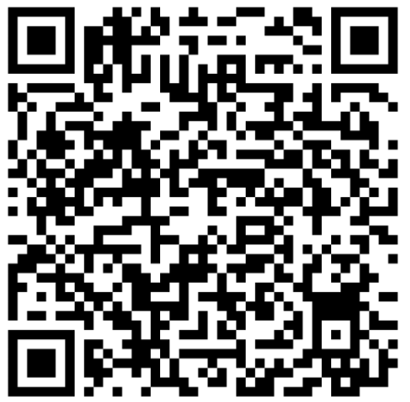
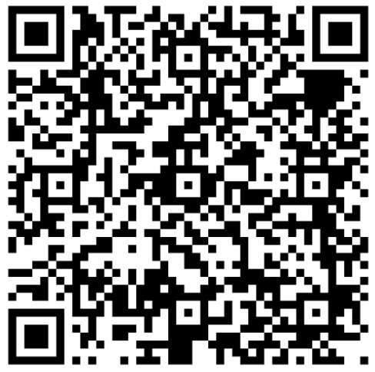
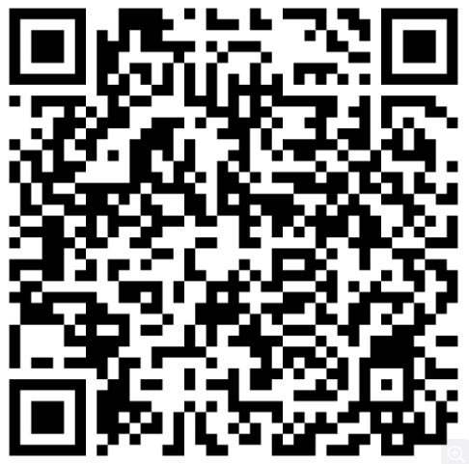
Get ready for the course
Before starting the course, download online material
https://tinyurl.com/PAMIcontrol
GTFCC method
PAMI Excel tool
User guide
Data model
Template report
Notes:
Before starting this course, take a moment to download the material you will need to have on hand to follow the course.
All material is available on a dedicated GTFCC webpage at https://tinyurl.com/PAMIcontrol.
Make sure to download:
The guidance document on the identification of PAMIs for cholera control;
The PAMI Excel tool;
The user guide of the Excel tool;
The PAMI data model template;
And the template report on the identification of PAMIs for control.
You can also access each document by scanning the QR codes at the bottom of your screen.

Slide 9
Get additional support
For any question or for technical assistance to identify PAMIs,
contact the GTFCC Secretariat
GTFCCsecretariat@who.int
Notes:
For any questions or to request technical assistance to identify PAMIs, please contact the GTFCC Secretariat at GTFCCsecretariat@who.int; we are here to support you.

Slide 10
Notes:
We have now completed this brief introduction.

