Slide 1
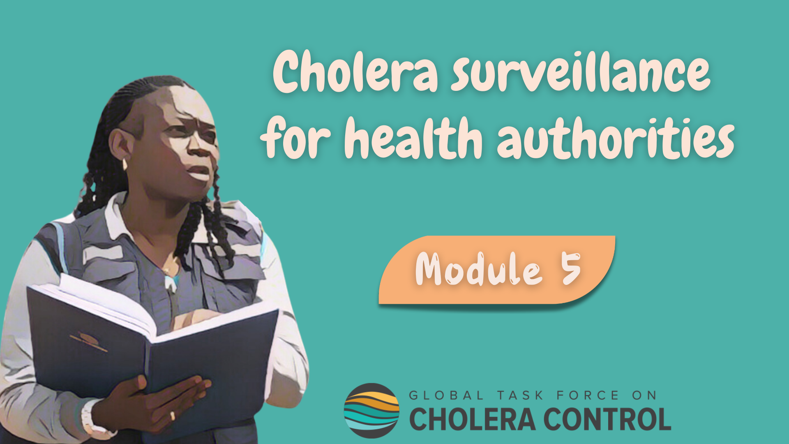
Notes:
Welcome to Module 5 of the GTFCC online course on cholera surveillance for health authorities.

Slide 2
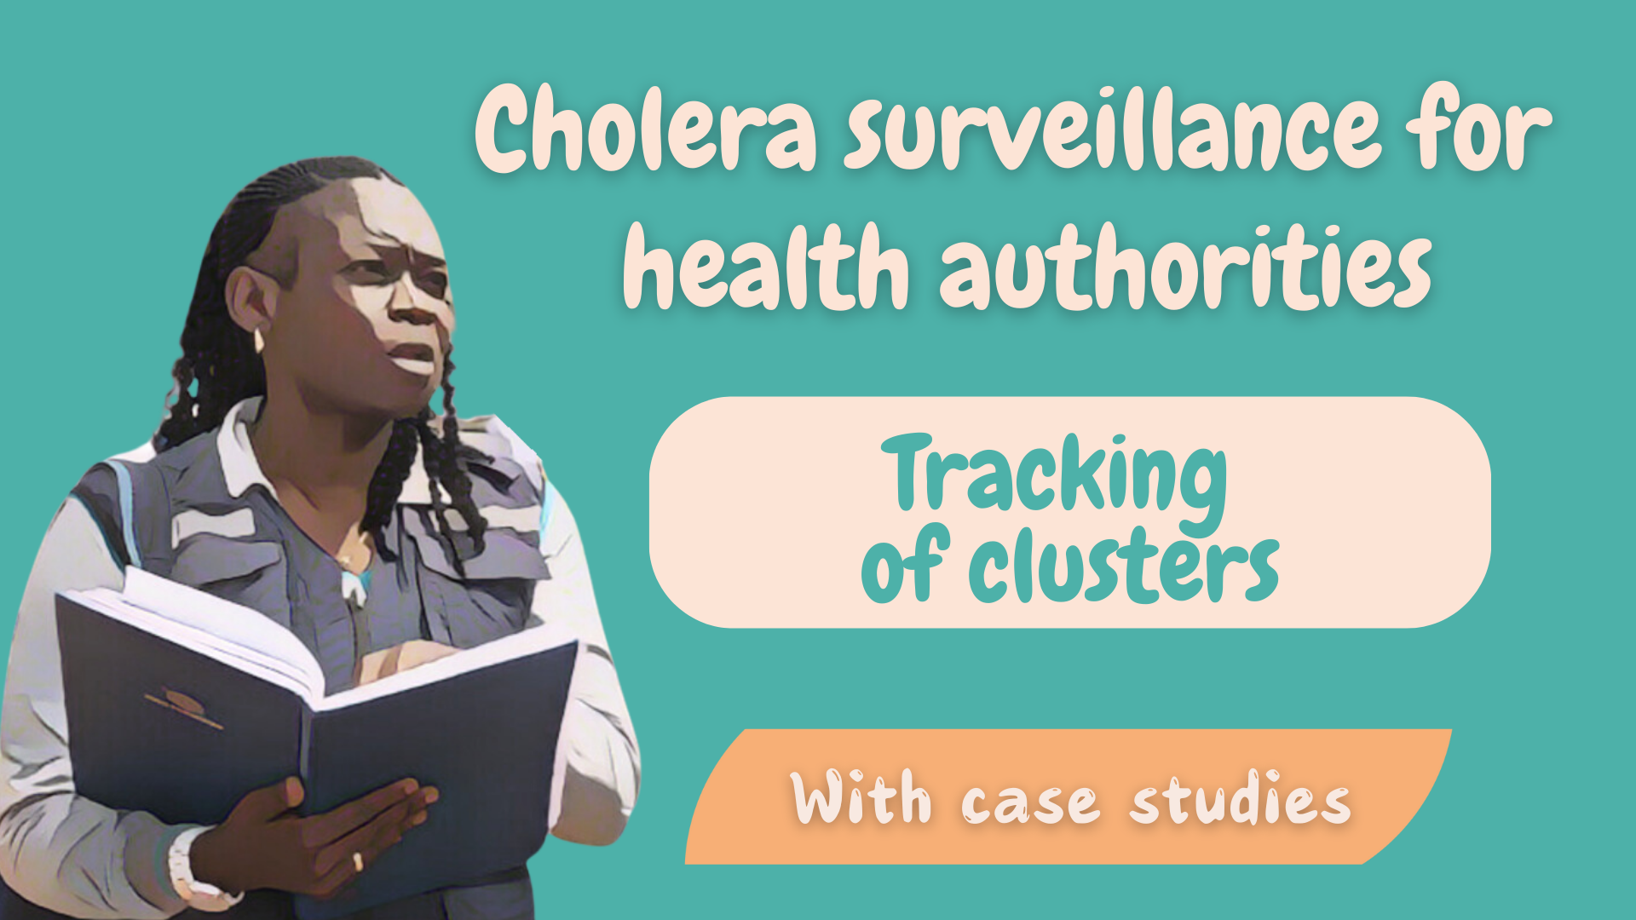
Notes:
In this module, we will dive into surveillance to track clusters of cholera cases.

Slide 3

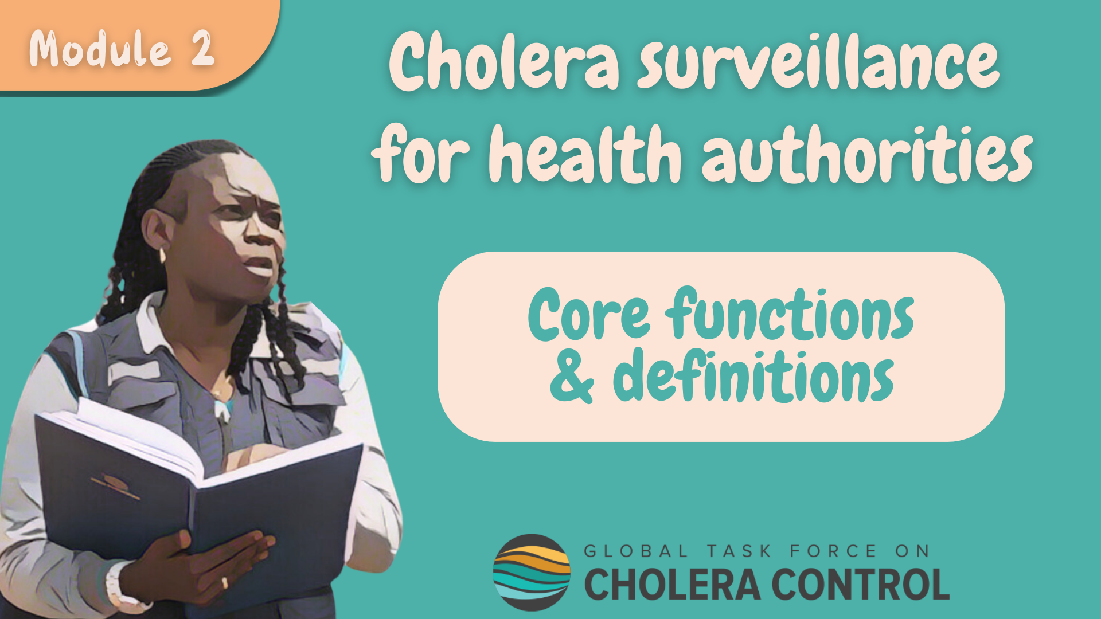
Get ready for this module
Before taking this module, complete Module 2 ‘Core functions’
Notes:
This module goes through the different core functions of health authorities in cholera surveillance and describe how strategies are adapted when the surveillance objective is to track clusters. As a prerequisite to follow this module, you should be familiar with the core functions of health authorities in cholera surveillance. Therefore, if you have not yet already done so, we encourage you to take module 2 of this course before taking this module.

Slide 4

What will you learn?
Surveillance strategies to track clusters of cholera cases
How health authorities
  Monitor that these strategies are effectively implemented
  Analyze surveillance data
  Investigate cholera cases to understand epidemiological links
  Disseminate findings to guide highly targeted interventions
Notes:
After completing this module, you will be familiar with surveillance strategies to track clusters of cholera cases including:
How health authorities monitor that these strategies are effectively implemented;
How health authorities analyze surveillance data, and investigate cholera cases to understand epidemiological links;
And how health authorities disseminate findings to guide highly targeted interventions to interrupt transmission and prevent the onset of cholera transmission in the community.

Slide 5

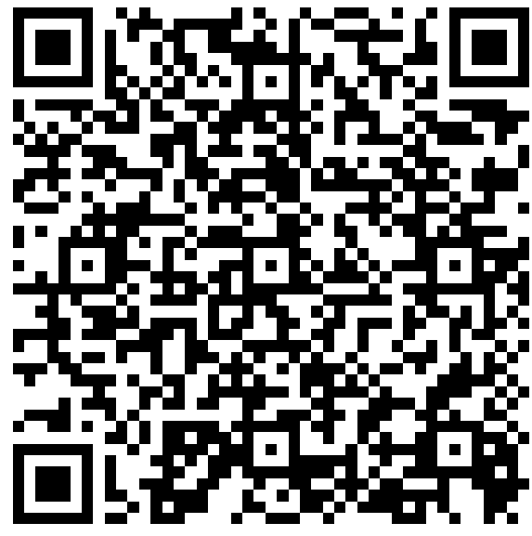
Get ready to practice
Case studies
  Based on fictional scenarios
  To deepen your understanding of how health authorities track cholera clusters
Use the GTFCC Surveillance Guidance
https://tinyurl.com/cholerasurv2024
Notes:
Case studies are offered throughout this module. They are based on fictional scenarios. These case studies will help you better understand how health authorities track clusters of cholera cases.
We encourage you to download the GTFCC guidance on cholera surveillance. Having it on hand will help you take the case studies. You can download this guidance at https://tinyurl.com/cholerasurv2024 or by scanning this QR code.

Slide 6



Cluster of cholera cases
All cholera cases have epidemiological links
A group of cases
  Infected one another
  or
  Were infected with the same source
More likely to occur at the very early stage of an outbreak
  Following cholera introduction in a new geographic area
Surveillance aims to
  Guide quick and highly targeted interventions
  Interrupt transmission before it spreads in the community
Notes:
A cholera cluster is when all cases have epidemiological links.
This corresponds to a group of cases who infected one another or were infected with the same source.
Clusters are more likely to occur at the very early stages of an outbreak following the introduction of cholera in a new geographic area.
A cluster is a type of outbreak which requires strong surveillance efforts in order to guide quick and highly targeted interventions around the cases. This aims to interrupt transmission before it spreads in the community and becomes more challenging to control.

Slide 7



Tracking clusters
Tracking cholera clusters is not performed in all countries
Recommended in countries which
  Are not frequently affected by cholera (“non endemic”)
    or
  Used to be endemic but are on the path to eliminate cholera
To prevent the (re)emergence of large outbreaks
  By default, OTHER countries implement surveillance to monitor a cholera outbreak regardless of the type of transmission
Learn about surveillance to monitor cholera outbreak in Module 4
Notes:
Not all countries aim to track clusters of cholera cases. This is usually recommended in countries which are not frequently affected by cholera; those are non-endemic countries. Tracking clusters is also recommended in countries which used to be endemic for cholera but which are now on the path to eliminate the disease as a threat to public health.
In those countries, tracking clusters is performed to prevent the emergence or reemergence of large cholera outbreaks.
If cholera transmission is detected in a country which does NOT aim to track clusters, then surveillance to monitor an outbreak is implemented by default. To learn more about surveillance by default to monitor an outbreak, we encourage you to go to Module 4.

Slide 8
Surveillance to track clusters
Where
Why
In surveillance units where there is clustered transmission
In non endemic countries or countries on the path to eliminate cholera
To rapidly generate information to guide highly targeted interventions to
Interrupt transmission
Prevent the onset of transmission in the community
How
In accordance with this module
Notes:
Surveillance is implemented to track clusters in any surveillance unit where there is clustered transmission in a country non-endemic for cholera or on the path to eliminate cholera.
The surveillance objective is then to rapidly generate information to guide highly targeted interventions around cases in order to interrupt transmission before it spreads in the community.
For surveillance to reach this objective effectively, it should be implemented in accordance with the recommendations provided in this module.

Slide 9
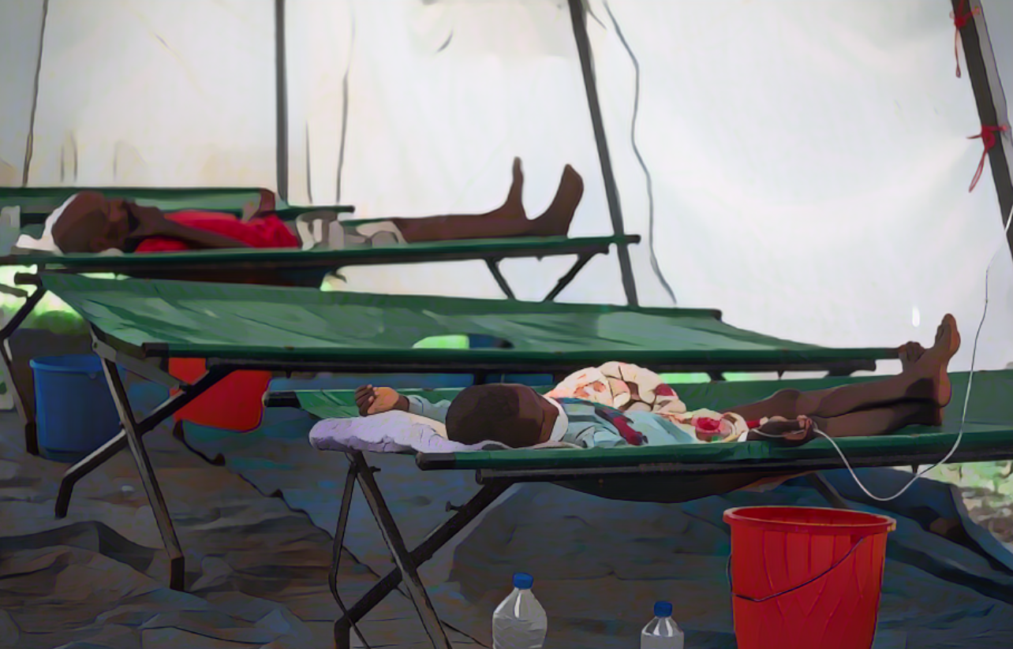
Reporting
and testing strategies
Photo adapted from: WHO / Mulugeta Ayene
Notes:
Let’s see how suspected cholera cases are reported and tested when the surveillance objective is to track cholera clusters.

Slide 10

Case definition
Suspected cholera case
Any person with AWD (or who died from AWD)
NO criteria on age or severe dehydration
  Comprehensive identification of suspected cases
  Increased chances to effectively interrupt transmission
Notes:
When the surveillance objective is to track cholera clusters, a suspected cholera case is any person who has acute watery diarrhoea (AWD) or who died from AWD.
There are no additional criteria on age or severe dehydration to identify suspected cholera cases. This sensitive case definition is used to facilitate the comprehensive identification of suspected cases in order to increase chances to interrupt transmission by implementing interventions around cases.

Slide 11

Reporting
Any suspected cholera case reported to the health authority within 24 hours
Reporting within a day is essential permit timely interventions around cases
Time is key!
If on a given week, no suspected cholera case was seen
  Absence of suspected cases reported to the health authority weekly
      Zero reporting
      Health facility-based surveillance and community-based surveillance
Notes:
Any suspected cholera case detected through health-facility based surveillance, community-based surveillance or event-based surveillance is reported to the health authority within a day.
Prompt reporting is essential in order not to delay interventions around cases. Time is key to interrupt transmission.
If on a given week, no suspected cholera case was detected, the absence of cases is reported to the health authority at the end of the week. This is zero reporting. Zero reporting should be performed by all reporting sites at health facility level and at community level.

Slide 12
Testing to track clusters
ALL suspected cholera cases are tested
Screening by RDT
Confirmatory testing
If RDTs ARE available
  ALL RDT+
If RDTs ARE available
  ALL suspected cholera cases
If RDTs NOT available
  ALL suspected cholera cases
By culture (including seroagglutination) or PCR
Notes:
When the surveillance objective is to track clusters, all suspected cholera cases are tested. Exhaustive testing is critical to understand clustered transmission and orient interventions accordingly.
Where rapid diagnostic tests (RDTs) are available, RDTs are used to triage samples for confirmatory testing. Any suspected cholera case is tested by RDT, and confirmatory testing is performed on suspected cases tested positive by RDT.
Where RDTs are not available, samples are not triaged for confirmatory testing, and confirmatory testing is performed on all suspected cholera cases.
Confirmatory testing is performed by culture including seroagglutination, or PCR.

Slide 13

Oversight of reporting & testing
by health authorities
Photo adapted from: WHO / Genna Print
Notes:
A core function of health authorities in cholera surveillance is to continuously ensure that suspected cholera cases are reported and tested in accordance with applicable strategies. Let’s look into this.

Slide 14


Oversight
Awareness and capacity building
Health authorities ensure that
  All reporting sites and laboratories in the surveillance unit
  Are aware and in capacity to implement reporting and testing in accordance with applicable strategies
Monitoring
Health authorities monitor surveillance performance indicators
  At least on a weekly basis
  Take supportive measures as needed
Notes:
Health authorities are responsible for ensuring that all reporting sites in the surveillance unit including for health facility-based surveillance and community-based surveillance as well as laboratories performing cholera testing are fully aware of the applicable strategies to report and test suspected cholera cases to track clusters, and are in-capacity to implement reporting and testing accordingly.
Health authorities then monitor surveillance performance indicators at least on a weekly basis to verify that reporting and testing is implemented according to applicable strategies to track clusters. If any reporting site or laboratory does not implement reporting or testing in accordance with applicable strategies, health authorities then take supportive measures to improve reporting or testing.

Slide 15



Oversight of reporting & testing by health authorities
Notes:
Let’s practice with a case study to better understand how health authorities continuously oversee reporting and testing.

Slide 16


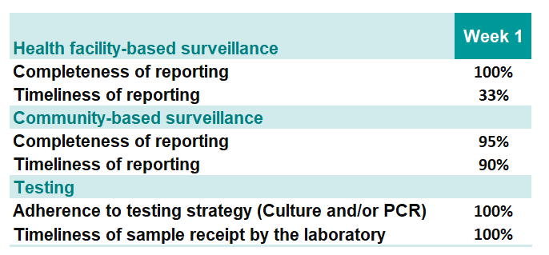

You are a public health officer in a surveillance unit with a confirmed cholera outbreak with clustered transmission
    You review surveillance performance indicators
What is the issue you are most concerned about?
What can be the impact of this issue?
What would you do?
Notes:
In this scenario, you are a public health officer working in a surveillance unit where a confirmed cholera outbreak with clustered transmission has been detected one week ago.
You review surveillance performance indicators.
Regarding health facility-based surveillance, the completeness of reporting has been 100% and the timeliness of reporting 33%.
Regarding community-based surveillance, the completeness of reporting has been 95% and the timeliness of reporting 90%.
Regarding testing, RDT are not available in your surveillance unit. The adherence to the testing strategy by culture and PCR has been 100% and all samples were received at the laboratory within the expected timeframe.
What is the issue you are most concerned about?
What can be the impact of this issue?
What would you do?
Pause the video, and take the time you need to reflect about this scenario and the appropriate course of action.

Slide 17





Most concerning issue
          Timeliness of health-facility based reporting
            Very low (33%)
Potential impact
Cholera is likely to spread
  Health authorities not able to take timely measures to mitigate the risk of transmission
What to do
Contact the health facilities reporting with delay
  Sensitize them on the importance of timely reporting
  Understand and resolve any issue preventing timely reporting
If that is not sufficient, actively contact health facilities on a daily basis
  Until timeliness of reporting improves
Notes:
A very concerning issue is that the timeliness of health facility-based reporting is very low, 33%.
This issue compromises the chances to interrupt clustered transmission. Cholera is likely to spread before health authorities are able to take measures to mitigate the risk of transmission around cases reported with delays.
It would be advisable to contact the health facilities which report with delay to sensitize them on the importance of timely reporting and to understand and solve any issue preventing timely reporting.
If that is not sufficient to improve the timeliness of health facility-based reporting, you could also actively contact health facilities on a daily basis to check if any suspected case has been seen at the facility until timeliness of reporting improves.
Overall, this illustrates that as long as surveillance performance indicators are closely monitored, issues with how reporting and testing are performed get detected. From there, it is then possible to work it out and find solutions.

Slide 18

Data analysis and
interpretation
Photo adapted from: WHO / NOOR / Alixandra Fazzina
Notes:
Moving on to the next core function of health authorities in cholera surveillance, let’s look into the analysis and interpretation of surveillance data when the surveillance objective is to track clusters.

Slide 19

Analysis
As soon as a suspected cholera case or a test result is reported,
health authorities analyse and interpret the data
  Data considered
    Data reported by health facility-based surveillance
    Data reported by community-based surveillance
    Test results reported by laboratories
    Signals detected by event-based surveillance
Notes:
To track cholera clusters, time is key. Therefore, as soon as a suspected cholera case or a test result is reported, health authorities immediately analyze and interpret the data.
The surveillance data considered in the analysis are the suspected cholera cases reported by health facility-based surveillance and community-based surveillance, any cholera test results as well as any cholera signal detected by event-based surveillance.

Slide 20

Descriptive analysis
Cholera cases described by person, place, and time at a fine scale
Person
Place (map)
Number of suspected cases
Number of confirmed cases
Number of health facility deaths
Number of community deaths
Place of residence
Time (epidemic curves)
By date of onset
Notes:
The analysis of the data focuses on describing the cases by person, place and time at a fine scale in space and time.
Key figures to describe the cases by person include:
the number of suspected cases;
the number of confirmed cases;
the number of health facility deaths;
and the number of community deaths.
The spatial distribution of suspected and confirmed cholera cases and of community deaths and health facility deaths are mapped, preferably at a fine scale - for example using GIS coordinates.
Lastly, the daily distribution of suspected and confirmed cholera cases and of community deaths and health facility deaths are plotted on epidemic curves.

Slide 21

Case investigation
Photo adapted from: WHO / Christopher Black
Notes:
Let’s move on to case investigation, which is absolutely essential when the surveillance objective is to track cholera clusters.

Slide 22
Case investigation
Identify epidemiological links between cases to characterize transmission
(clustered or community transmission) and guide interventions
Epidemiological link
If in the 5 days before the onset of illness, a case:
Had contact with a confirmed case during their infectious period that plausibly led to infection
or
Was exposed to the same source or vehicle of infection as a confirmed case
Contact that plausibly led to infection
  Contact with vomit/feces
  Provision of direct care or bedside visit
  Shared housing or shared sanitary facilities
  Shared meal or consumed food/beverage prepared or handled by a case
Notes:
Case investigations are critical to identify epidemiological links between cases to determine whether transmission is still clustered or if cholera has started to spread in the community. In addition, the nature of the epidemiological links identified by the case investigations is also taken into consideration to determine appropriate interventions to interrupt transmission.
There is an epidemiological link if in the 5 days before the onset of illness, a case had contact with a confirmed cholera case during his infectious period that plausibly led to infection or if he was exposed to the same source or vehicle of infection as a confirmed cholera case.
Contact that plausibly led to infection includes:
Contact with vomit or faeces;
Provision of direct care or bedside visit;
Having shared housing or shared sanitary facilities;
Having shared a meal or consumed food or beverage prepared or handled by a confirmed case.

Slide 23

Case investigation
At a minimum on ALL confirmed cases
and any suspected case for which a specimen for testing was not collected
Investigation of all confirmed cases
All suspected cases tested
Confirmed cases considered to establish epidemiological links
Suspected cases with no specimen for laboratory testing
Specimen collected as part of the investigation
Pragmatic approach
Given laboratory confirmation delays, undertake case investigation on all suspected cases
Consider only confirmed cases to determine transmission chains
Notes:
Case investigations should be performed at a minimum on all confirmed cholera cases as well as on any suspected case for which a specimen for laboratory testing was not collected.
All suspected cholera cases are tested and only confirmed cases are considered to determine epidemiological links. Therefore, all confirmed cases must be investigated.
Suspected cases for which a specimen for laboratory testing was not collected are also investigated and a sample for testing is then collected during the investigation.
Given usual delays for laboratory confirmation, in practice, the most pragmatic approach is to undertake case investigation on all suspected cases without waiting for laboratory results. Then, only epidemiological links between confirmed cases are later considered to determine transmission chains.

Slide 24
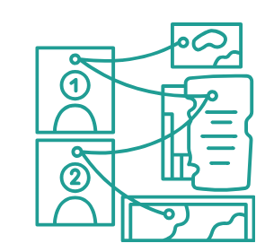
Interpretation
Findings of analysis of surveillance data & case investigations are interpreted daily
Understand cholera transmission
  Is there clustered transmission?
    All confirmed cases epidemiologically linked
    or
  Is there community transmission?
    Any confirmed case without an epidemiological link
Determine how to end transmission
  If there is clustered transmission
    What is/are the transmission chain(s)?
    Which interventions could interrupt it/them rapidly?
Notes:
Health authorities consider the findings of the analysis of surveillance data and the findings of case investigations in conjunction and interpret them on a daily basis.
This is in order to understand how cholera transmission is currently occurring.
Is there still clustered transmission meaning that all confirmed cases have epidemiological links? Or has transmission in the community started to occur?
If there is still clustered transmission, how can it be ended? Considering the nature of the epidemiological links, which interventions would interrupt transmission rapidly and effectively?

Slide 25
Interpret surveillance data and
findings of case investigations to characterize the transmission type
Notes:
Let’s practice with a case study to better understand how health authorities interpret the surveillance data and the findings of case investigations to characterize cholera transmission.

Slide 26

You are a public health officer in a surveillance unit in a country where the previous cholera outbreak was reported 3 years ago
In the last 10 days, 4 suspected cholera cases were reported, tested, and investigated
On 21 June, Mr M returned from a cholera affected area in a neighboring country and went directly back to his home with improved WASH facilities in the capital city where he lives with his wife (Ms M)
On 27 June, Ms M’s aunt went back to her village, in a rural area with unimproved WASH facilities. She had AWD on 28 June. She tested positive for cholera by PCR on 29 June
A suspected cholera case was reported in Ms M’s aunt hometown village on 30 June. Case investigation did not identify direct or indirect contact with Ms M’s aunt. On 01 July this suspected case tested negative for cholera by PCR
During the night of 21-22 June, Mr M started having AWD. Ms M cared for him. On the morning of 22 June, he was transferred by ambulance to the capital hospital. This hospital has very high IPC standards. On 23 June, Mr M’s PCR test results returned positive for cholera
What is the cholera situation in your surveillance unit as of:
  23 June?
  26 June?
  29 June?
  01 July?
On 24 June, Ms M had AWD. Her aunt rapidly came from a neighboring village (same surveillance unit) to take care of her; they both stayed at home.
On 25 June, Ms M was transferred by ambulance to the capital hospital and tested positive for cholera by PCR on 26 June
Notes:
You are a public health officer working in a surveillance unit in a country where the previous cholera outbreak was reported 3 years ago.
However, in the last 10 days, 4 suspected cholera cases were reported. They were also tested and case investigations were performed. Here is what happened.
On 21 June, Mister M returned from a cholera affected area in a neighboring country and went directly back to his home with improved WASH facilities in the capital city where he lives with his wife (Miss M).
During the night of 21-22 June, Mister M started having AWD. Miss M cared for him. On the morning of 22 June, he was transferred by ambulance to the capital hospital. This hospital has very high infection prevention and control standards. On 23 June, Mister M PCR test results returned positive for cholera.
On 24 June, Miss M had AWD. Her aunt rapidly came from a neighboring village which is in the same surveillance unit to take care of her; they both stayed at home.
On 25 June, Miss M was transferred by ambulance to the capital hospital and she tested positive for cholera by PCR on 26 June.
On 27 June, the aunt of Ms M went back to her village, in a rural area with unimproved WASH facilities. She had AWD on 28 June, and she tested positive for cholera by PCR on 29 June.
A suspected cholera case was reported in the hometown village of the aunt of Miss M on 30 June. Case investigation did not identify direct or indirect contact between this suspected case and the aunt of miss M. On 01 July, this suspected case tested negative for cholera by PCR.
What is the cholera situation in your surveillance unit as of 23 June, 26 June, 29 June, and 01 July?
Pause the video, and take the time you need to reflect about this scenario.

Slide 27


Epidemiological links
between confirmed cases
1) As of 23 June
Confirmed case (Mr M): internationally imported
Not a confirmed cholera outbreak (case not locally acquired)
Mr M
2) As of 26 June
Confirmed case (Ms M): locally acquired
Epidemiological link with a confirmed case (Mr M)
Confirmed cholera outbreak with clustered transmission
3) As of 29 June
Ms M
Confirmed case (Ms M’s aunt): epidemiological link with a confirmed case (Ms M)
Remains a confirmed cholera outbreak with clustered transmission
4) As of 01 July
Suspected case without established epidemiological links tested negative
Not considered to determine transmission chains
Remains a confirmed cholera outbreak with clustered transmission
Ms M’s aunt
Notes:
As of 23 June, there is a confirmed cholera case (Mister M) who is an internationally imported case. This is not a confirmed cholera outbreak because the confirmed case is not a locally acquired case.
As of 26 June, there is a confirmed cholera case (Miss M) who is locally acquired. This case has an epidemiological link with a confirmed cholera case (Mister M). Therefore, this is a confirmed cholera outbreak with clustered transmission.
As of 29 June, there is another confirmed cholera case (the aunt of miss M) who also has an epidemiological link with a confirmed cholera case (Miss M). The cholera situation remains a confirmed cholera outbreak with clustered transmission.
As of 01 July, the suspected cholera case without established epidemiological links with a confirmed cholera case (the aunt of Ms M) tested negative. Since he tested negative, he is not considered to determine transmission chains. The cholera situation remains a confirmed cholera outbreak with clustered transmission.
Overall, this illustrates how surveillance data, tests results, and findings of case investigations need to be considered rapidly, and in conjunction, to characterize an evolutive cholera situation.

Slide 28
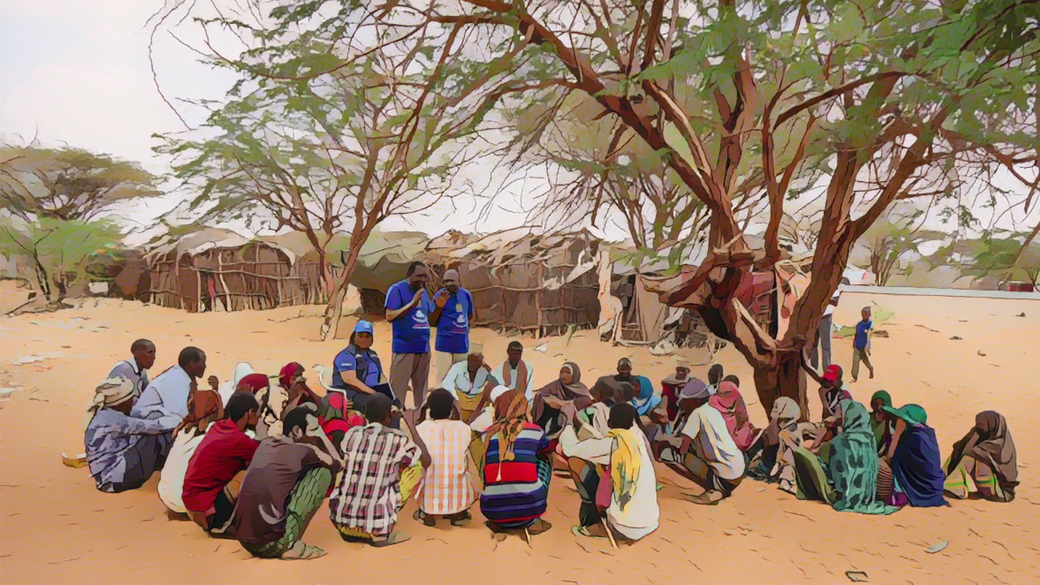
Dissemination
of outcomes
and response
Photo adapted from: WHO / NOOR / Billy Miaron
Notes:
Moving on to the last core function of health authorities in cholera surveillance, disseminating the surveillance outcomes for public health response.

Slide 29

Update stakeholders
Situation reports disseminated daily
Stakeholders
  Upper-level health authority
  Multisectoral stakeholders, partners, agencies involved in the response
  Health facility workers, community health workers / volunteers
  Etc
Discussed daily in a multisectoral manner for
quick decision-making on interventions
Notes:
When there is clustered transmission, health authorities prepare daily situation reports that describe and interpret the cholera situation and ensure that they are broadly disseminated.
Stakeholders to be updated daily on the cholera situation include the upper-level health authority; stakeholders, partners, and agencies from all sectors involved in responding to cholera as well as health facility workers, community health workers or volunteers.
The epidemiological situation should be discussed and assessed daily in a multisectoral manner to guide the decision-making on quick and highly targeted interventions to interrupt transmission.

Slide 30
Targeted interventions
Highly targeted interventions rapidly implemented
to prevent secondary cases and interrupt transmission
Cases-Area Targeted Interventions (CATIs)
  At and around the household of cases
    Promotion of hand washing with soap, treatment of water, food safety, etc
    Distribution of WaSH kits
Infection prevention and control (IPC)
Sensitization of health workers
Targeted measures oriented by investigation
  Nature of epidemiological links
  Source(s) or vehicle(s) of infection
  Individuals identified as at-risk of exposure
Notes:
Highly targeted interventions should be rapidly implemented to prevent secondary cases, and interrupt transmission.
Interventions may include Cases-Area Targeted Interventions (CATI) at and around the household of cases. For example, this may include raising awareness on how cholera spreads and promoting hand washing with soap, treatment of water, and food safety. WASH kits can also be distributed as needed.
Infection prevention and control (IPC) measures should also be considered by sensitizing health workers on how to prevent contaminations in health care settings.
In addition, targeted measures to prevent and interrupt transmission should be determined taking into account the findings of the investigations regarding the nature of the epidemiological links, the source or vehicle of infection, and the individuals identified as at-risk of exposure.

Slide 31
End of clustered transmission
Clustered transmission is usually a temporary situation
End of outbreak
Community transmission
Transmission ended
  No more cases
Transmission continues
  Cases no longer in clusters
No epi links between ALL confirmed cases
No longer established
    Epidemiological links not identified
No longer investigated
  Overstretched investigation capacities
For a minimum of 4 consecutive weeks,
ALL suspected cases tested negative
(RDT, culture, or PCR)
Notes:
Clustered transmission is usually a temporary situation which does not last for an extended period of time. Clustered transmission can evolve in two directions.
The most favorable evolution is that transmission has been successfully ended; this is the end of the outbreak.
Clustered transmission has been successfully ended when for a minimum of four consecutive weeks, all suspected cholera cases have a negative test result by RDT, culture, or PCR.
A more pejorative evolution is when transmission continues but is no longer occurring in clusters. Instead, transmission is occurring in the community.
There is community transmission if all confirmed cases no longer have documented epidemiological links.
It can be that epidemiological links can no longer be established if investigation fails to identify any links between some cases.
Or it can be that epidemiological links can no longer be investigated in a timely and comprehensive manner, for example due to an increase in the number of cases resulting in overstretched investigation capacities.

Slide 32


Adaptive surveillance
End of outbreak
Surveillance strategies adapted for the early detection of an outbreak
  Inform and train surveillance stakeholders
  Health facility workers
  Community health workers / volunteers
  Laboratories
Learn about surveillance for early detection in Module 3
Notes:
If the criteria to consider the end of a cholera outbreak with clustered transmission are met, the surveillance strategies need to be adapted as the surveillance objective becomes to detect any new outbreak early. Health authorities should inform and train surveillance stakeholders on the new surveillance strategies.
Surveillance stakeholders to be sensitized include health facility workers, community health workers and volunteers, and laboratories.
For a refresher on the applicable surveillance strategies, we encourage you to go back to module 3.

Slide 33
Adaptive surveillance
Community transmission
Surveillance strategies adapted to monitor the outbreak
  Inform and train surveillance stakeholders
  Health facility workers
  Community health workers / volunteers
  Laboratories
Learn about surveillance outbreak monitoring in Module 4
Notes:
If transmission is no longer occurring in cluster but instead transmission in the community has been detected, the surveillance strategies need to be adapted as the surveillance objective becomes to monitor the outbreak. Health authorities should inform and train surveillance stakeholders on the new surveillance strategies.
Surveillance stakeholders to be sensitized include health facility workers, community health workers and volunteers, and laboratories.
For a refresher on the applicable surveillance strategies, we encourage you to go back to module 4.

Slide 34
Orient highly target interventions to interrupt transmission
Notes:
Let’s practice with a case study to better understand how health authorities target interventions to interrupt transmission at cluster stage.

Slide 35
You are a public health officer in a surveillance unit with a confirmed cholera outbreak with clustered transmission
The scenario is the SAME as the previous one
On 21 June, Mr M returned from a cholera affected area in a neighboring country and went directly back to his home with improved WASH facilities in the capital city where he lives with his wife (Ms M)
On 24 June Ms M had AWD. Her aunt rapidly came from a neighboring village (same surveillance unit) to take care of her; they both stayed at home
On 25 June, Ms M was transferred by ambulance to the capital hospital and tested positive for cholera by PCR on 26 June
During the night of 21-22 June, Mr M started having AWD. Ms M cared for him. On the morning of 22 June, he was transferred by ambulance to the capital hospital. This hospital has very high IPC standards. On 23 June, Mr M’s PCR test results returned positive for cholera
On 27 June, Ms M’s aunt went back to her village, in a rural area with unimproved WASH facilities. She had AWD on 28 June. She tested positive for cholera by PCR on 29 June
1) What is your assessement of the greatest risk for onset of community transmission?
2) What would you have recommended to prevent this and when?
3) What are other risks for secondary transmission?
4) What would you have recommended to prevent this?
Notes:
In this scenario, you still are a public health officer in a surveillance unit with a confirmed cholera outbreak with clustered transmission. The scenario is the same as the one used in the previous case study, up to the return of the aunt of Miss M in her village where she becomes symptomatic.
In this scenario, what is your assessement of the greatest risk for onset of community transmission? What would you have recommended to prevent this and when?
What are other risks for secondary transmission? What would you have recommended to prevent this?
Pause the video, and take the time you need to reflect about this scenario and the best course of actions.

Slide 36



1) Greatest risk for onset of community transmission
Village of the aunt of Ms M
  Unimproved sanitation facilities
2) Recommendations to prevent this and when
As soon as the investigation indicated that Ms M’s aunt provided care to Ms M
  Before she became symptomatic
  For example, Ms M’s aunt:
    Informed about how cholera is spread and what to do if she developed AWD
    Provided with hygiene kits
    Encouraged to stay at her niece’s home during the incubation period depending on the sanitation facilities she could have access to in her village
        5 days / at least until 30 June
Notes:
There is high risk that community transmission could start in the village of the aunt of Miss M considering unimproved sanitation facilities in this village where she became symptomatic.
Interventions to prevent the onset of community transmission should have been considered as soon as the case investigation indicated that the aunt of miss M provided care to Miss M, before the aunt of miss M became symptomatic.
For example, the aunt of Miss M could have been informed about how cholera spreads and what to do if she developed AWD. She could have been provided with hygiene kits. Depending on the sanitation facilities she could have access to in her village, she could have been encouraged to stay for example at her niece’s home during the incubation period (that is for 5 days, at least until 30 June).

Slide 37



Other risks for secondary transmission
Ambulances
  Mr and Ms M may have contaminated the ambulances with feces/vomits
  Ambulance drivers and other patients transported in the vehicles (if not cleaned according to appropriate protocols) could be at risk of exposure
Hospital
  Reportedly high IPC standards, but breaches in IPC protocols cannot be excluded
4) Recommendations to prevent this
For example
  Trace the ambulance drivers that transported Mr and Ms M
  Trace the hospital staff who provided care to Mr and Ms M
  Interview them to assess the risk of exposure and determine how to mitigate risks
Notes:
Other risks for secondary transmission include the ambulances which transported Mister and Miss M as they may have contaminated the vehicles with feces or vomits. If so, the ambulance drivers and other patients transported could be at risk of exposure if the vehicles were not cleaned according to appropriate protocols.
Other risks for secondary transmission also include the capital hospital where Mister and Miss M were hospitalized. This hospital reportedly has high IPC standards, however, hospital staff could be at risk of exposure if there were any breaches in IPC protocols.
For example, to prevent secondary transmission, the ambulance drivers that transported Mister and Miss M could have been traced and the hospital staff who provided care to Mister and Miss M could have also been traced. They could have been interviewed to better assess their risk of exposure to mitigate associated risks of secondary transmission accordingly.
Overall, this illustrates how essential surveillance and investigations are to orient interventions to interrupt transmission at cluster stage, and prevent further spread.

Slide 38





Wrap up
Oversee
reporting
and testing
Transmit, analyze, interpret data
Investigate
Disseminate outcomes
Respond
Determine epidemiological links between confirmed cases with case investigation
Inform all stakeholders of the cholera situation on a daily basis
Monitor that suspected cases are reported daily and that ALL suspected cases are tested
Guide highly targeted interventions to interrupt transmission
Analyze the reported data and test results daily
Notes:
As we wrap up this module, here is a summary of the key role of health authorities when the surveillance objective is to track cholera clusters.
Health authorities monitor that any suspected cholera case is reported within a day and that all suspected cholera cases are tested.
Health authorities analyze the reported data and test results immediately and perform case investigations to determine epidemiological links between cases.
Health authorities update all relevant stakeholders on the cholera situation on a daily basis, and they orient highly targeted interventions to interrupt transmission.

Slide 39

Notes:
Before moving on to the next module, we encourage you to take a short quiz. There are three questions in this quiz.

Slide 40

Question 1
When the surveillance objective is to track cholera clusters, health authorities review surveillance performance indicators to monitor that:
Select all that apply
    Suspected cholera cases are reported within 24 hours
    Suspected cholera cases are reported on a weekly basis
    The absence of suspected cholera cases is reported within 24 hours
    The absence of suspected cholera cases is reported on a weekly basis
    All suspected cholera cases are tested for cholera
    A subset of suspected cholera cases selected according to a systematic sampling scheme are tested for cholera
Notes:
Question 1. Select all that apply. When the surveillance objective is to track cholera clusters, health authorities review surveillance performance indicators to monitor that:
Suspected cholera cases are reported within 24 hours.
Suspected cholera cases are reported on a weekly basis.
The absence of suspected cholera cases is reported within 24 hours.
The absence of suspected cholera cases is reported on a weekly basis.
All suspected cholera cases are tested for cholera.
A subset of suspected cholera cases selected according to a systematic sampling scheme are tested for cholera.

Slide 41

Question 1 – Answers
When the surveillance objective is to track cholera clusters, health authorities review surveillance performance indicators to monitor that:
    Suspected cholera cases are reported within 24 hours
    Suspected cholera cases are reported on a weekly basis
    The absence of suspected cholera cases is reported within 24 hours
    The absence of suspected cholera cases is reported on a weekly basis
    All suspected cholera cases are tested for cholera
    A subset of suspected cholera cases selected according to a systematic sampling scheme are tested for cholera
Notes:
The correct answers are a, d and e. When the surveillance objective is to track cholera clusters, health authorities review surveillance performance indicators to monitor that suspected cholera cases are reported within 24 hours, that the absence of suspected cholera cases is reported on a weekly basis, and that all suspected cholera cases are tested for cholera.

Slide 42
Question 2
When the surveillance objective is to track cholera clusters, health authorities:
    a) Analyze reports of suspected cholera cases, test results, and findings of case investigation as soon as they are available to rapidly orient highly targeted interventions
    b) Compile and analyze reports of suspected cholera cases, test results, and findings of case investigation on a weekly basis to characterize transmission dynamics in a robust manner
Notes:
Question 2. When the surveillance objective is to track cholera clusters, health authorities:
a) Analyze reports of suspected cholera cases, test results, and findings of case investigation as soon as they are available to rapidly orient highly targeted interventions;
b) Compile and analyze reports of suspected cholera cases, test results, and findings of case investigation on a weekly basis to characterize transmission dynamics in a robust manner.

Slide 43
Question 2 – Answer
When the surveillance objective is to track cholera clusters, health authorities:
    a) Analyze reports of suspected cholera cases, test results, and findings of case investigation as soon as they are available to rapidly orient highly targeted interventions
    b) Compile and analyze reports of suspected cholera cases, test results, and findings of case investigation on a weekly basis to characterize transmission dynamics in a robust manner
Notes:
The correct answer is a. When the surveillance objective is to track cholera clusters, health authorities analyze reports of suspected cholera cases, test results, and findings of case investigation as soon as they are available to rapidly orient highly targeted interventions.

Slide 44
Question 3
To characterize the type of cholera transmission in a surveillance unit (clustered transmission or community transmission), health authorities determine epidemiological links (or lack of thereof) between:
    a) Suspected cholera cases
    b) Suspected cholera cases tested positive by RDT
    c) Confirmed cholera cases
Notes:
Question 3. This is the last question. To characterize the type of cholera transmission in a surveillance unit (clustered transmission or community transmission), health authorities determine epidemiological links (or lack of thereof) between:
a) Suspected cholera cases;
b) Suspected cholera cases tested positive by RDT;
c) Confirmed cholera cases.

Slide 45
Question 3 – Answer
To characterize the type of cholera transmission in a surveillance unit (clustered transmission or community transmission), health authorities determine epidemiological links (or lack of thereof) between:
    a) Suspected cholera cases
    b) Suspected cholera cases tested positive by RDT
    c) Confirmed cholera cases
Notes:
The correct answer is c. To characterize the type of cholera transmission in the surveillance unit, health authorities determine epidemiological links between confirmed cholera cases.

Slide 46

Notes:
We have now completed this module.

